Slide 1
Images from the
Etna School
A History and Reminiscences
Barbara Prince and Josh Murphy

Slide 2
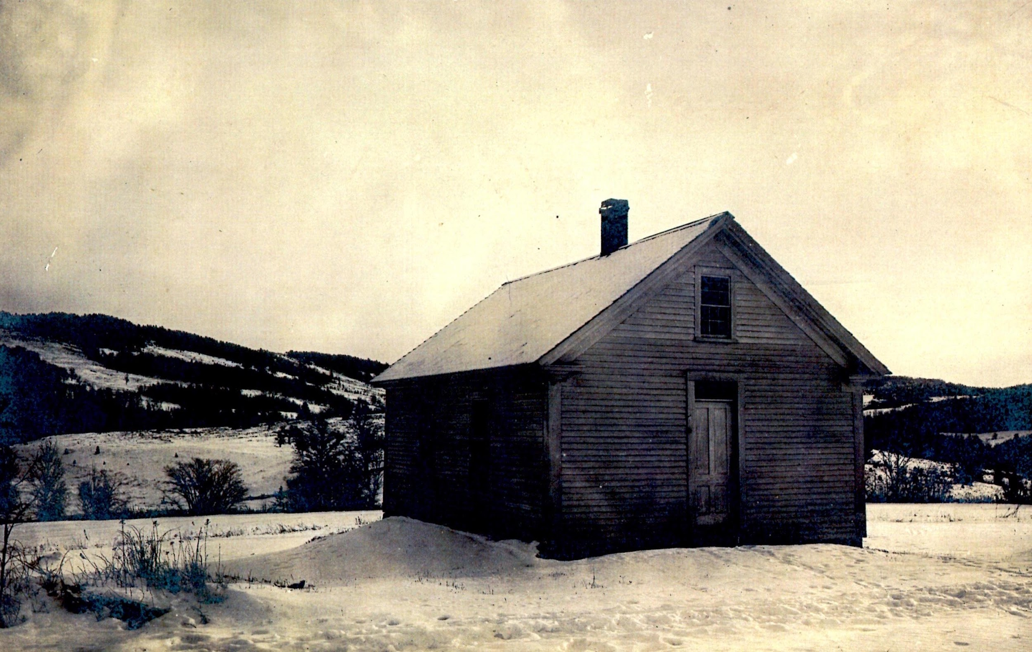
Arvin School House at Ruddsboro and Dana Roads
Notes:
Lord’s History of Hanover. At the annual town meeting of Hanover in March 1790, a special committee of five was chosen to “take up the affair of schooling” and report on the 30th of the same month. Upon their recommendation, that part of the town lying west of Moose Mountain was divided into 5 districts. The College District, including Greensborough and extending some distance up the river was designated as Number One. Number Five (later to be called Mill Village) was located to the east of Number One. Number Two covered the northwest section along the river to the Lyme line. Number Three lay to the eastward of Number Two and Number Four lay in the midst of the other Four. Additional districts were added over the years. In 1822, Number 12, made from sections of 3, 5, and 8 was set up east of Moose Mountain. The last division was made in 1853 when Number 18 was set off in the southeast part of the town from Ruddsboro district.

Slide 3
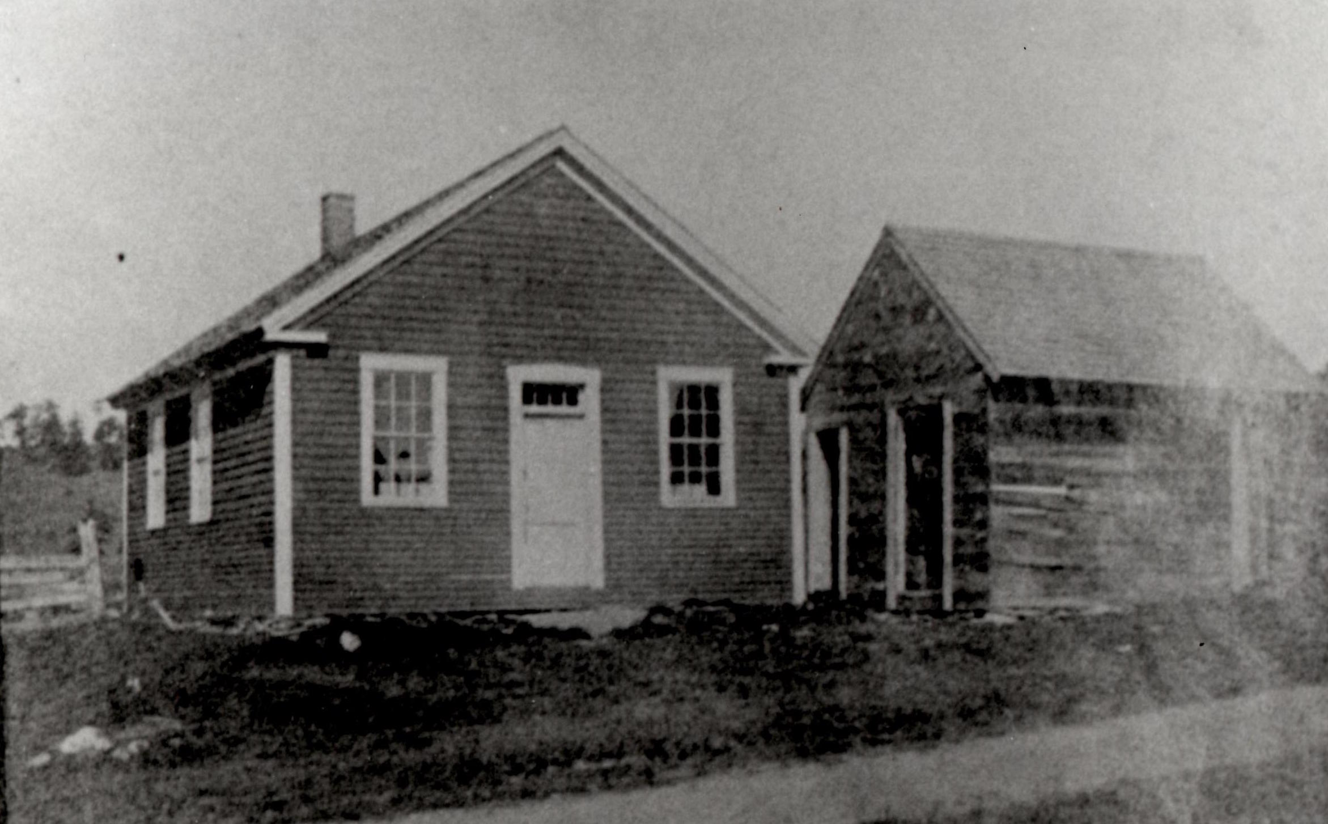
Mason Four Corners by Reservoir

Slide 4
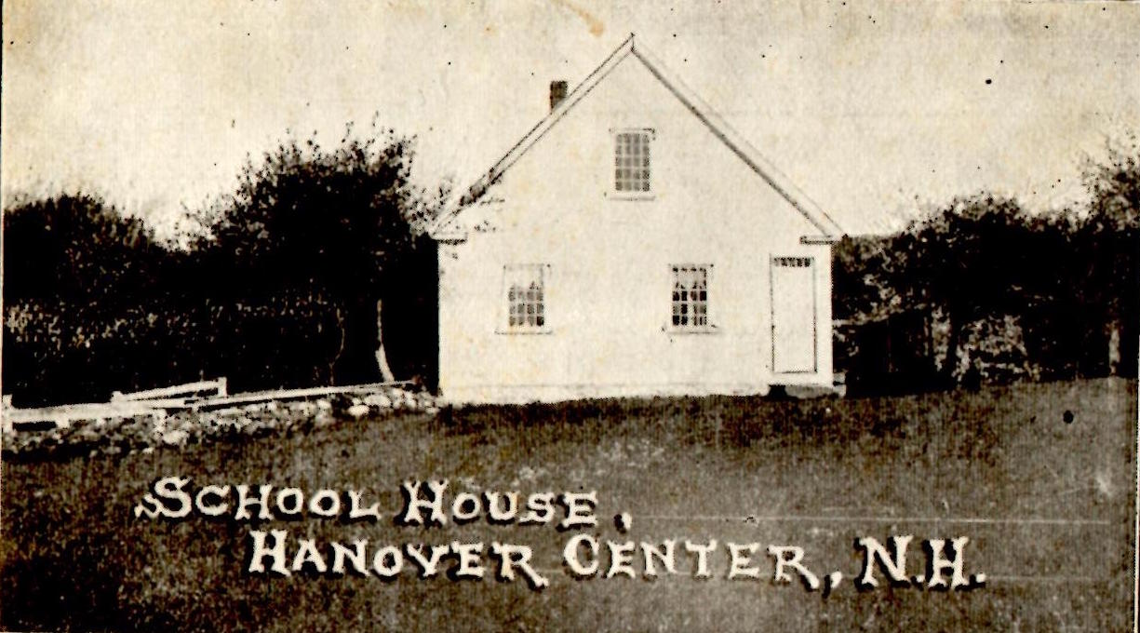
Hanover Center School House

Slide 5
Etna School
First Days

Slide 6
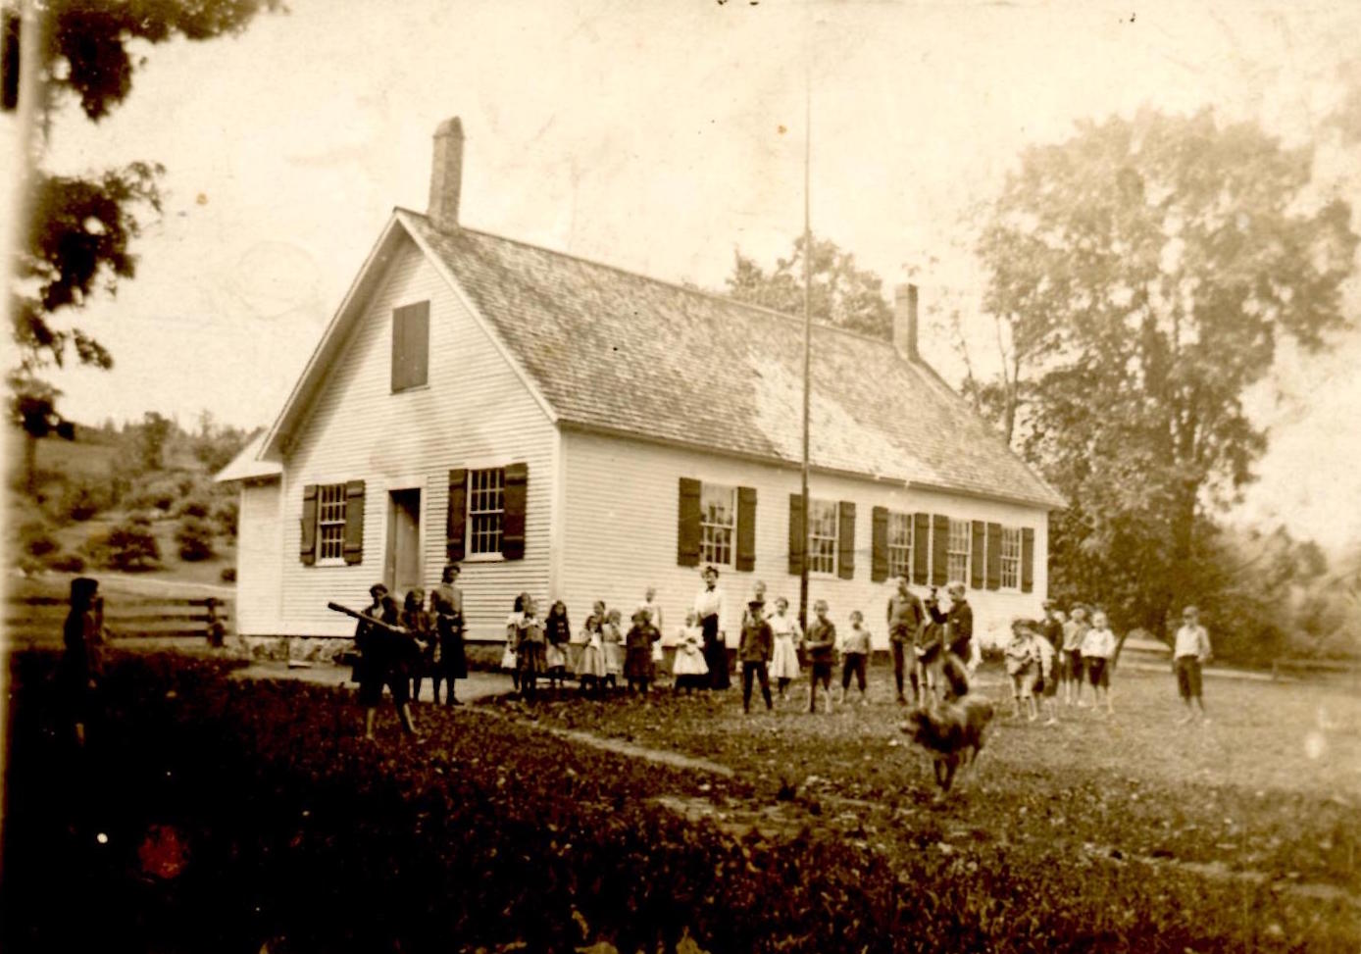
Etna School House
Notes:
Lord’s History of Hanover, 1928: “In 1851, the committee said ‘The School houses of Hanover do not represent the intelligence or wealth of the citizens. Many of them are a standing reproach to the districts . . . Some of our school houses are imperfectly provided with blackboards and chalk. Only one school in the town has a set of outline maps. Not one has a glove or a book of reference.’ In 1852, there is a similar report and the caustic reference to district number 5 was perhaps the effective cause of the new house that was built the following summer: “A large number of our school houses are cold and inconvenient . . .In District 5 the teachers think that nearly one half the value of the school the last winter was lost by a cold and uncomfortable house . . . Our school houses are in general our poorest buildings, and many of them unfit for the purpose of instruction.” The new school house in Number 5 was not built without long consideration and some opposition, It was first proposed to repair the old house, but when it was decided to build a new one the question of a location arose and when a new site was chosen on the south side of the rook several persons felt aggrieved and presented a remonstrance, which was heard by a committee consisting of John S. Woodman, John Terry and N.W. Thompson, non-residents of the district. The decision of the committee was adverse to the remonstrants and the location as chosen was confirmed.

Slide 7
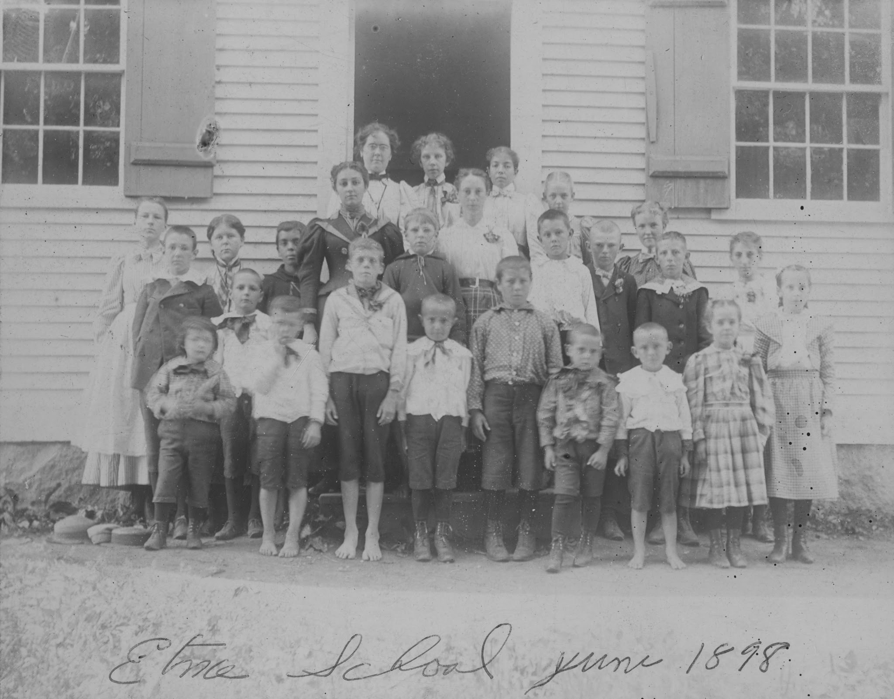
Etna School June 1898
Notes:
Lord’s History of Hanover: “In early days it was customary to auction off at the school meeting, to the lowest bidder, the furnishing of wood for fuel, but afterward it was furnished by the different families from which children came to school in proportion to the number of children. In Number 5 the following vote was passed in 1852: ‘Voted that the instructress board with the inhabitants that are situated near the school-house through the summer, and that the master board with those that are situated at the outskurts of said District, that the mistress teaching the winter school shall goard at one place while teaching the winter school.’ This arrangement continued for several years, growing a little more definite as time went on, so that in 1839,we find the record ‘John Huntoon boards the school-mistress through the winter term of school at one dollar per week.’”
1852 School Report: Teachers were M. Adaline Dewey (summer school, 12 weeks, 24 scholars, Emeline F. Wright (8 weeks, 38 scholars) and Helen A. Bridgman (8 weeks, 12 scholars).

Slide 8
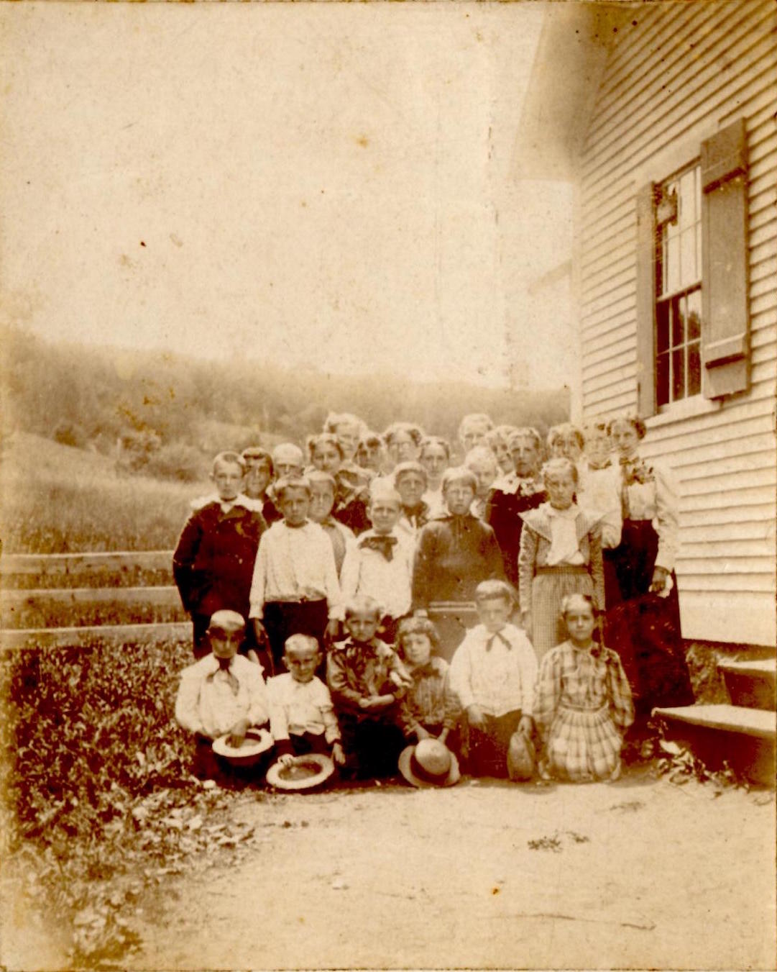
Etna School - Bridgman
Notes:
Lord’s History of Hanover: “The length of schools differed greatly. . . In 1824, [District no. 5] ‘voted the School seperating the Mails and Femails, to have 3 months mans Schools and two months of the womans. In 1831: “Voted to have 14 weeks mans school and 10 weeks womans school the ensuing Winter both schools to commence about the first of December. How long this double school continued the record does not disclose, but in 1865 and again in 1866 it was left to the discretion of the committee whether there should be one or two schools. Probably the discontinuance dates from that time.

Slide 9
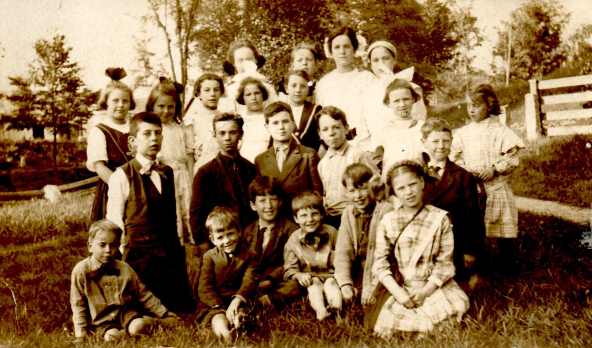
Etna School Children

Slide 10
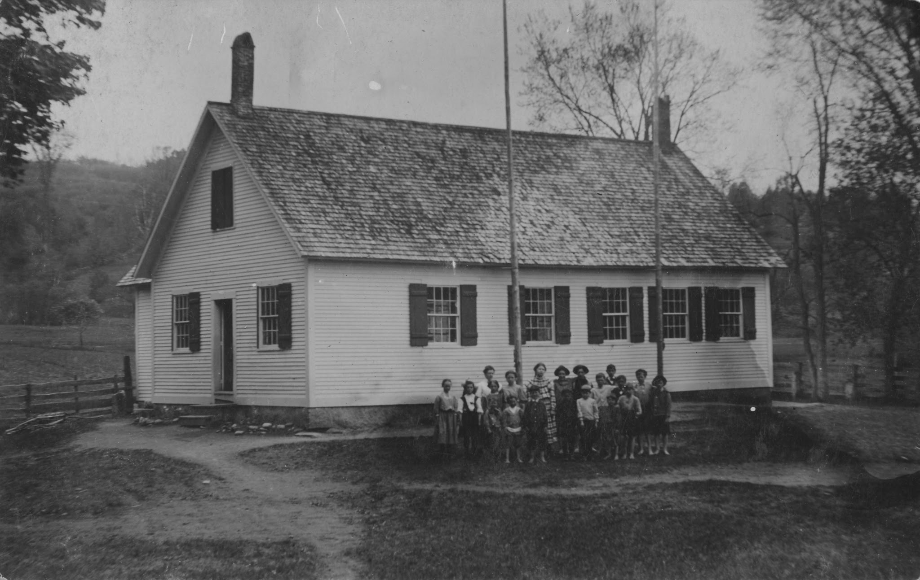
Possibly 1908. Jay Barrett’s Hanover, NH, Vol. II

Slide 11
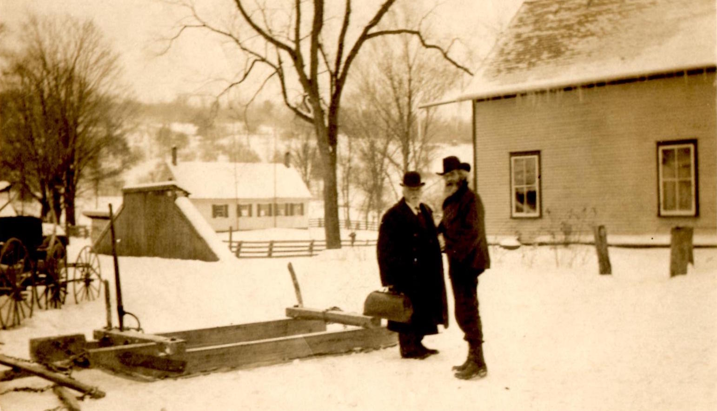
Etna School House in distance, Dean Hoyt, J.D. Bridgman

Slide 12
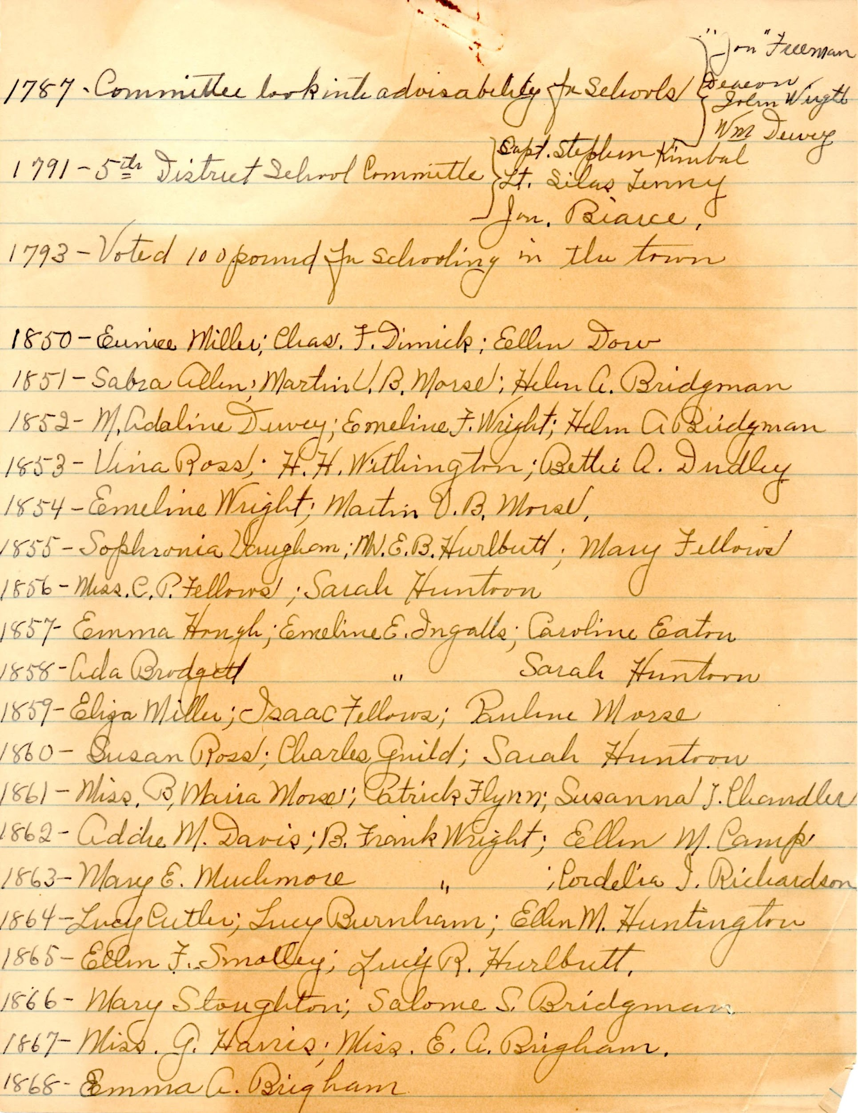
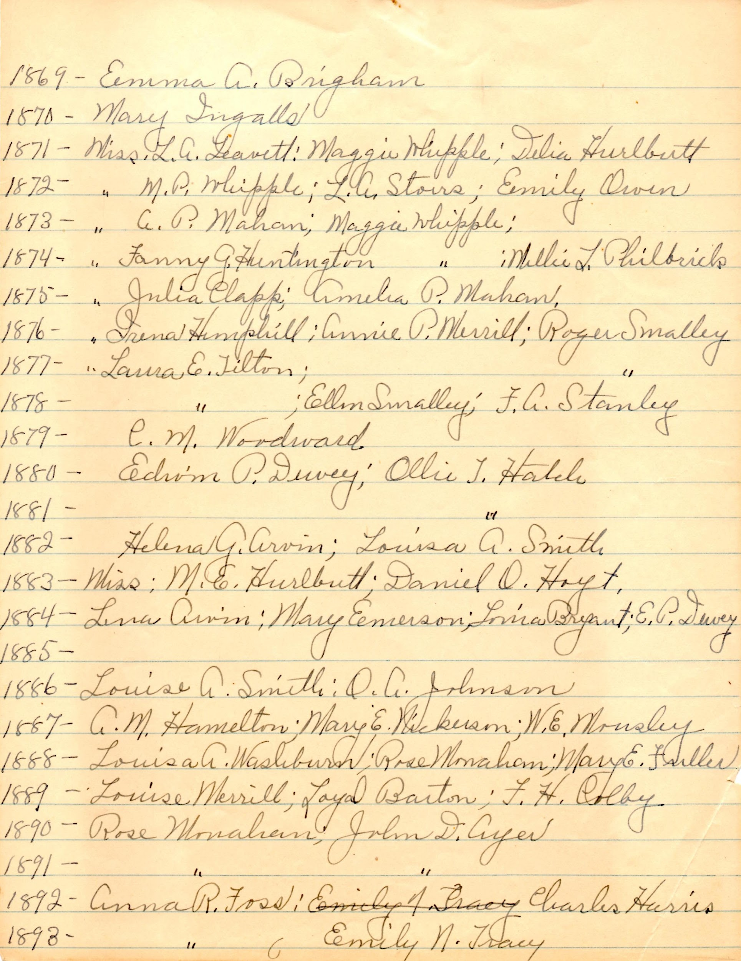
List of Etna School Teachers
Notes:
Begun by Mildred Hoyt and updated by Lillian Bailey?

Slide 13
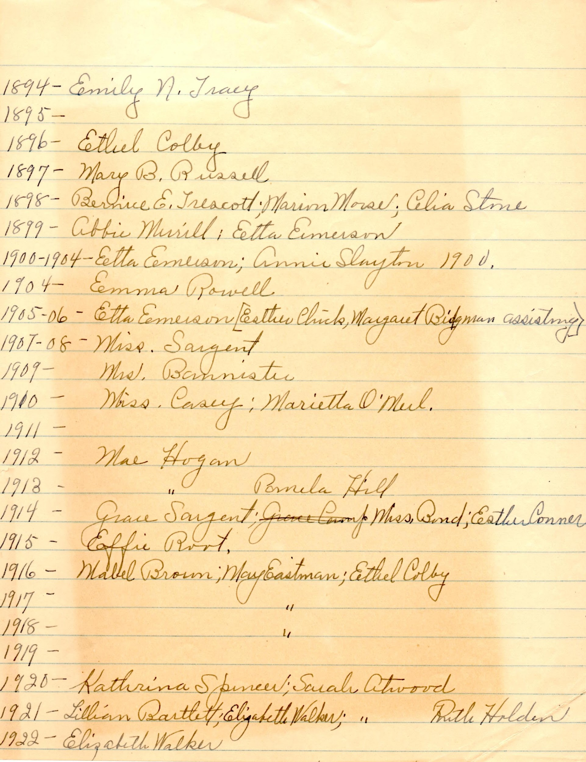
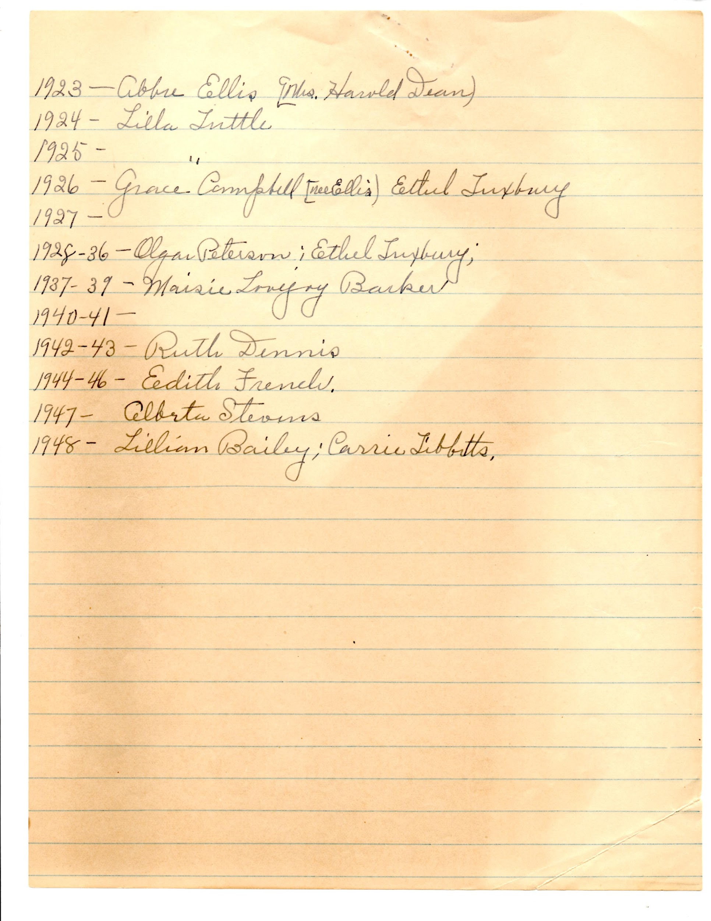
List of Etna School Teachers

Slide 14
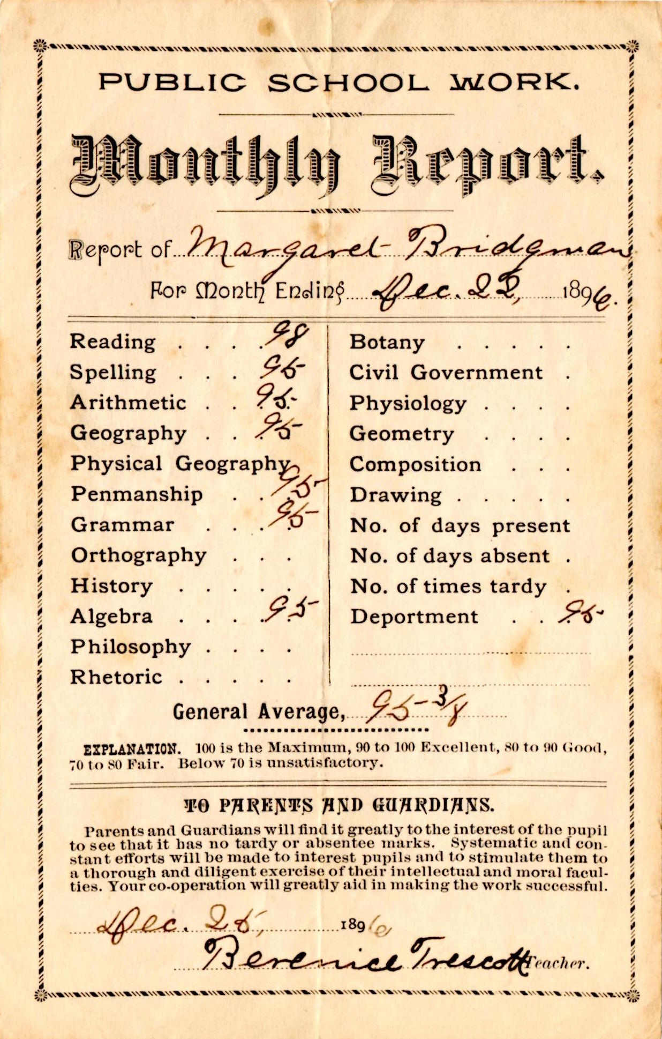
Monthly School Reports
Notes:
Monthly reports for Margaret (Maggie) Bridgman

Slide 15
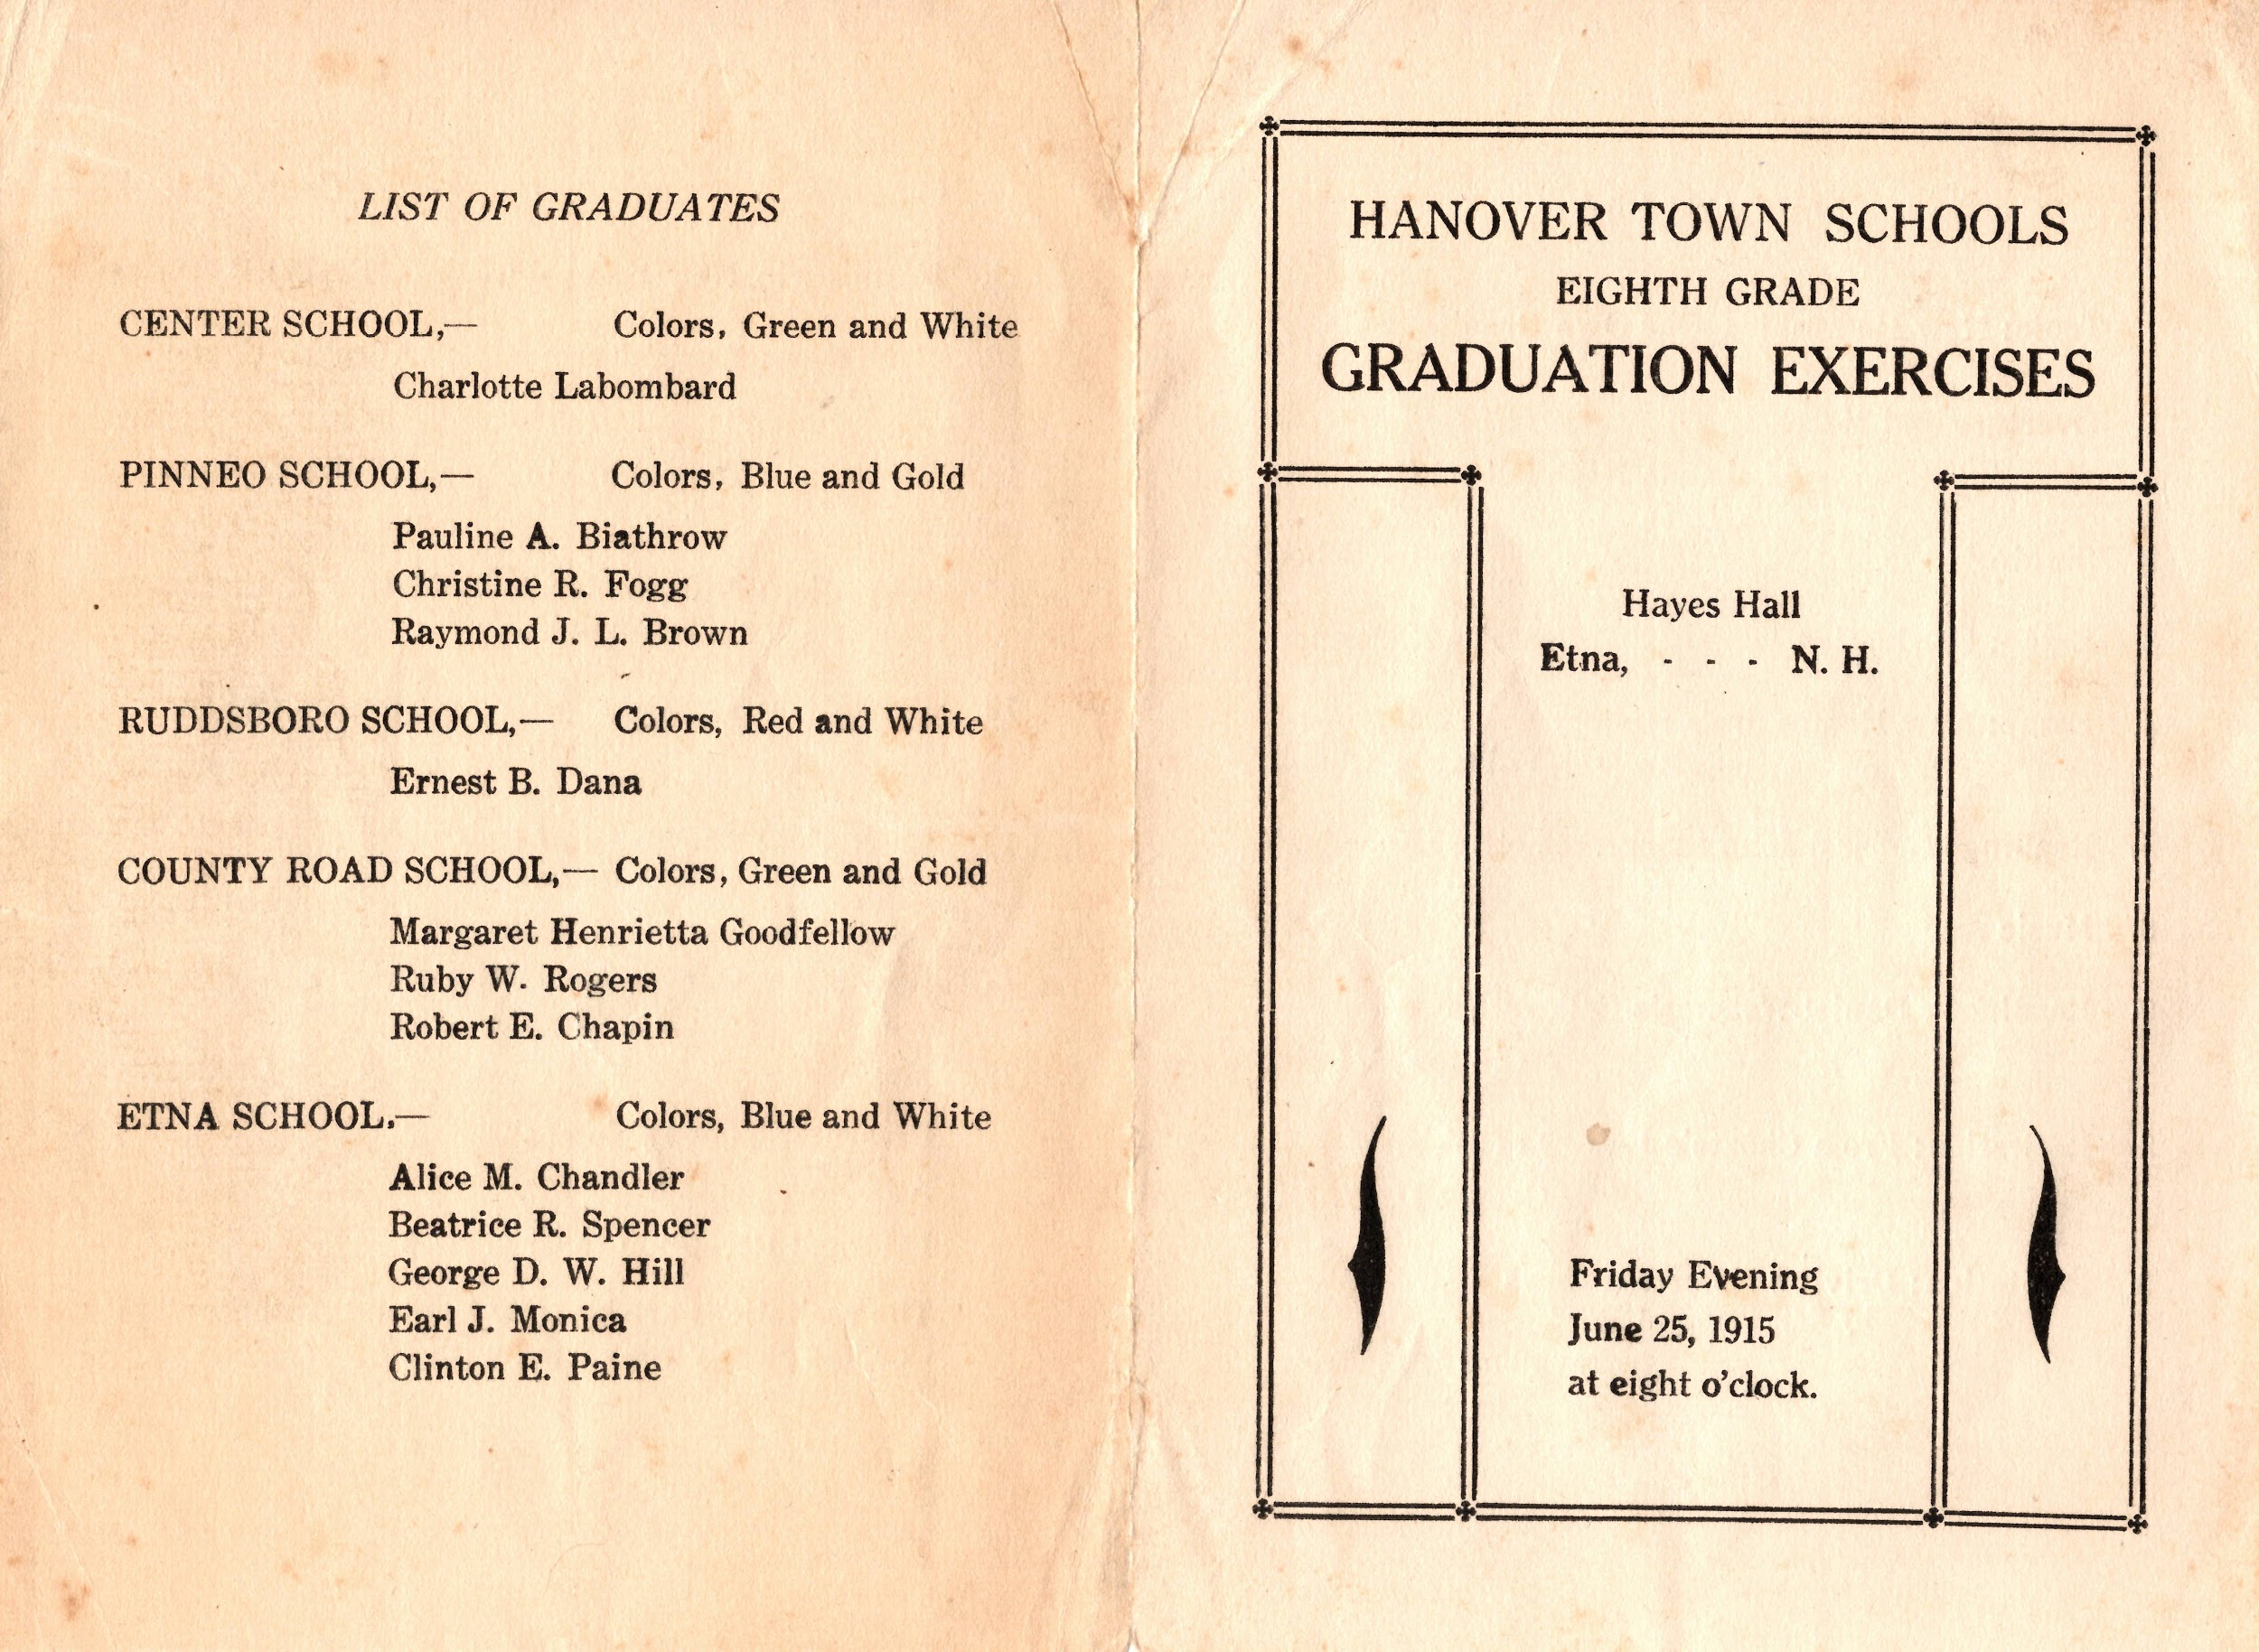

Slide 16
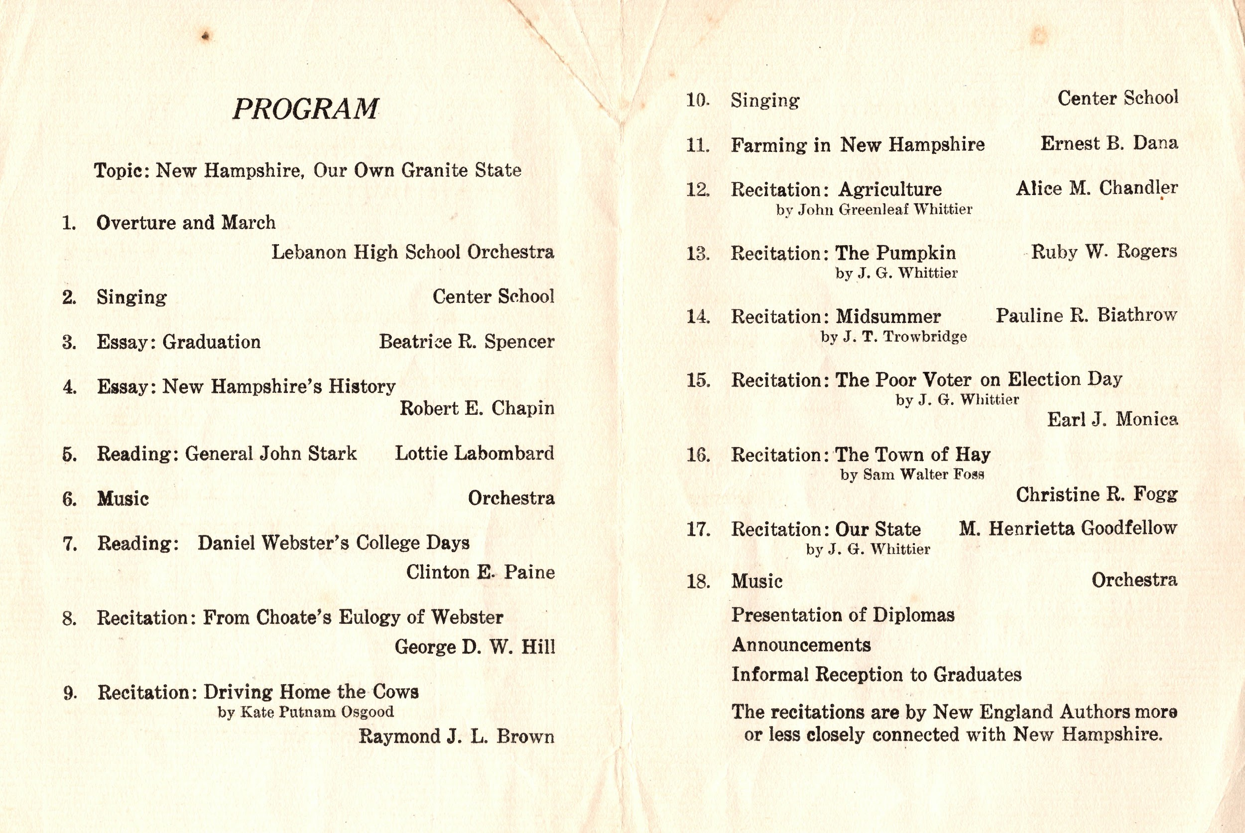

Slide 17
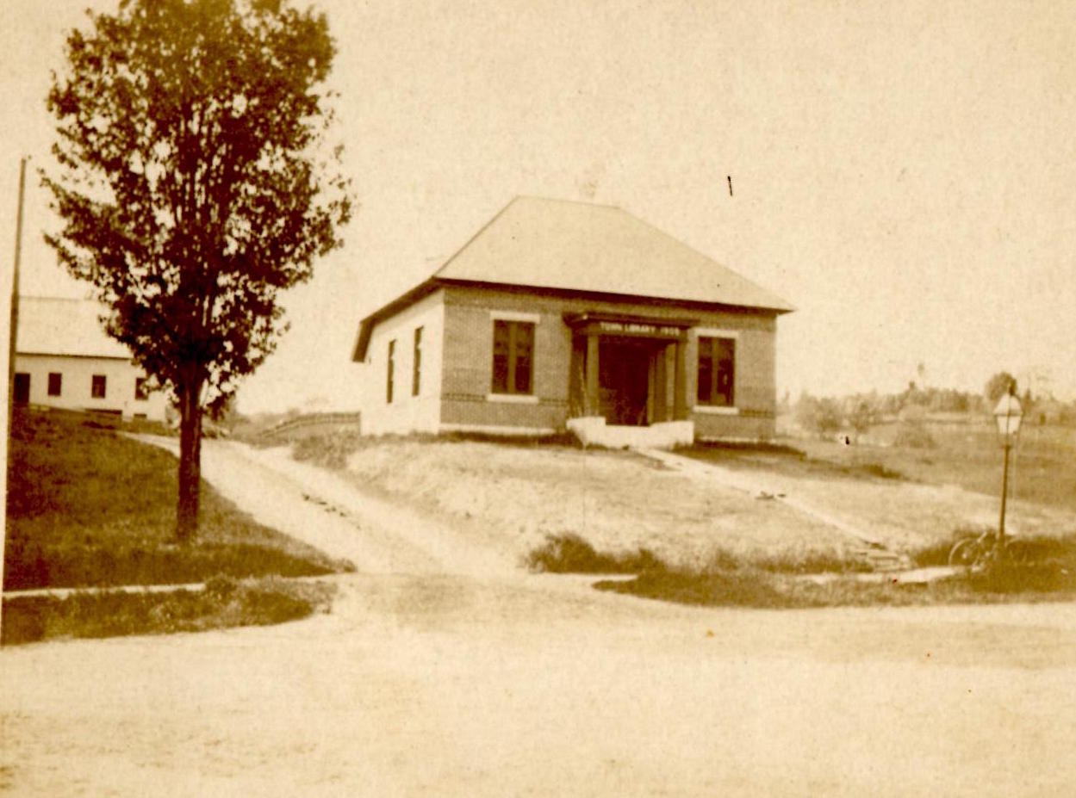
Library, Etna Village
Notes:
In 1920, Kathrina Spencer was teacher at the school. Miss Spencer is the librarian pictured with the cow in the photo at the Etna Library. She was librarian from 1935 to 1953.

Slide 18
Lillian Bailey,
teaching principal
1948-1954

Slide 19
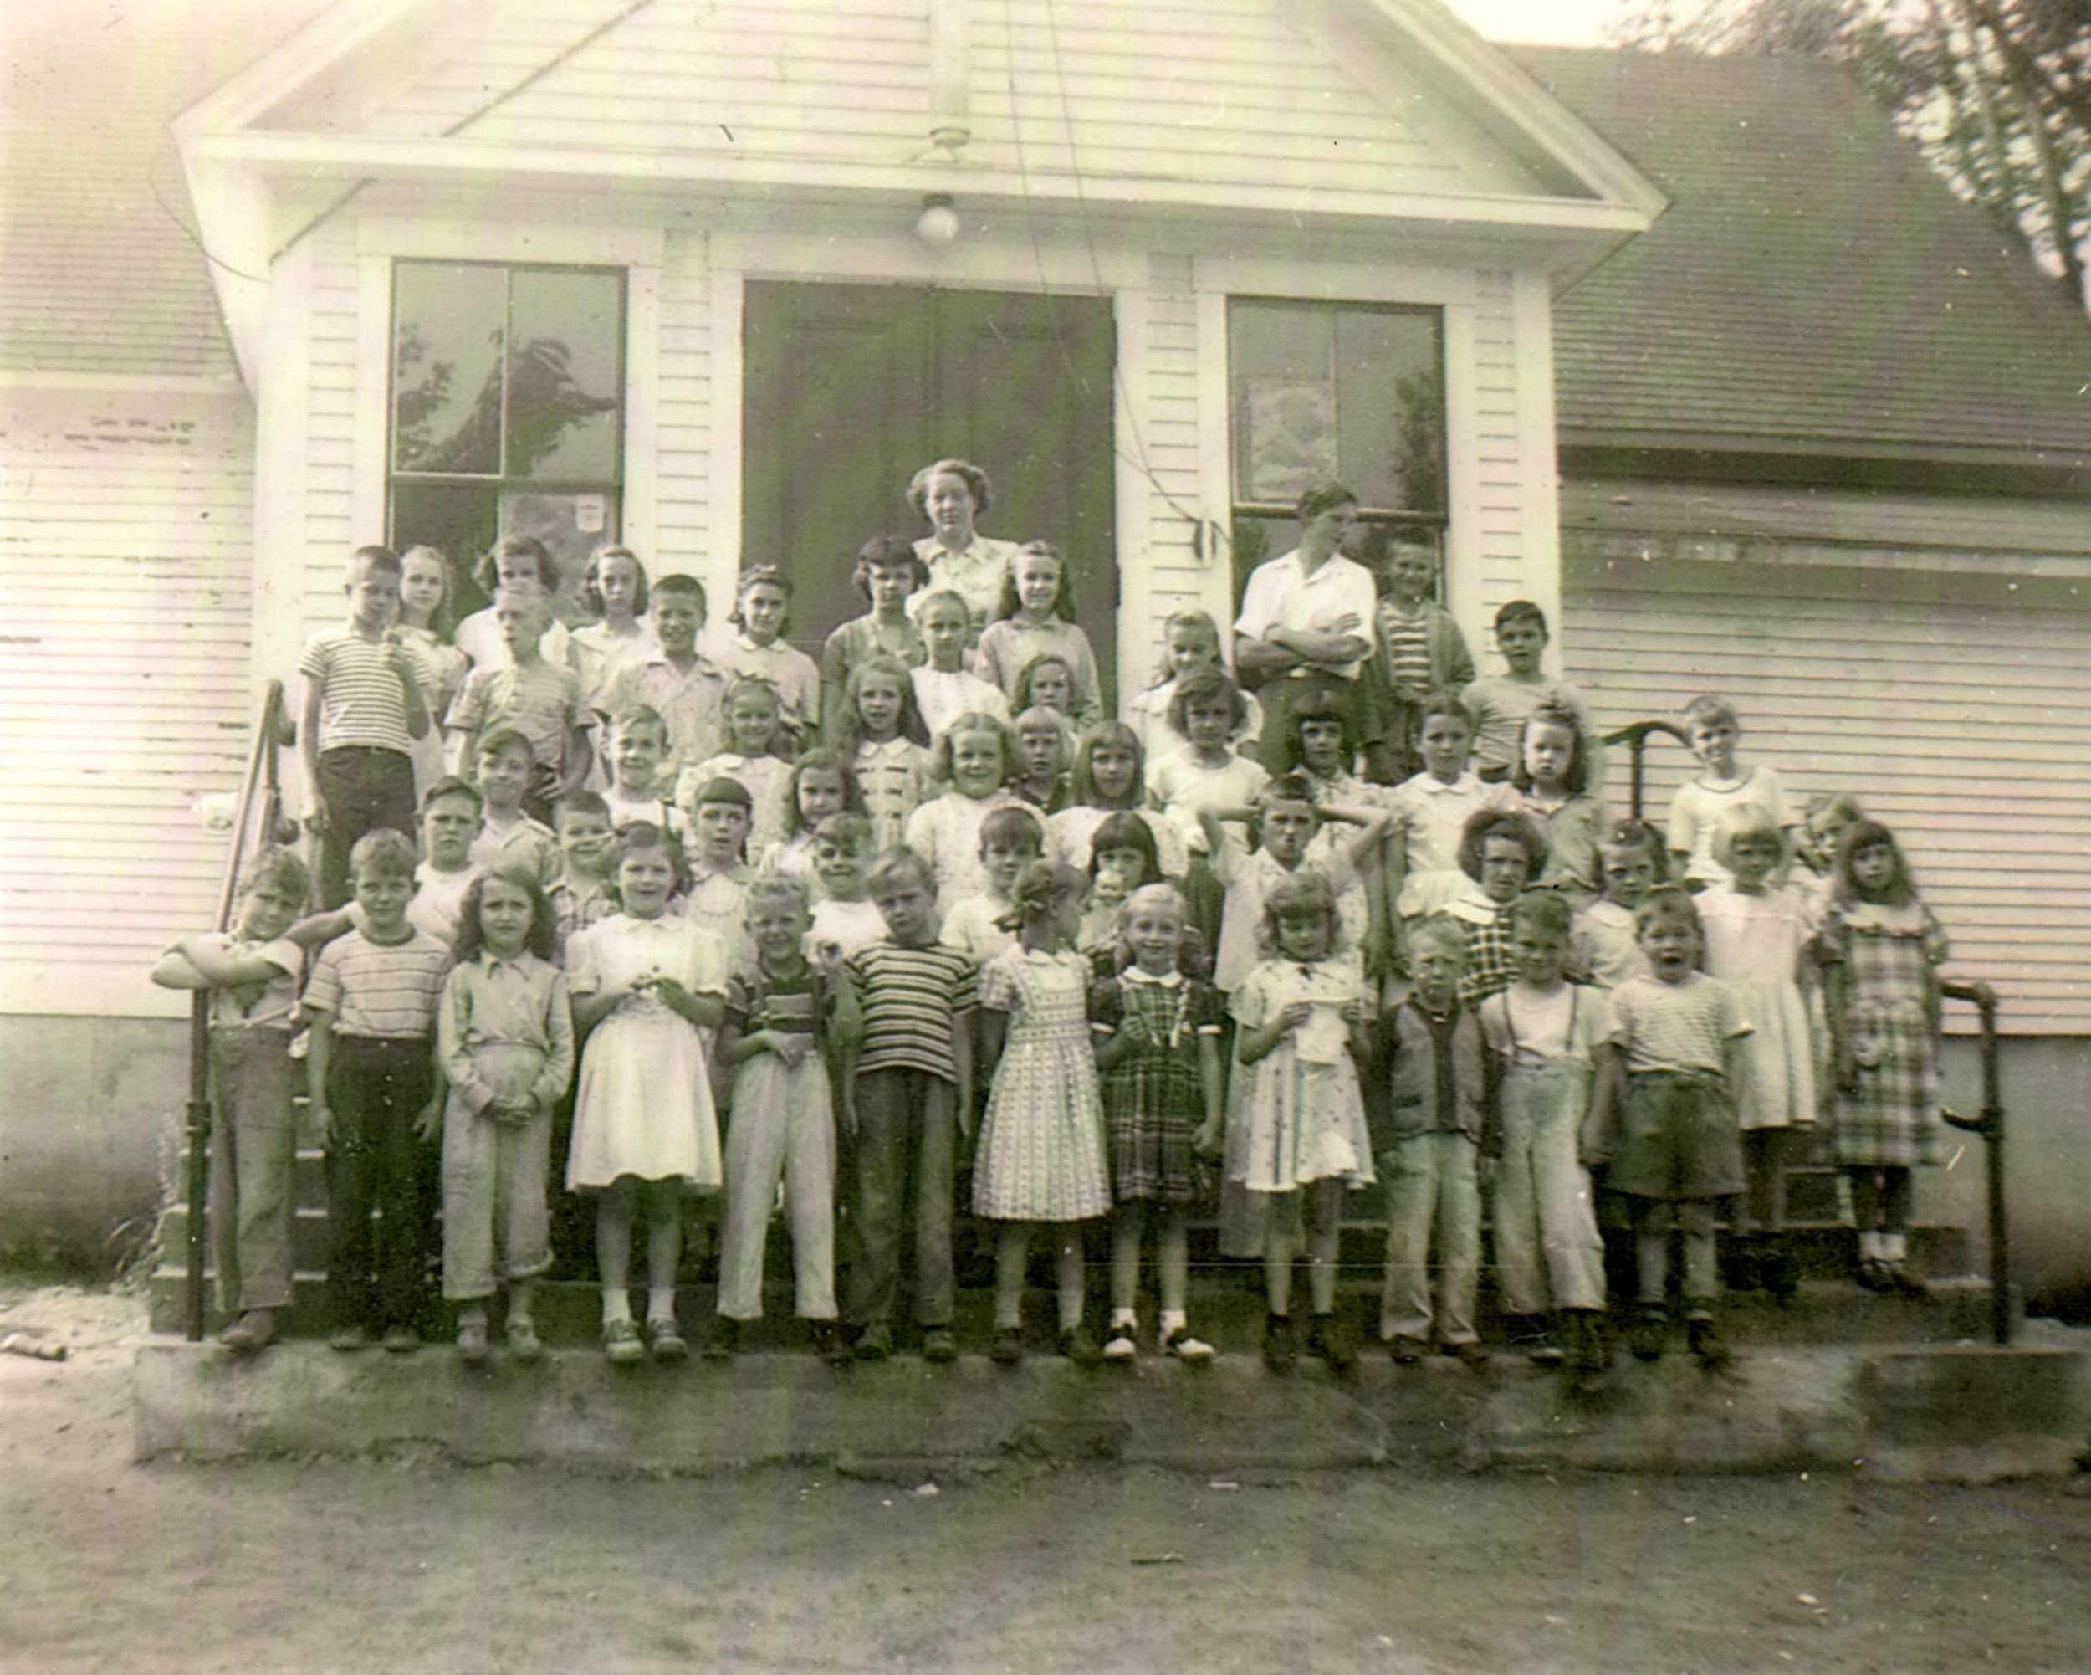
Etna School House 1948 or 1949, Mrs. William (Lillian) Bailey and class
Notes:
Probably classes headed for ‘57, ‘58, ‘59, ‘60.

Slide 20
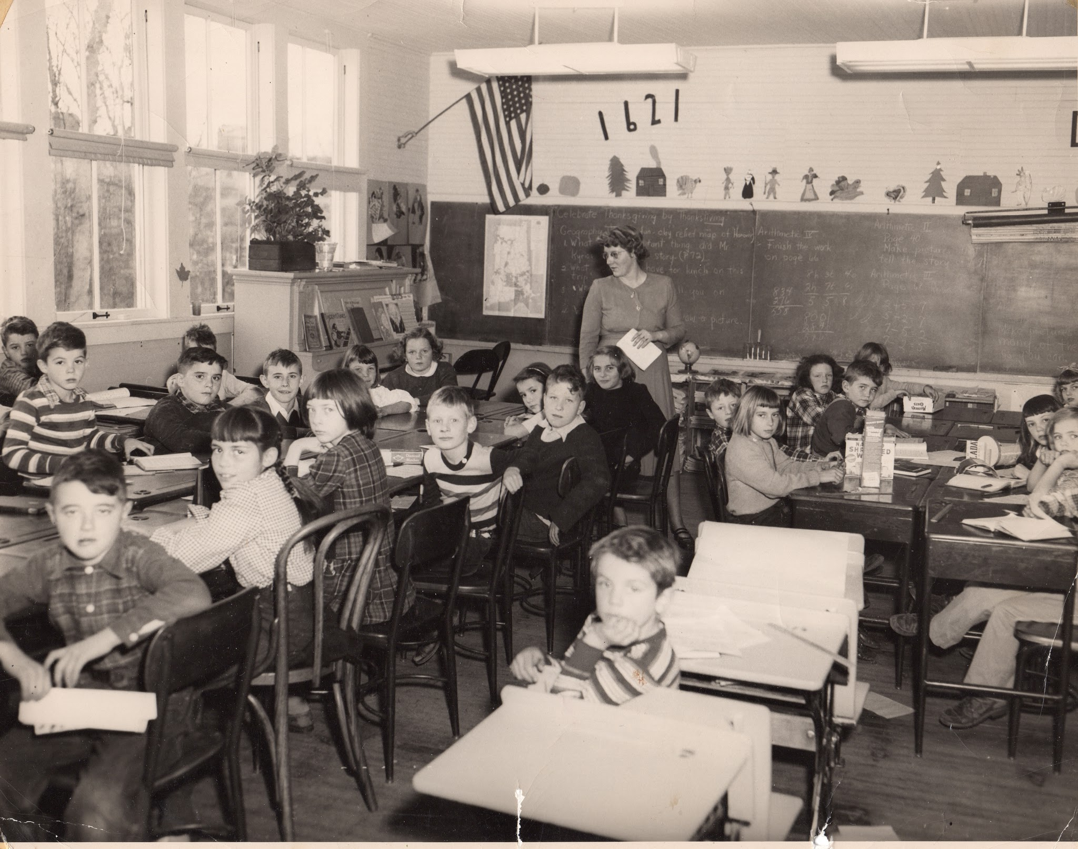
Lillian Bailey and students
Notes:
[left to right] Two window seats unknown; Row 1 is Bob Greenwood, two unknown boys, Marjorie Gault, Nancy Bailey; Row 2 is Stanley Scott, Ellen Evans, Dawn Nichols, Granger Morgan, Bob Penn, Styvesant girl, "Bunny" Thompson; Row 3 is Swett boy, Patty Stark, Tom Forward, West boy, Nancy Cotting; Row 4 is maybe Diane Pelton, Gault girl, and Trottier girl. May include John Lord, Ernie Sherman, and even a Hamel Boy.
Greenwood, Scott, Evans, Nichols, Gault, Bailey, Morgan, Thompson, Forward, Stark, Cotton, West

Slide 21
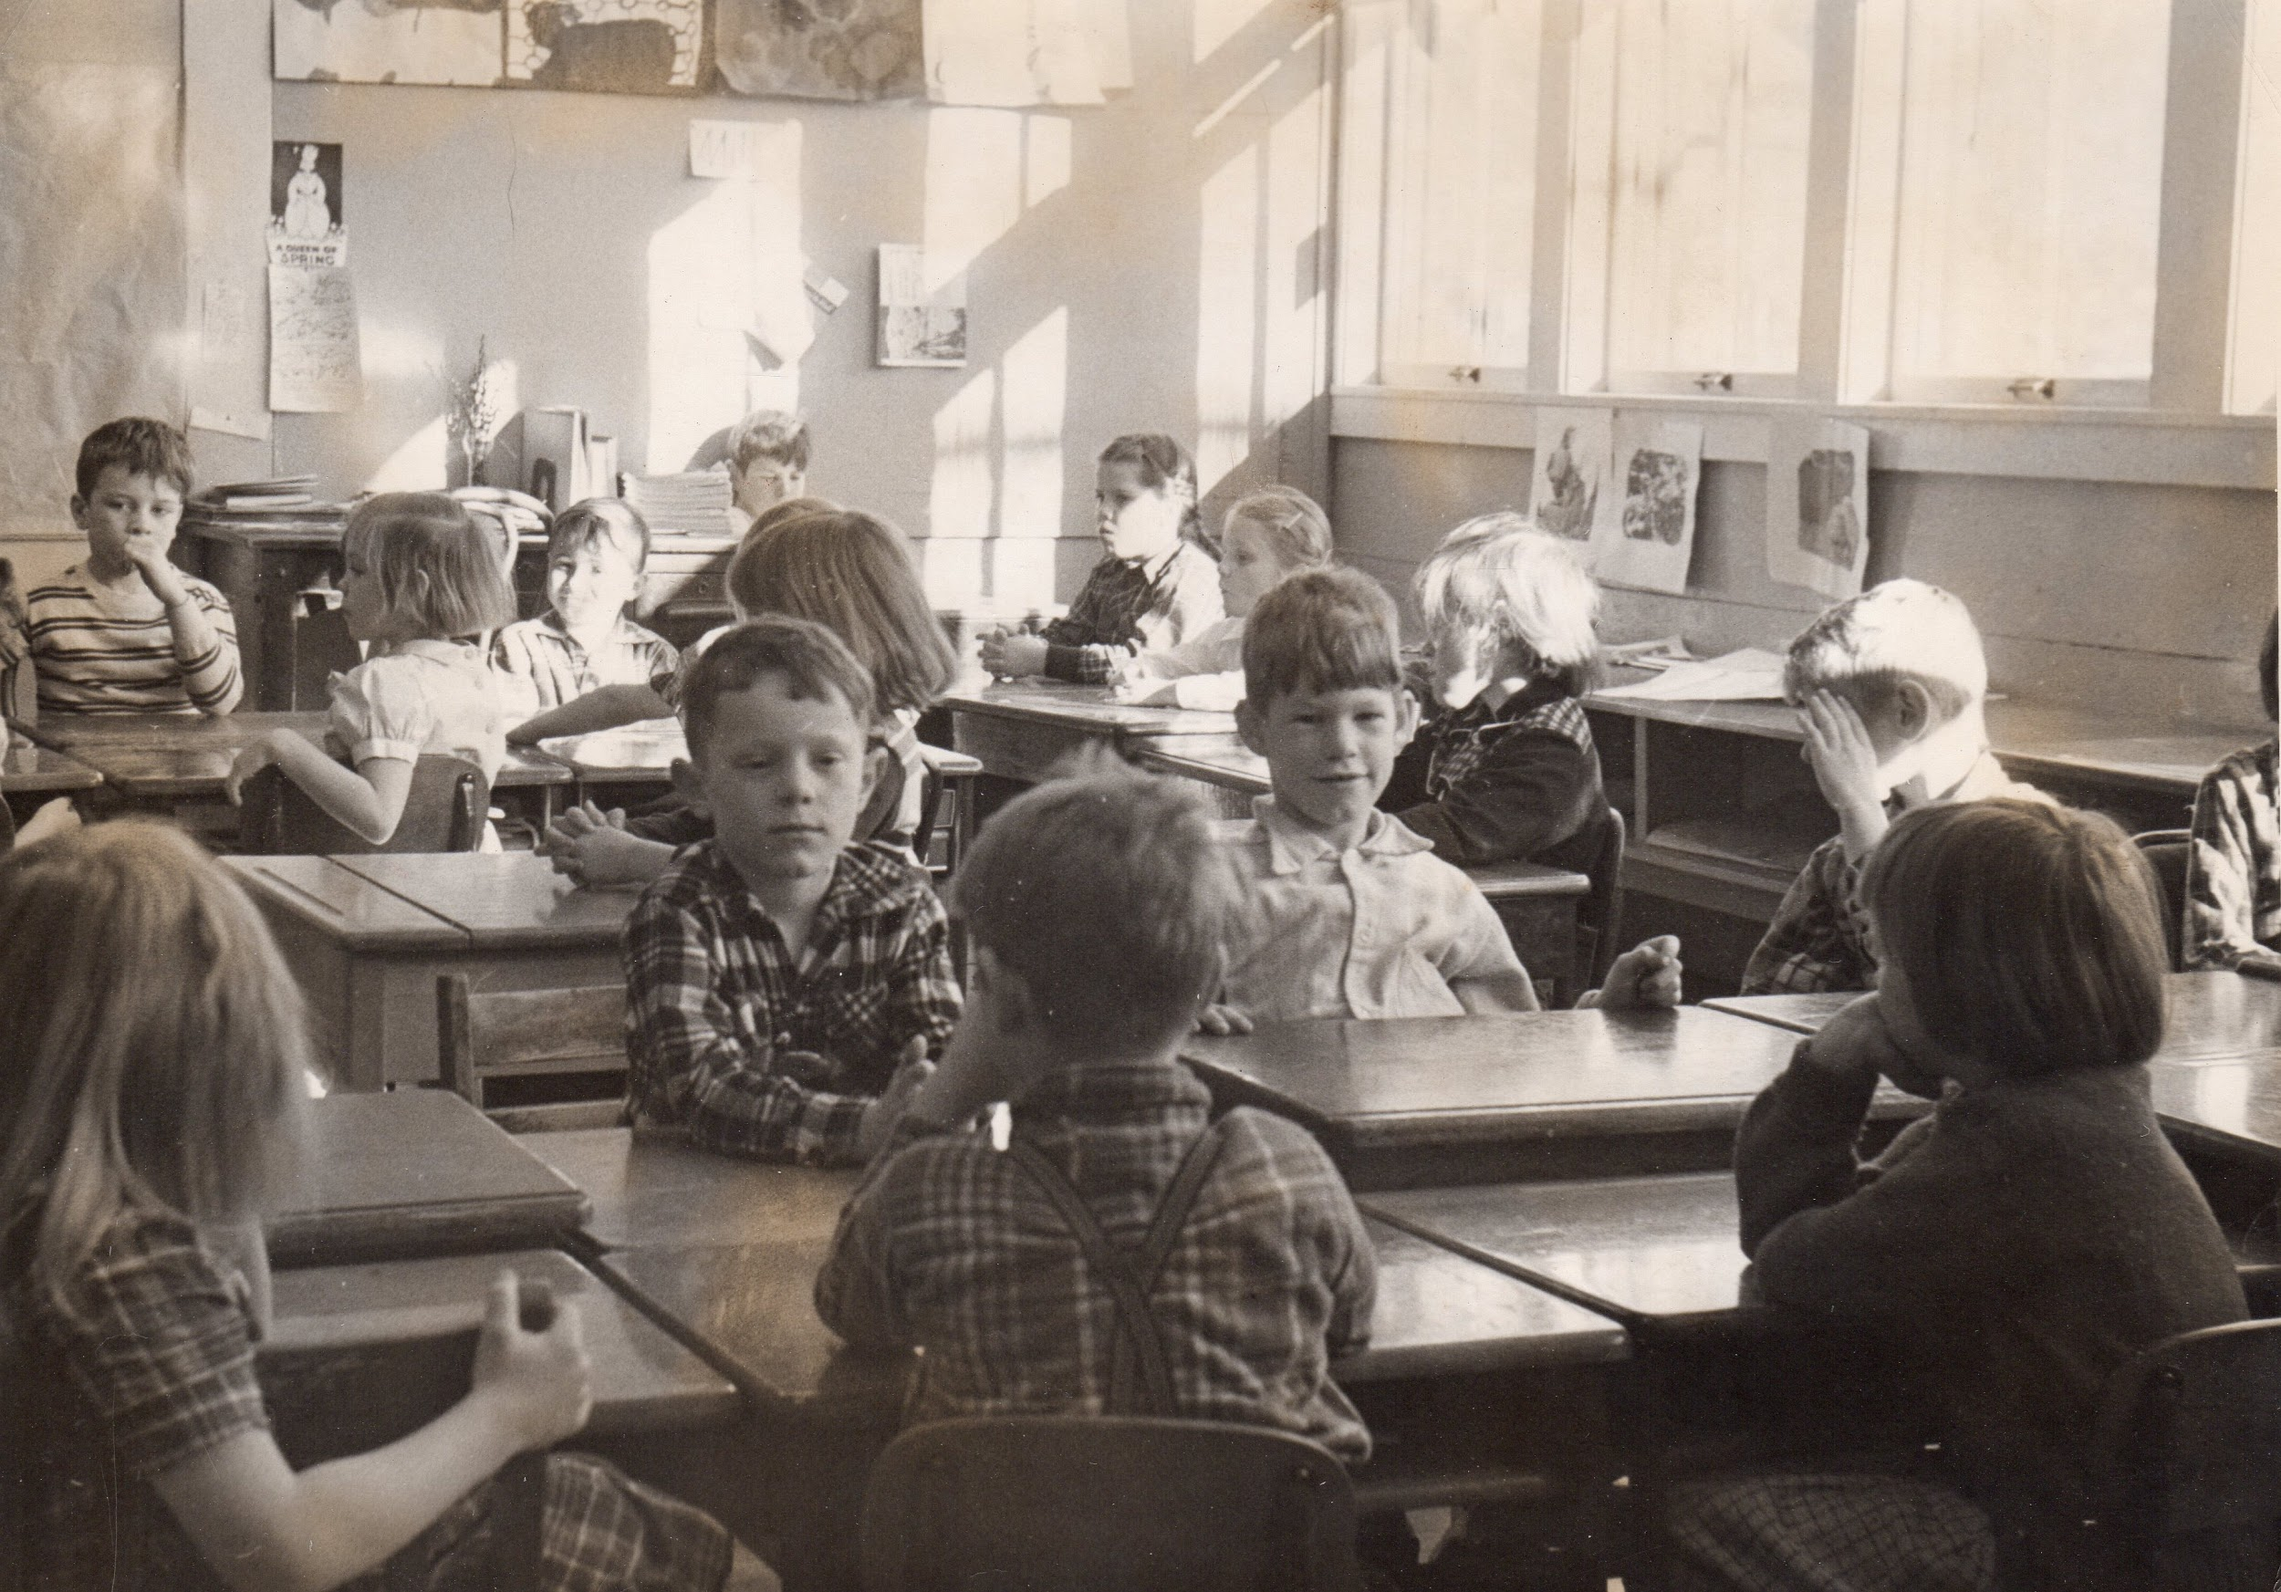
Center: David Stebbins, Keith Pelton. Behind: Bobbie Goodwin, Norma Hayes, Roland Laramie, Shiela Stanley, and Beth Ann Richardson. Dana Robes at large desk.

Slide 22
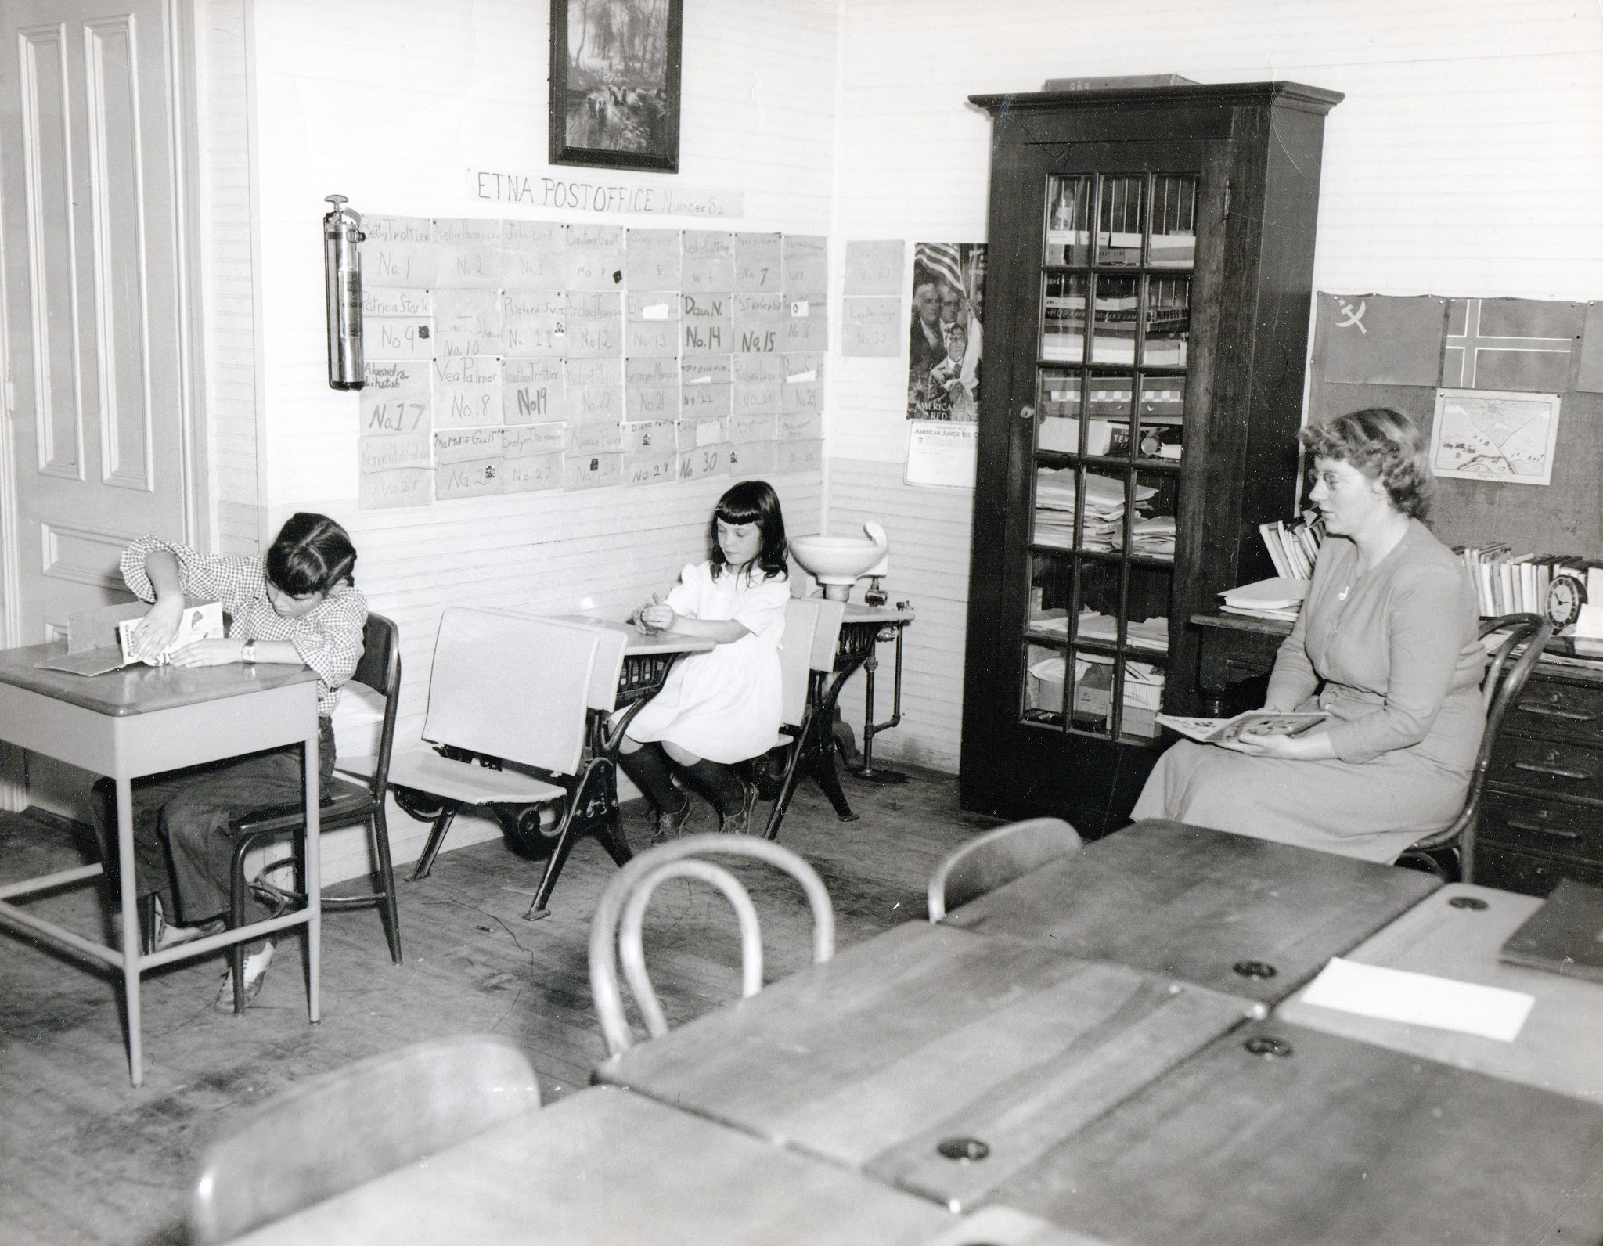
Lillian Bailey with students Ellen Evans and Marjorie Gault.
Notes:
Norma Hayes Pelton?

Slide 23
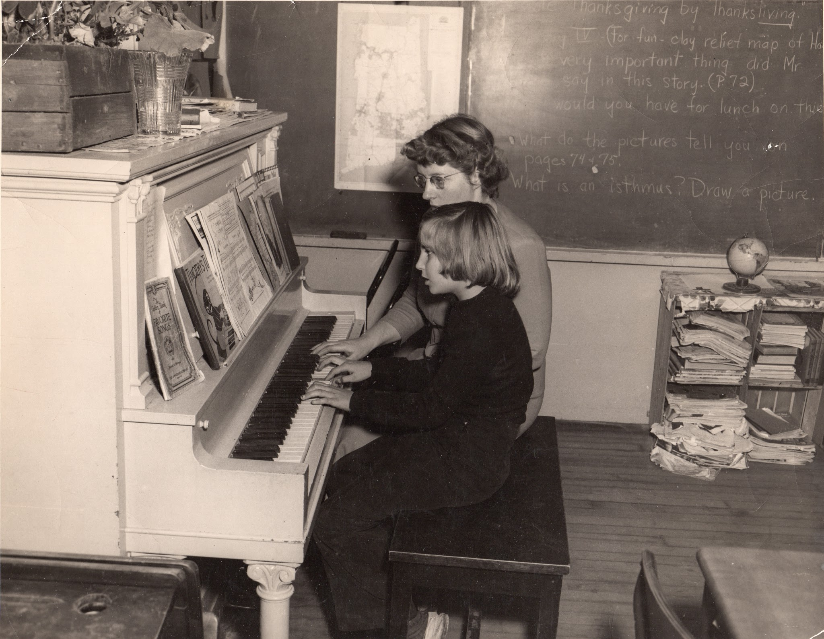
Lillian Bailey playing piano with student

Slide 24
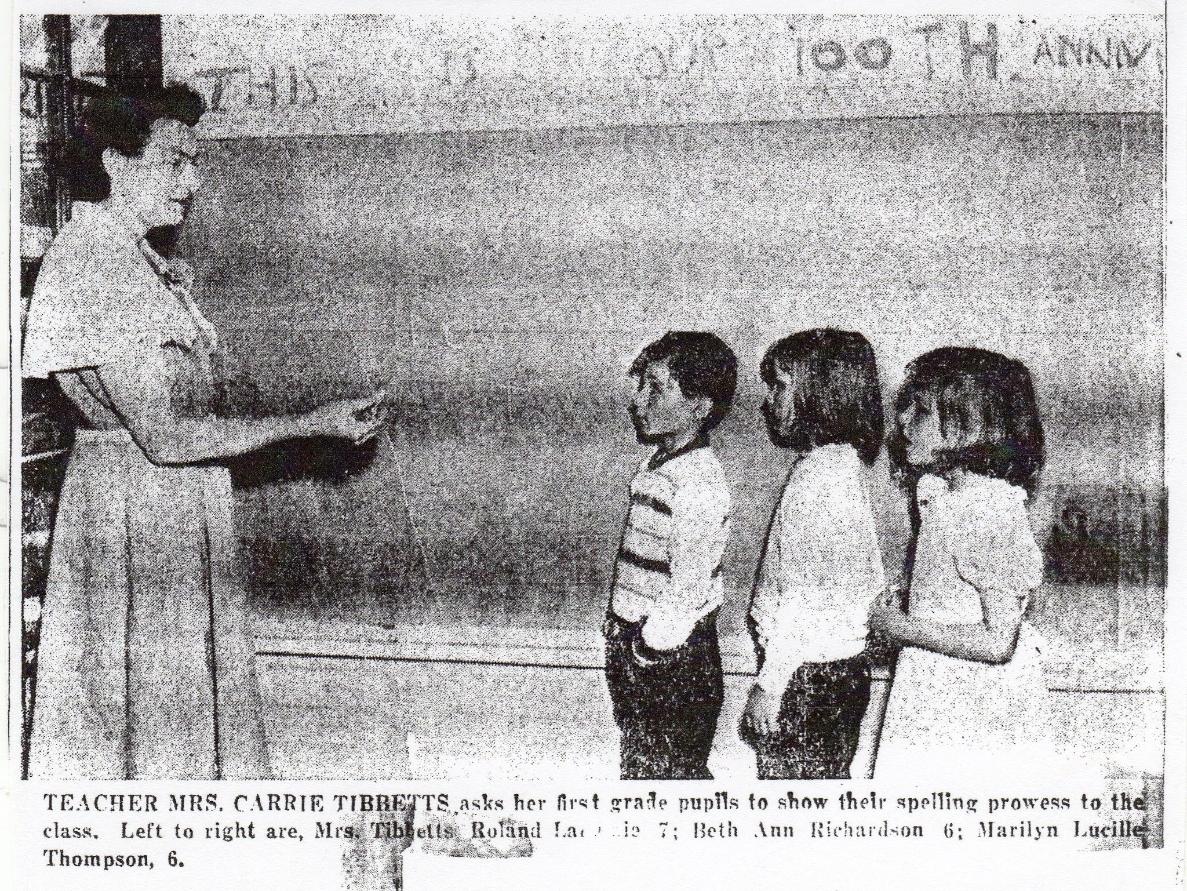
Notes:
Mrs. Carrie Tibbetts asks her first grade pupils to show their spelling. Roland La?, Beth Ann Richardson, Marilyn Lucille Thompson.

Slide 25
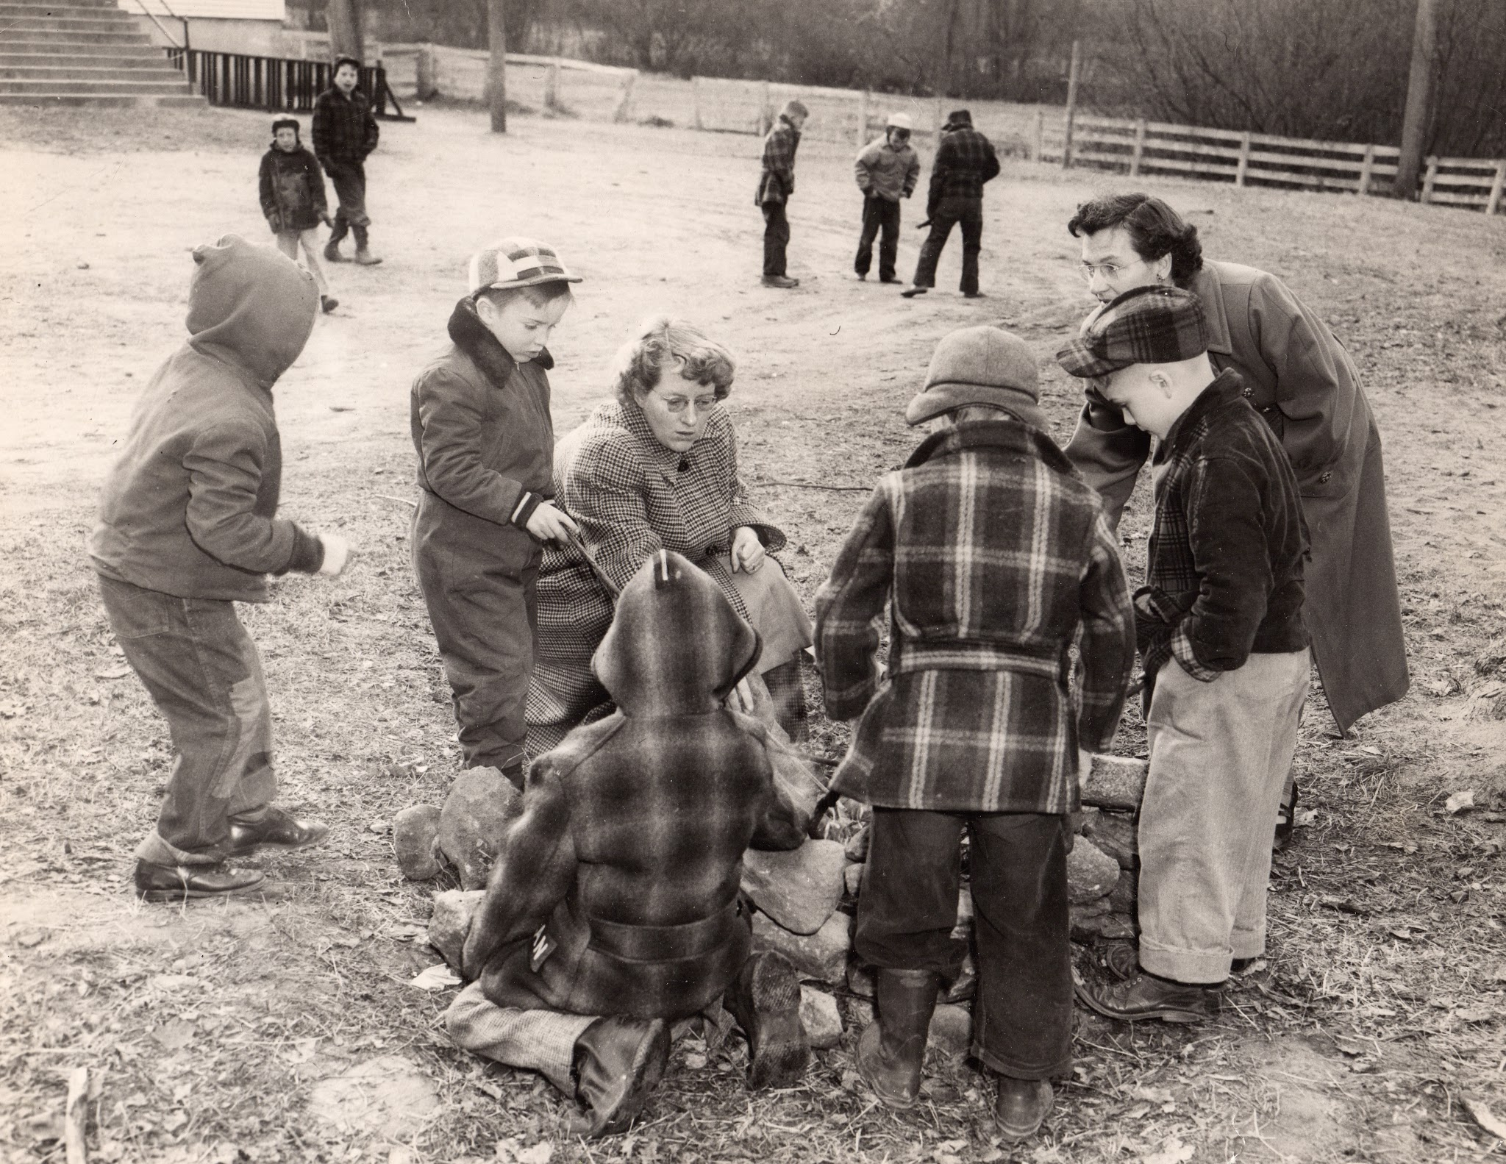
Lillian Bailey, Carrie Tibbets and students

Slide 26
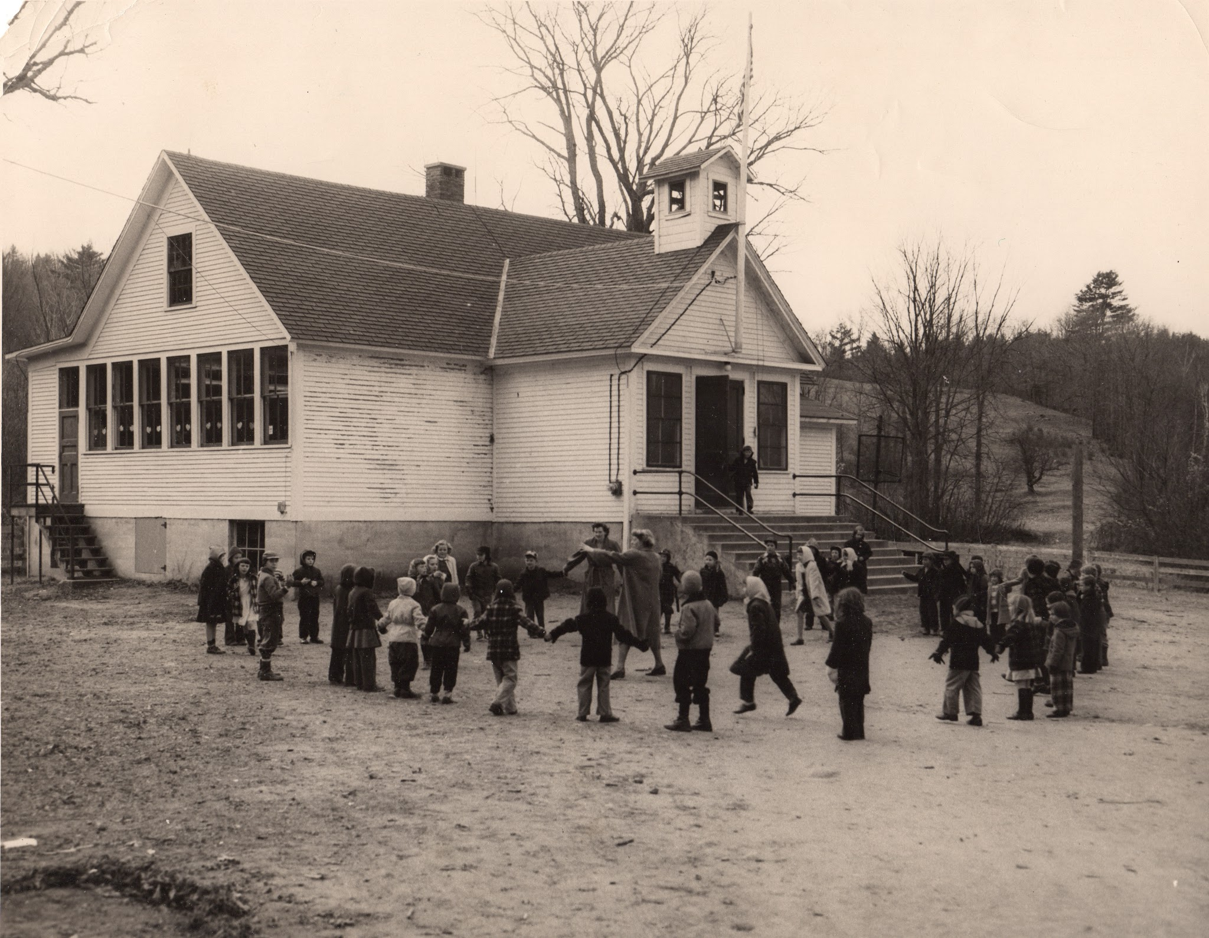
Etna School 1950s

Slide 27
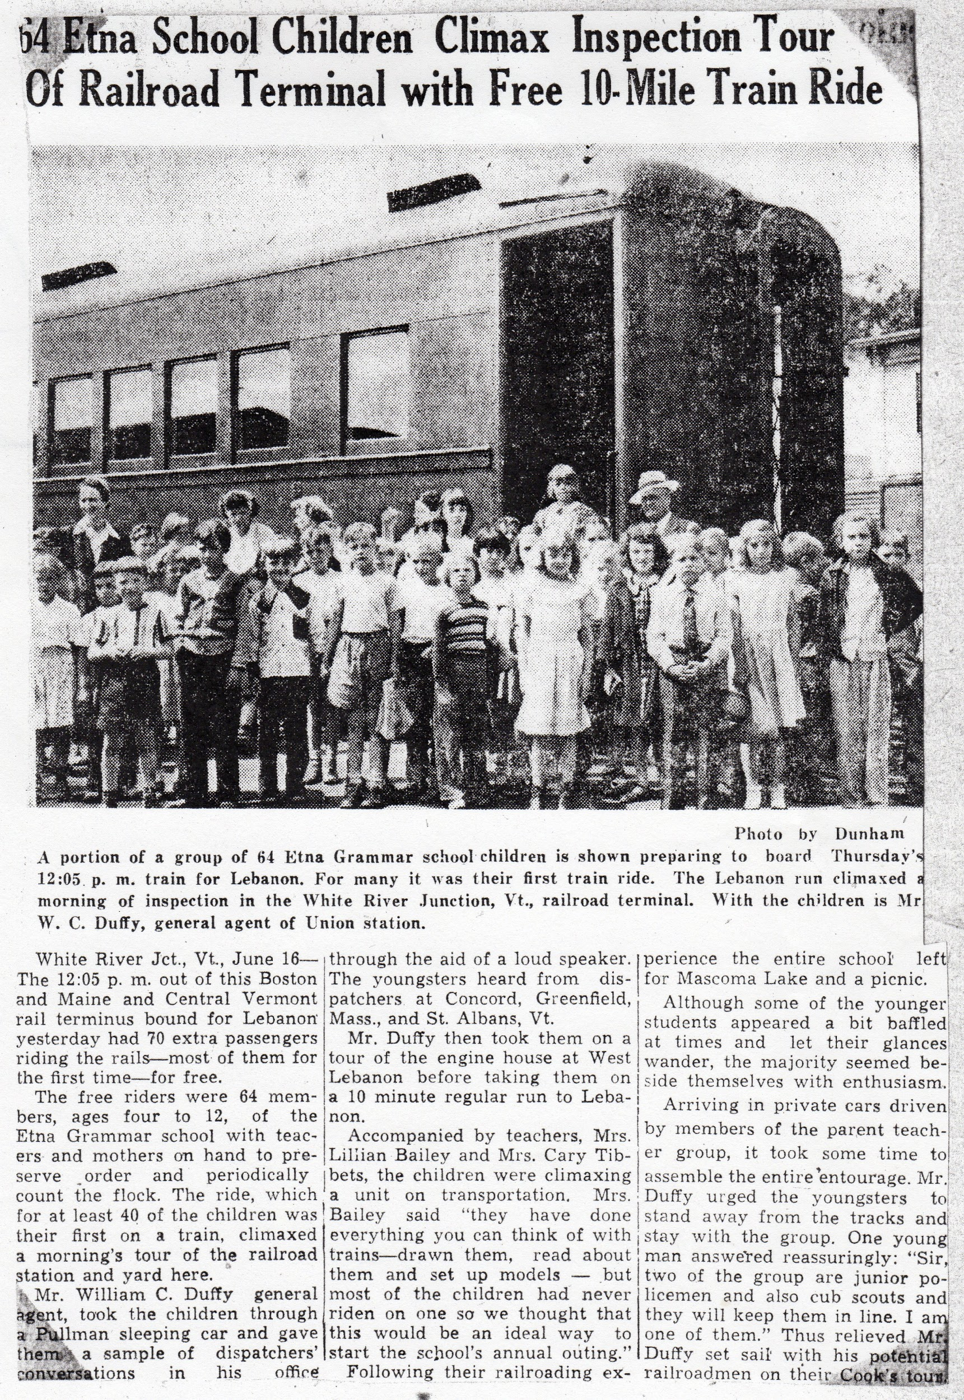
Provided by Alexandra Lihatsh Corwin
Notes:
June 16, 19-- 64 Etna school children boarded the 12:05 train at WRJ for Lebanon with Mrs. Bailey. Mrs. Tibbetts and mothers. Mr. W.C. Duffy, general agent, played dispatches from Concord, Greenfield Mass., and St. Albans VT and took them on a tour of the Lebanon Engine House.

Slide 28
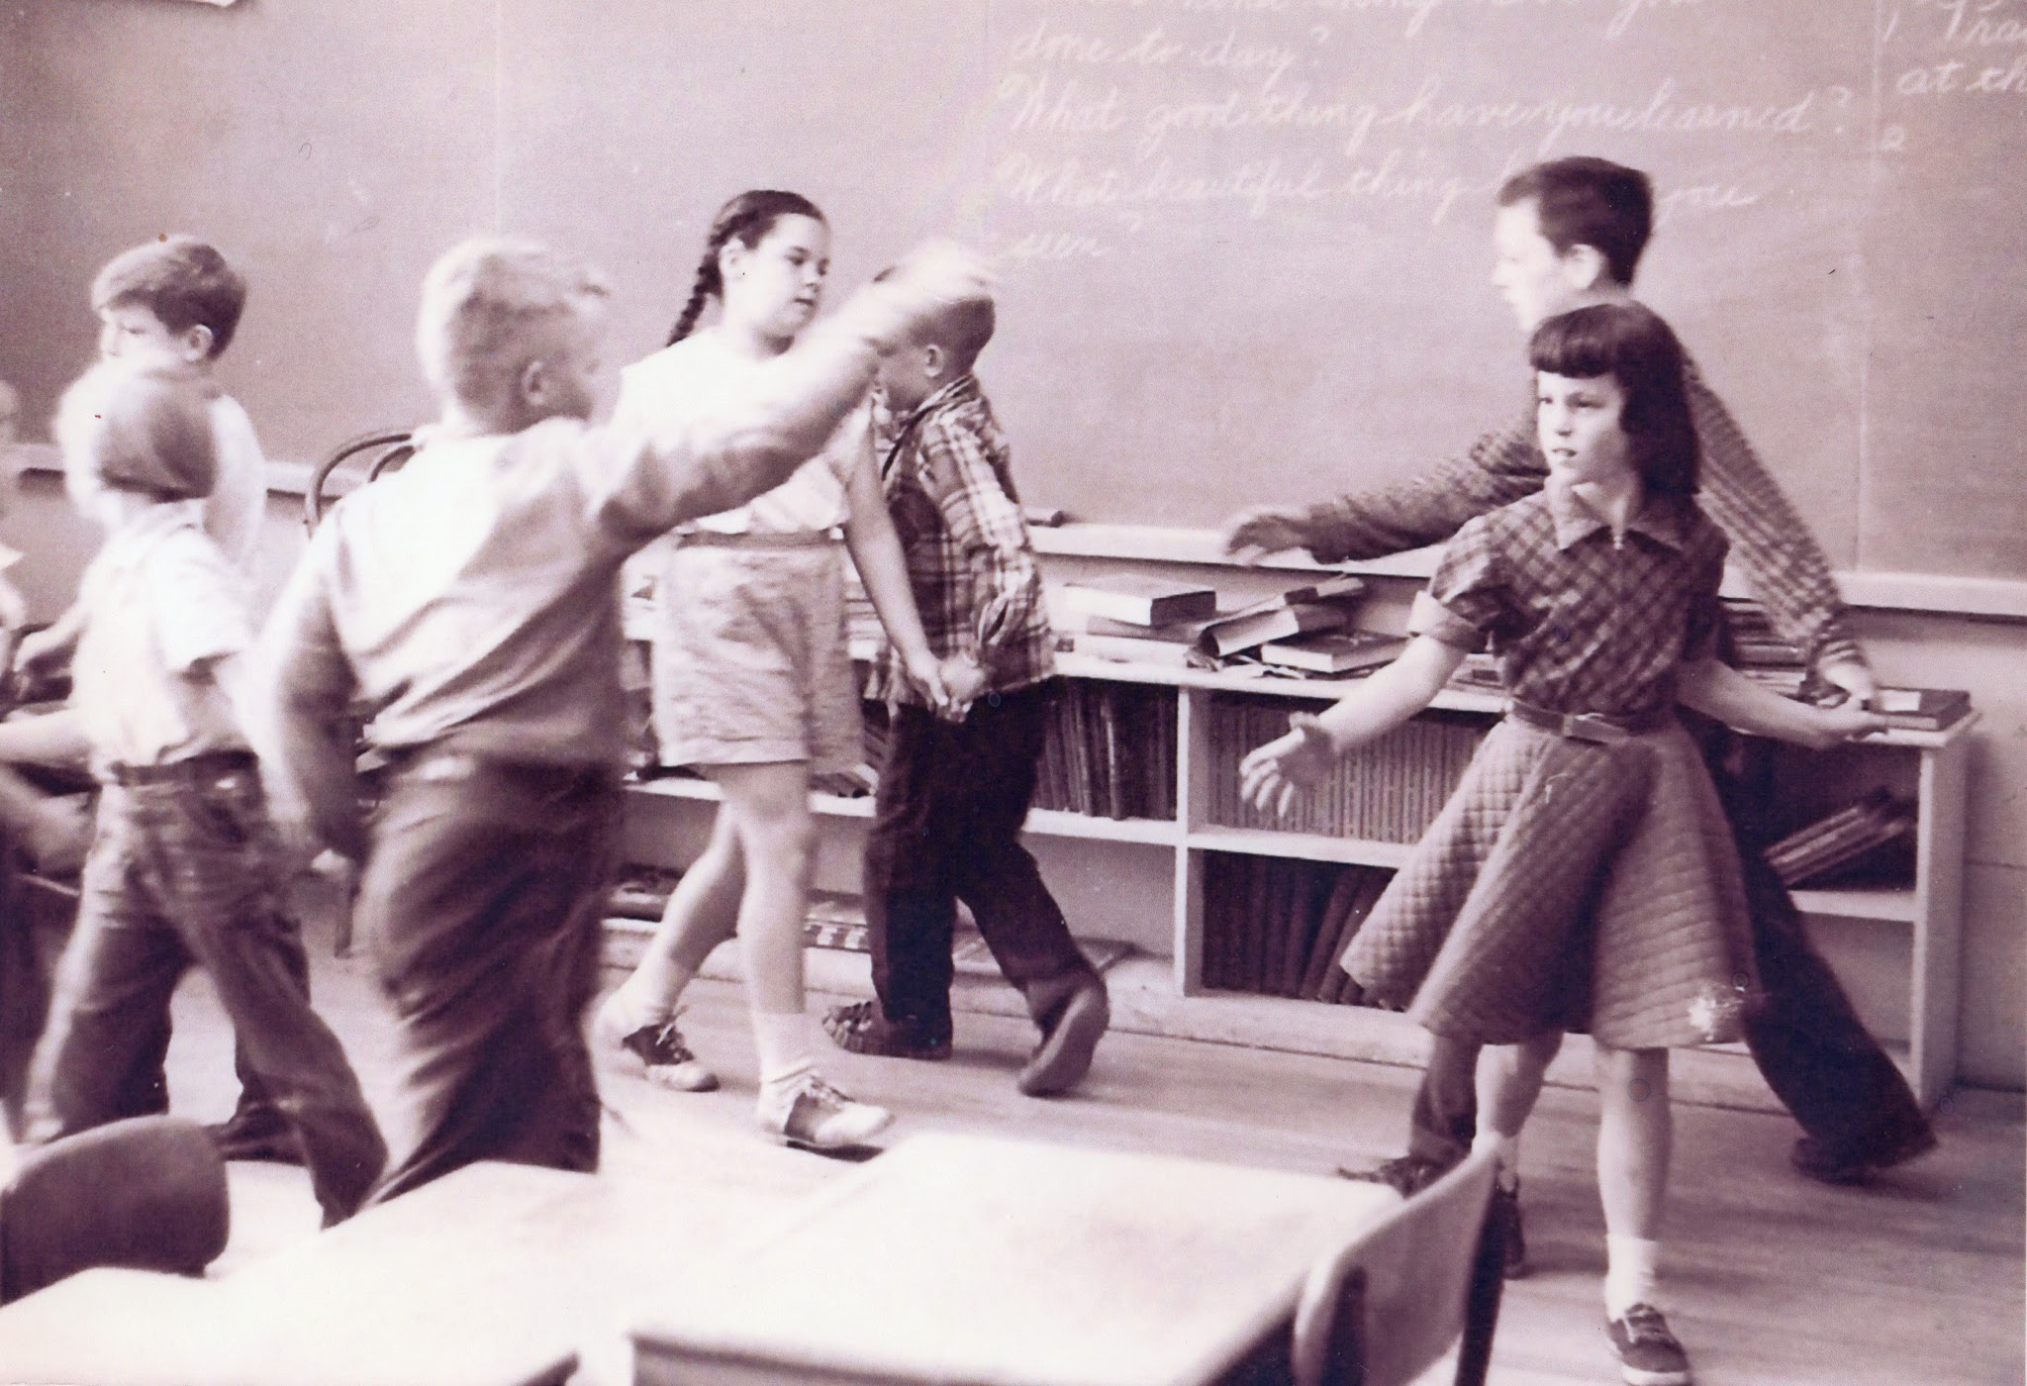
Left to right: Dana Robes?, Maxine Hayes?, John Camp, Faith Stanley, Willie Elder, Howard Randall, Ann Stebbins
Notes:
Square dancing

Slide 29
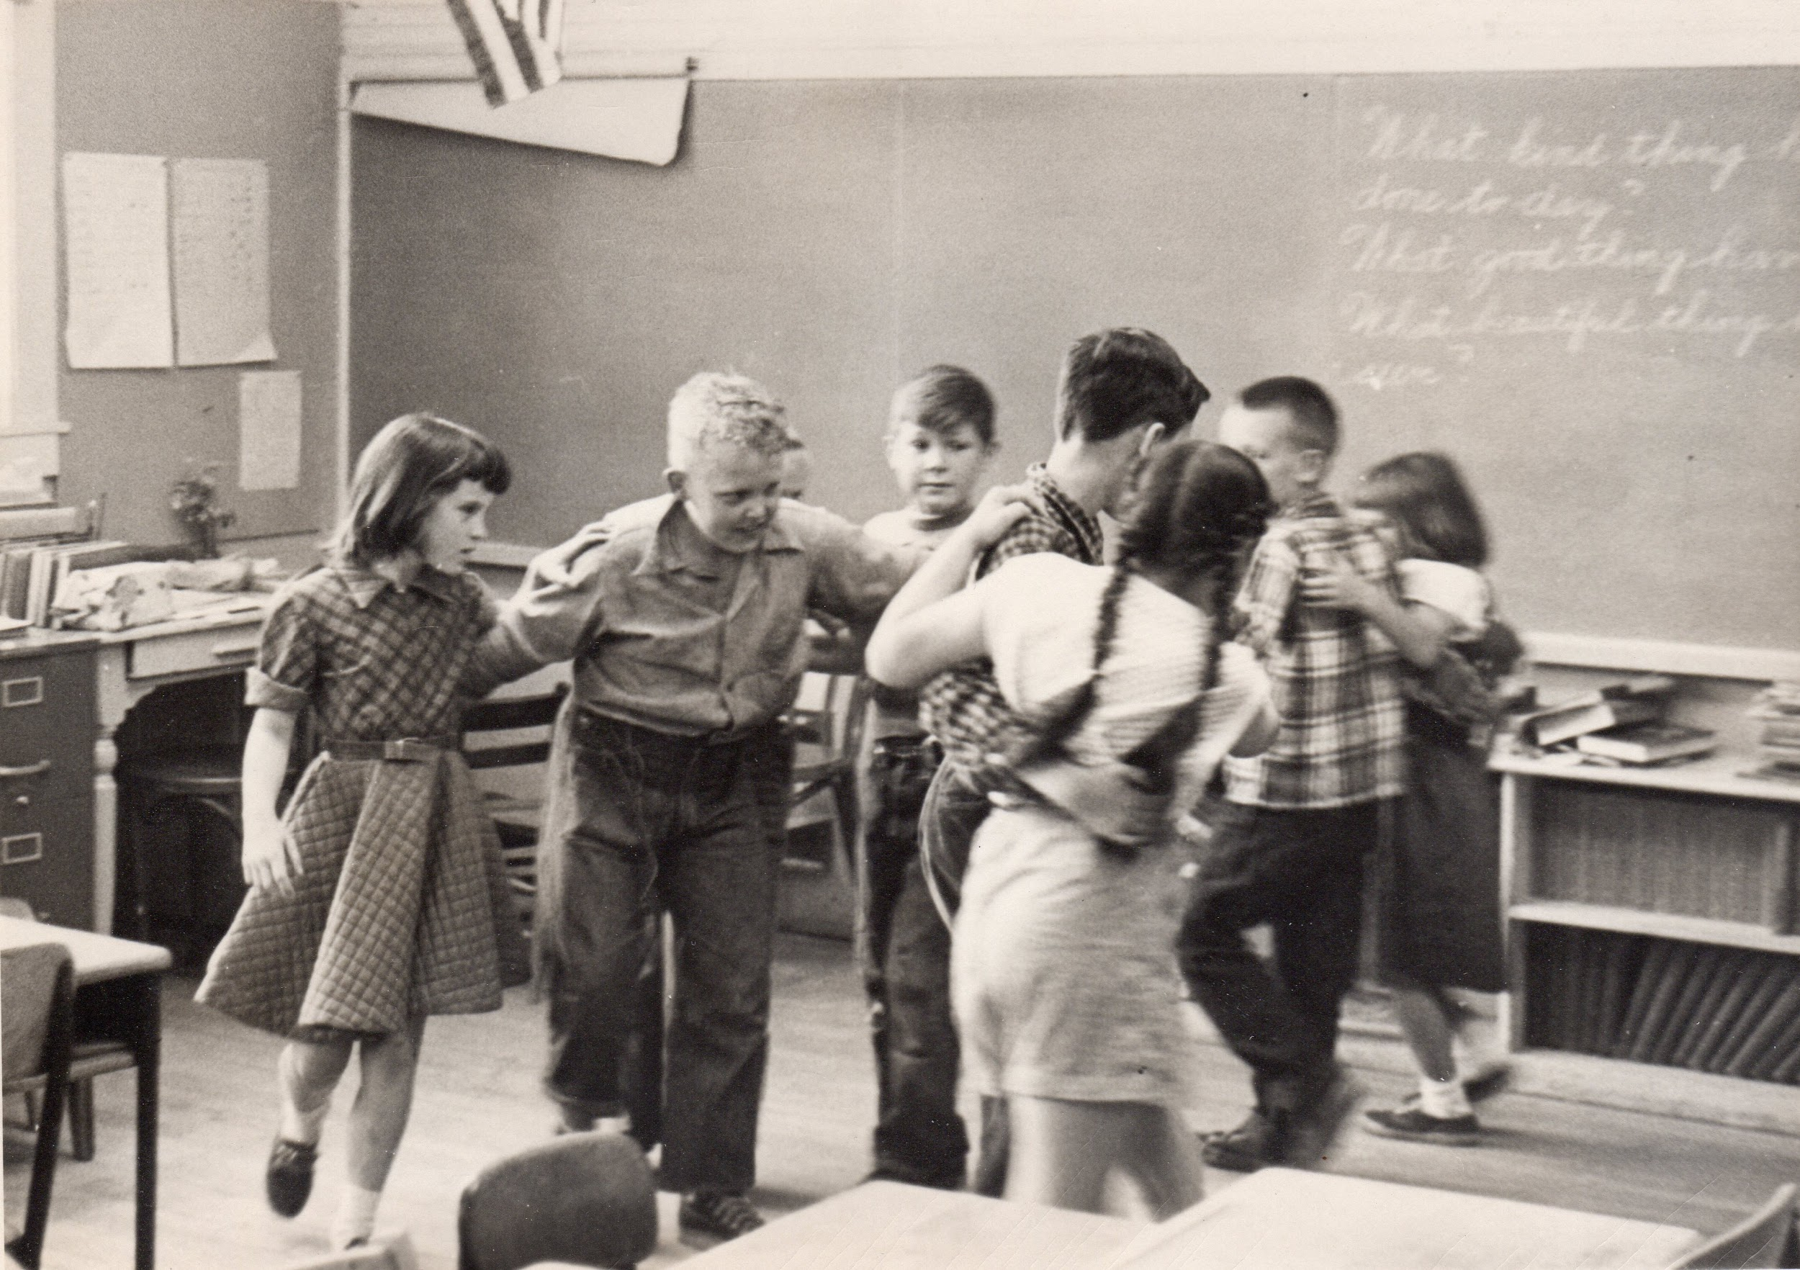
Ann Stebbins, John Camp, Dana Robes, Howard Randall, Faith Stanley, Willie Elder.

Slide 30
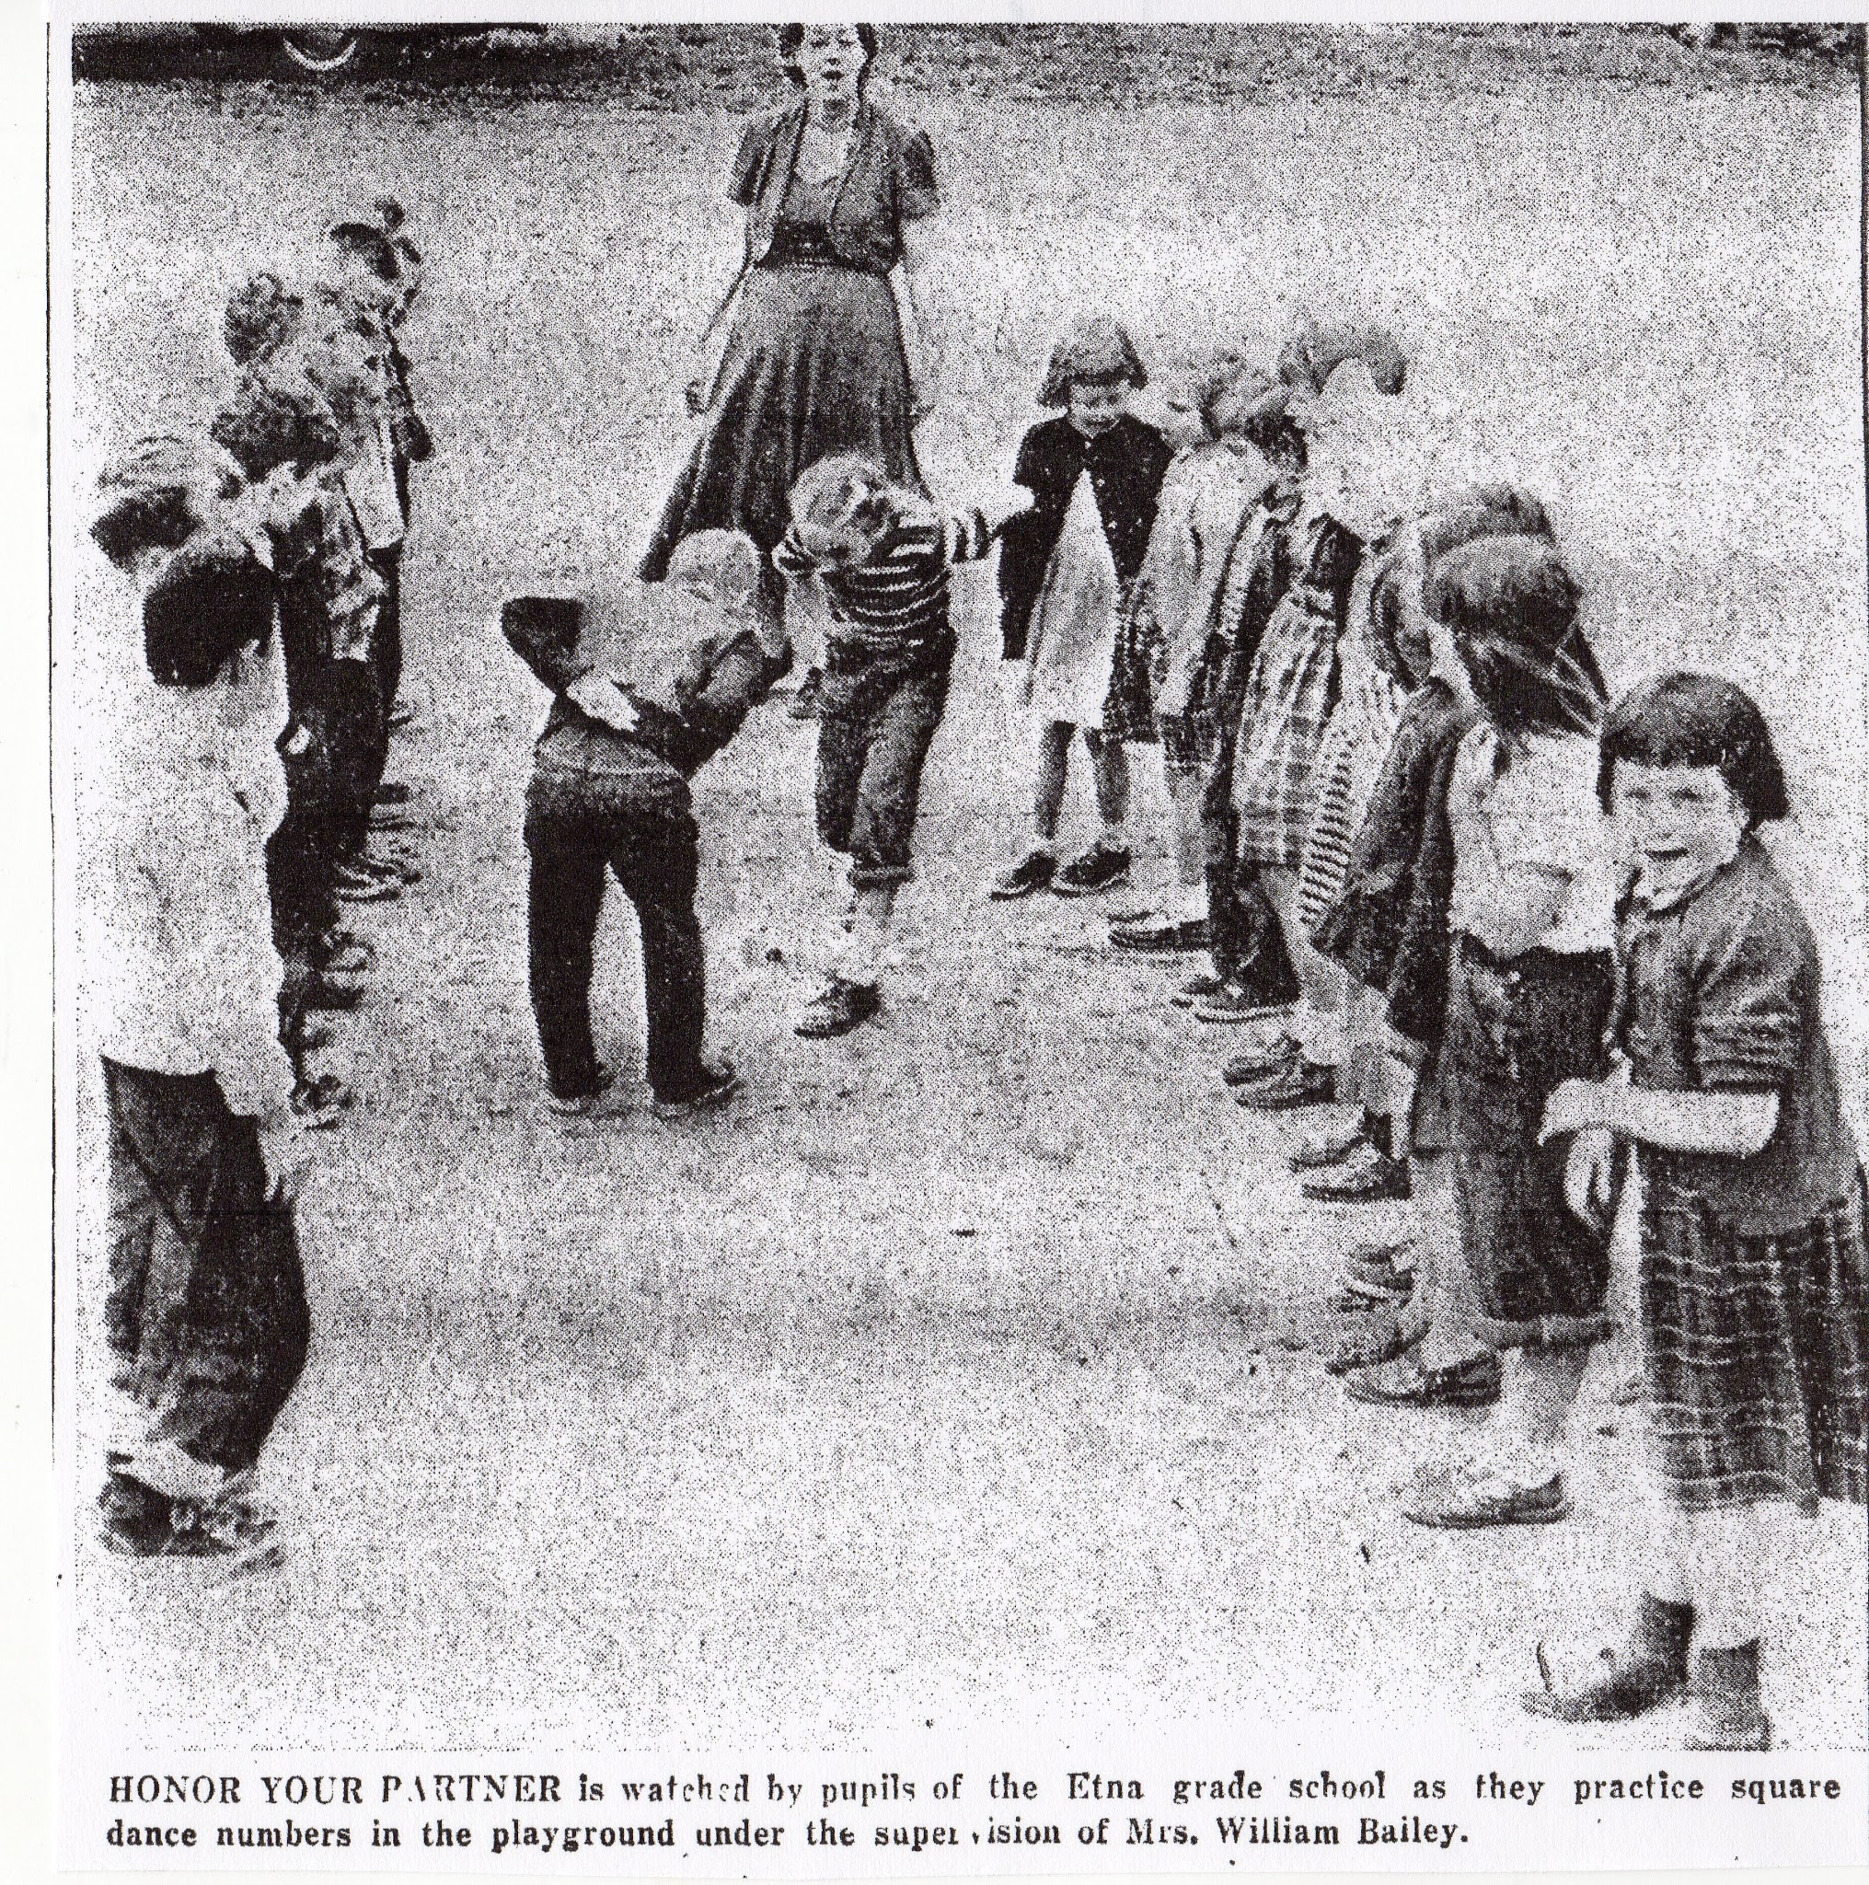
Notes:
Honor Your Partner, supervised by Lillian Bailey.

Slide 31
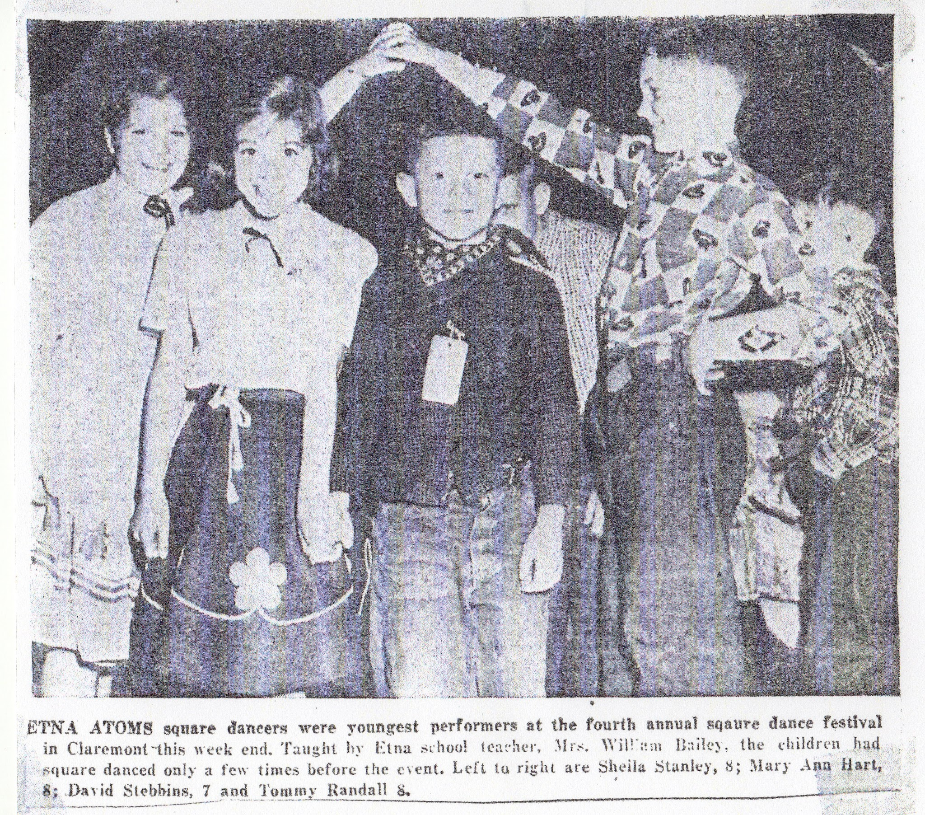
Shiela Stanley, Mary Ann Hart, David Stebbins, Tommy Randall.
Notes:
Etna ATOMS square dancers were youngest performers at the fourth annual square dance festival in Clairemont. Shiela Stanley, Mary Ann Hart, David Stebbins and Tommy Randall.

Slide 32
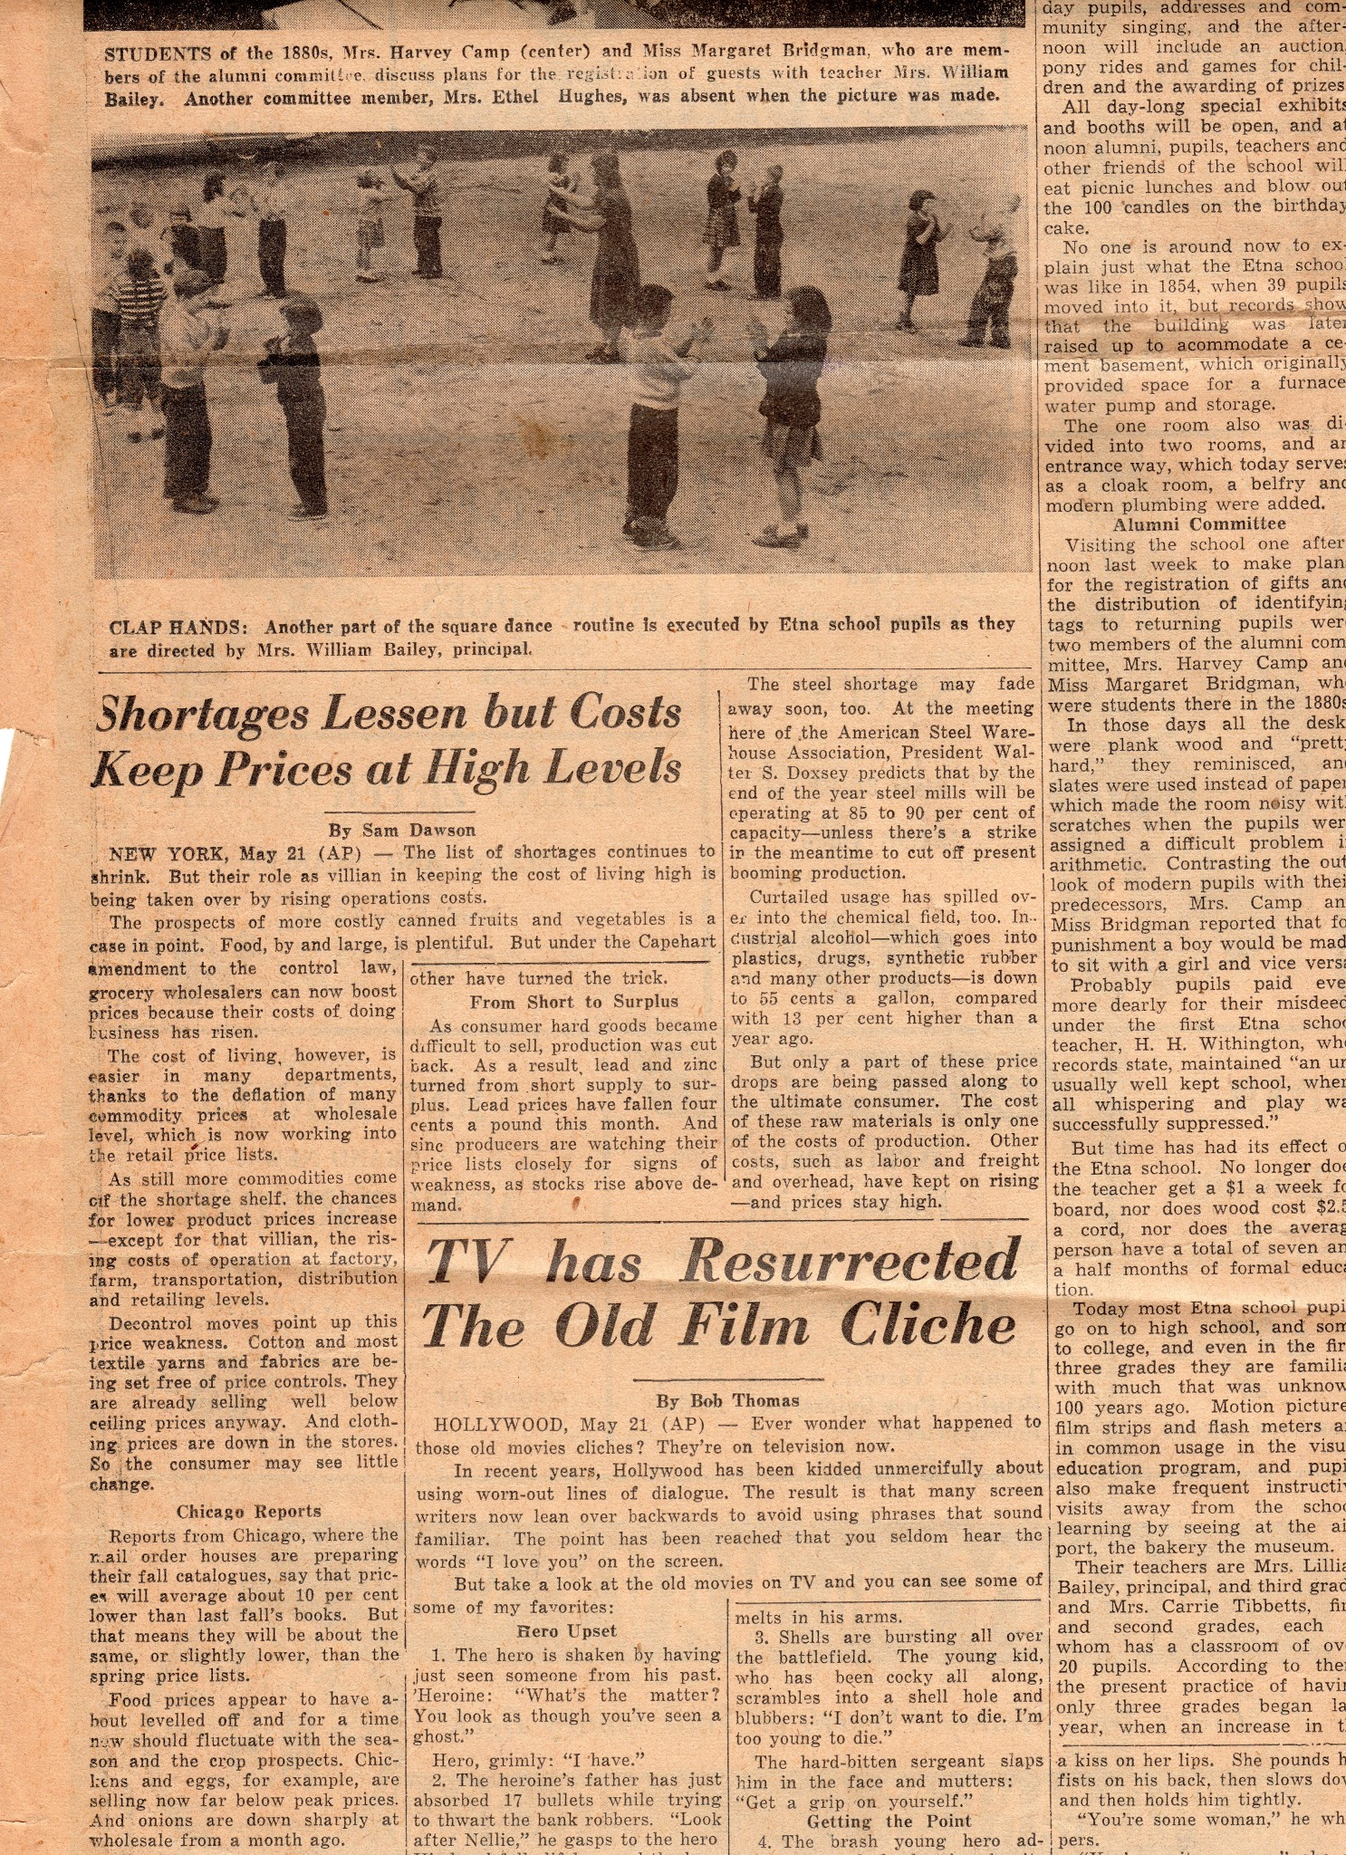
Notes:
Clap hands. Article on side tells about preparations for Centennial. Mrs. Harvey Camp and Mrs. Margaret Bridgman, who attended the school in the 1880’s told how it used to be. Teacher made $1 a week and the average person went to school for 71/2 months a year. Slates were used instead of paper which made the room noisy as students worked on an arithmetic problem. First Etna School teacher was H. H. Withington. Records show that he ran “an unusually well kept school where all whispering and play was successfully suppressed.” In 1854, there were 39 pupils. In 1952, Mrs. Bailey and Mrs. Tibbetts each had a classroom with over 20 students. They had motion pictures and frequent visits outside school, eg. airport, baker, museum. The number of grades was decreased to 3 in 1951.

Slide 33
Etna School
Centennial Celebration
May 24, 1952

Slide 34
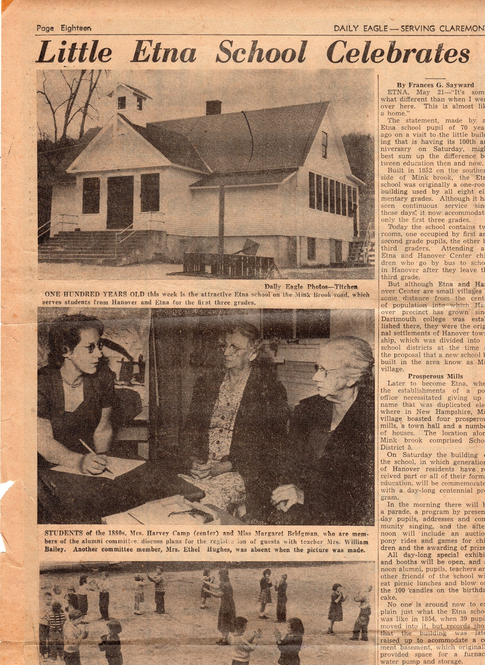
Notes:
Daily Eagle - When the school was built in 1852, Mill Village, later to become Etna, had 4 prosperous mills, a town hall and a number of houses. The school was a one room building used by all 8 elementary grades. In 1952, there were two classes - first and second graders in one and third graders in the other. Etna and Hanover Center children attended and then took the bus into Hanover after third grade.

Slide 35
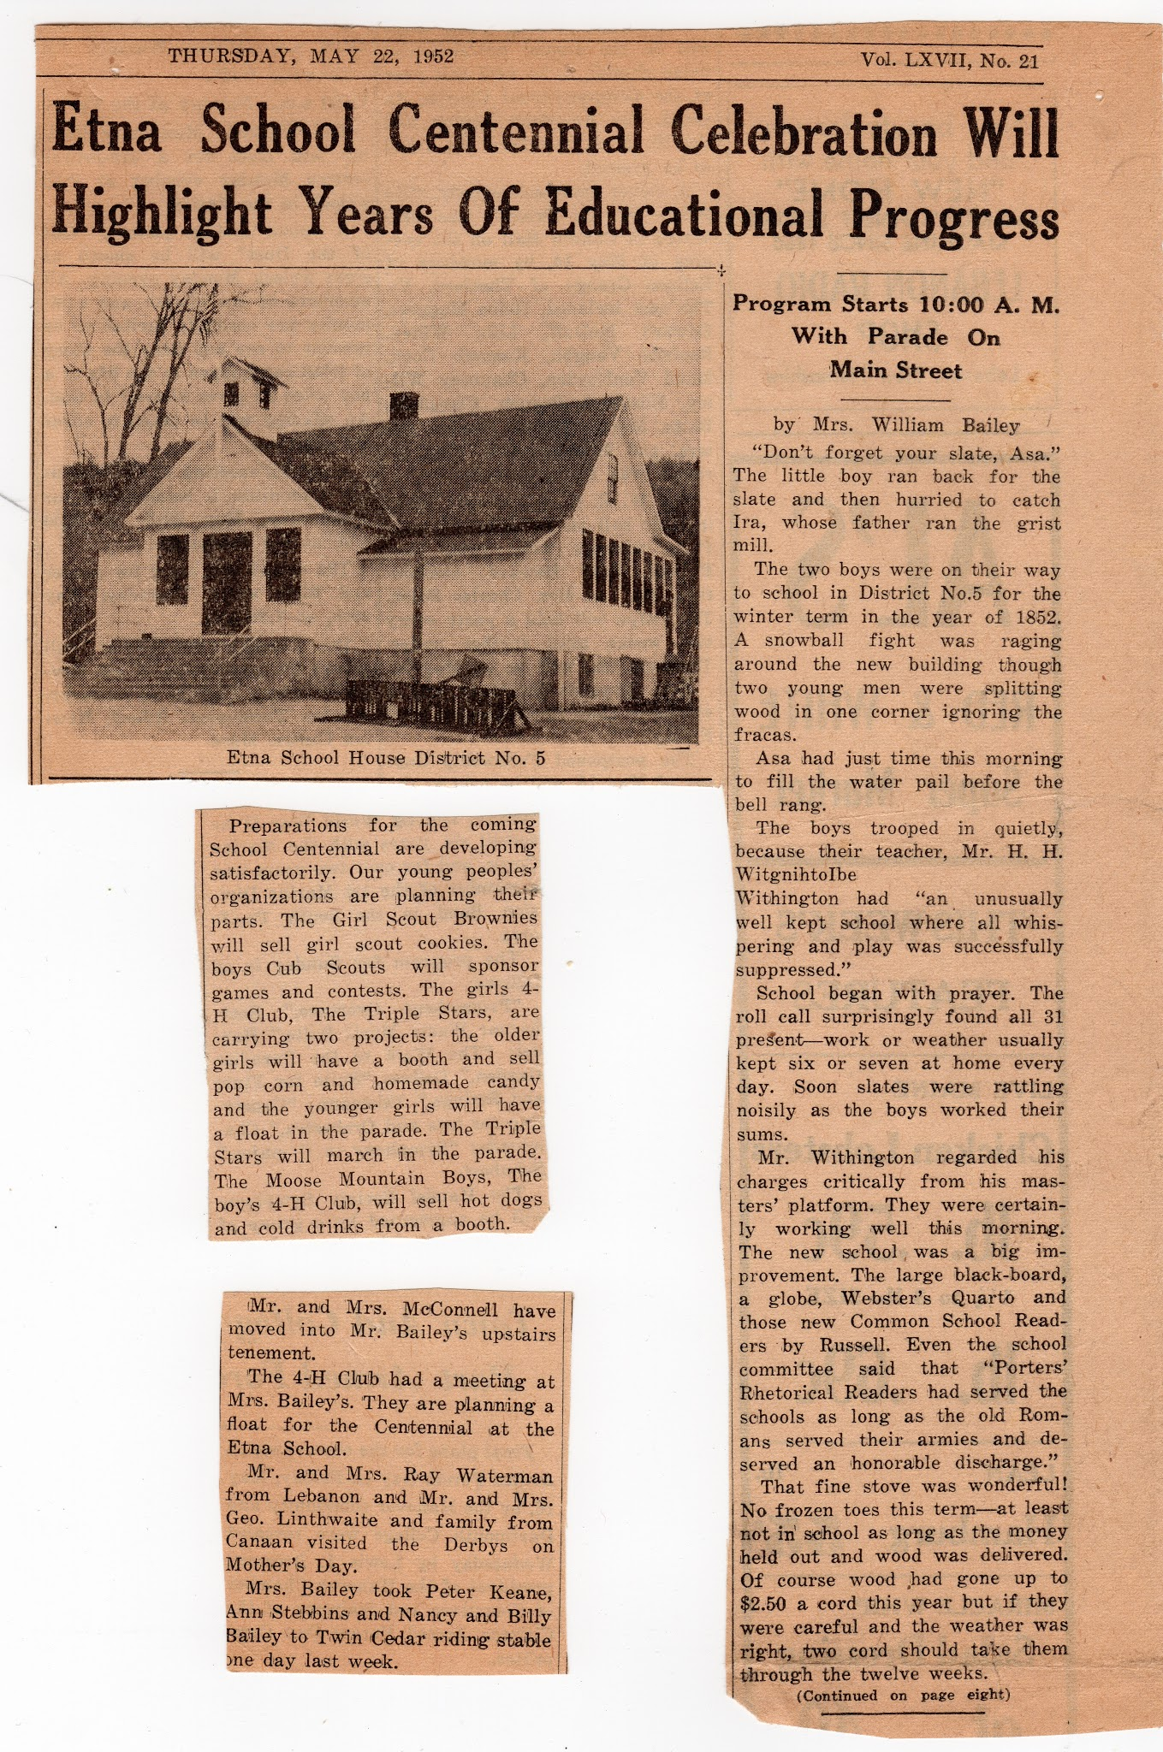
Notes:
By Lillian Bailey: “Mr. Witherington regarded his charges critically from his master’s platform. They were certainly working well this morning. The new school was a big improvement, The large black-board, a glove Webster’s Quarto and those new Common School Readers by Russell. . . That fine stove was wonderful! . . . Of course Wood had gone up to $2.50 a cord this year but if they were careful and the weather was right, two cord should take them through the twelve weeks. . . Miss Bettie Dudley was to teach girls’ school. They were to have as long as the boys this year.”

Slide 36
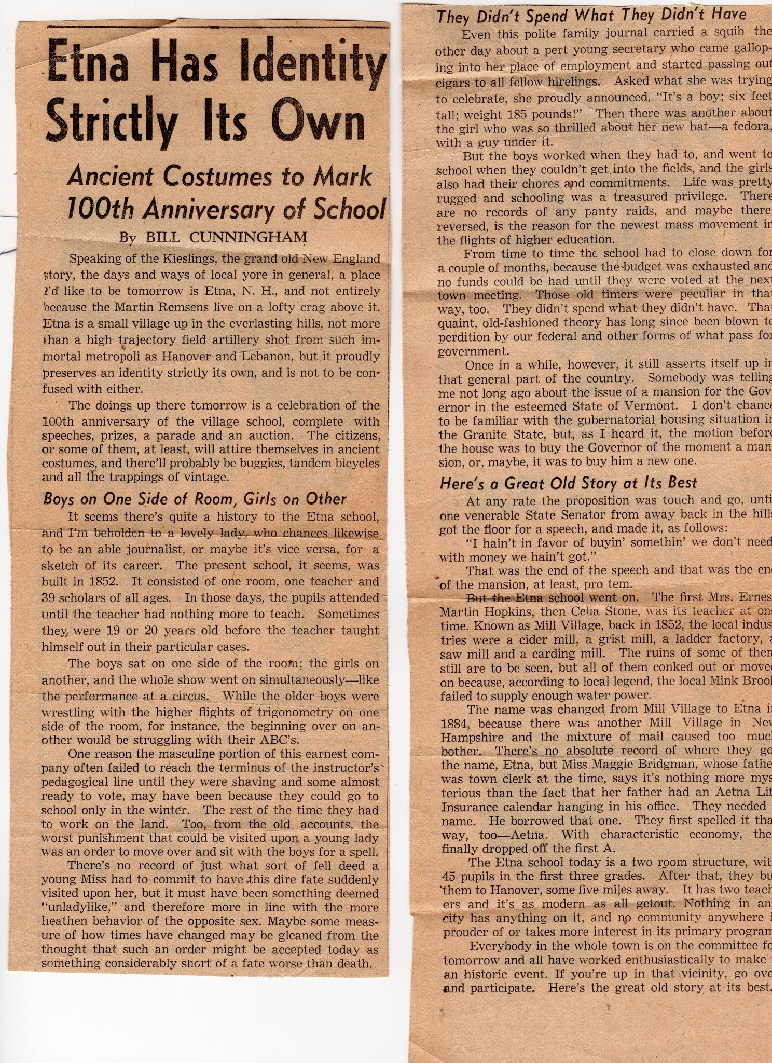
Notes:
Known as Mill Village in 1852, there was a cider mill, grist mill, ladder factory, saw mill and a carding mill. No record of when Mill Village changed to Etna but Maggie Bridgman, whose father was town clerk at the time, said that her father had an Aetna Life Insurance Calendar hanging in his office and picked that name. Later, the “A” was dropped.

Slide 37
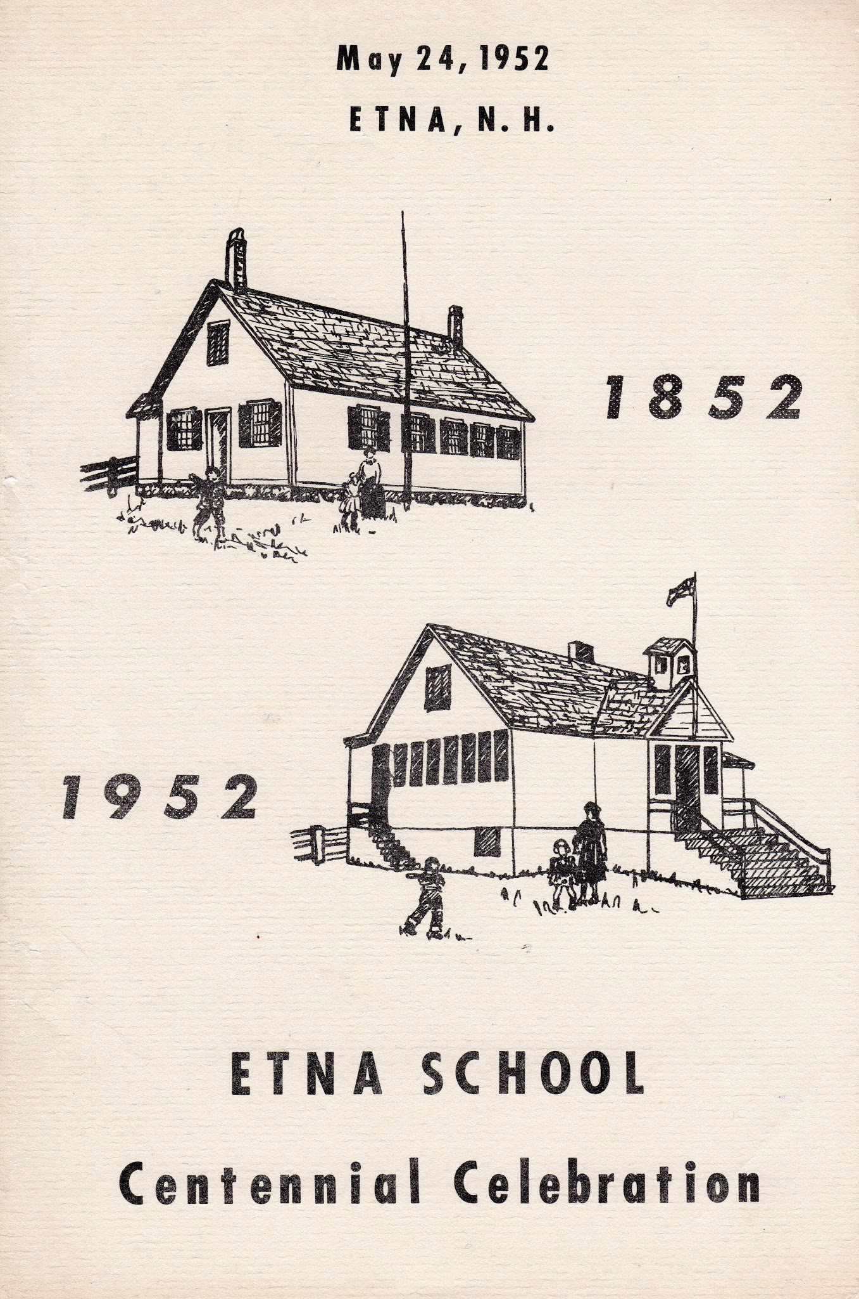

Slide 38
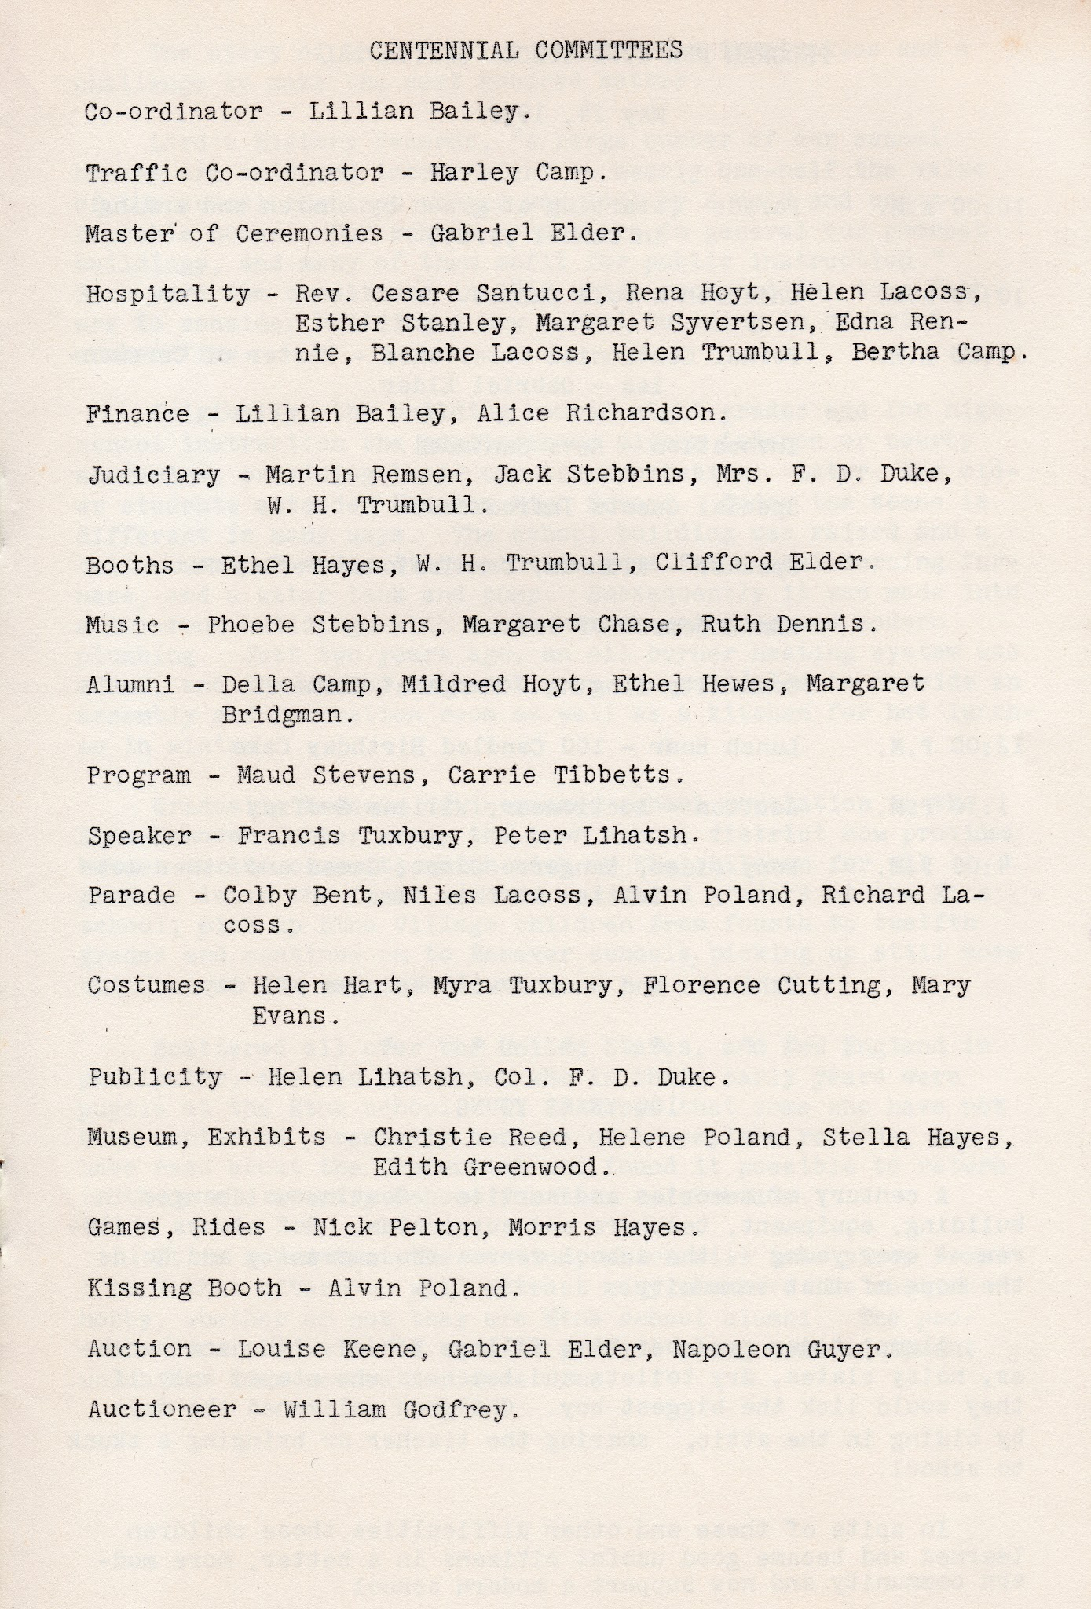

Slide 39
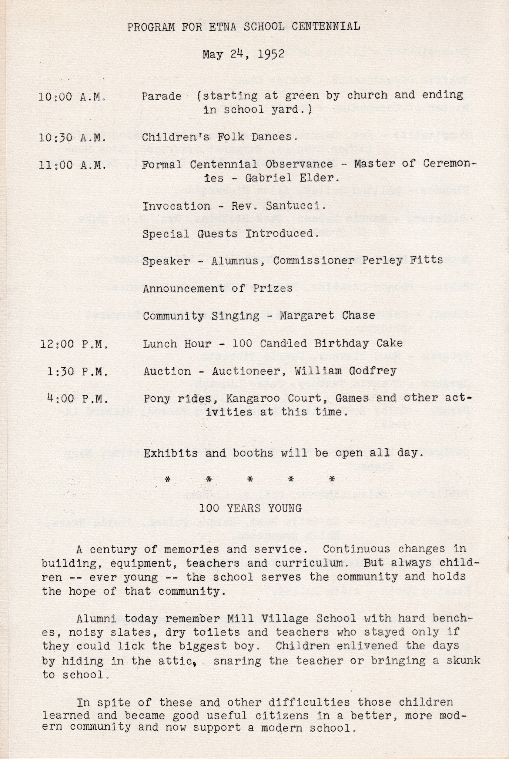
10:00 Parade, 10:30 Children’s Folk Dances, 11:00 Formal Centennial Observance (Gabriel Elder - master of ceremonies), Invocation by Rev. Santucci, Speaker/Alumnus Pearley Fitts, Announcement of Prizes, Community Singing with Margaret Chase, 12:00 Lunch, 100 Candled Birthday Cake, 1:30 Auctioneer William Godfrey, 4:00 Pony Rides, Kangaroo Court, Games.
Notes:
10:00 Parade, 10:30 Children’s Folk Dances, 11:00 Formal Centennial Observance (Gabriel Elder - master of ceremonies), Invocation by Rev. Santucci, Speaker/Alumnus Pearley Fitts, Announcement of Prizes, Community Singing with Margaret Chase, 12:00 Lunch, 100 Candled Birthday Cake, 1:30 Auctioneer William Godfrey, 4:00 Pony Rides, Kangaroo Court, Games.

Slide 40
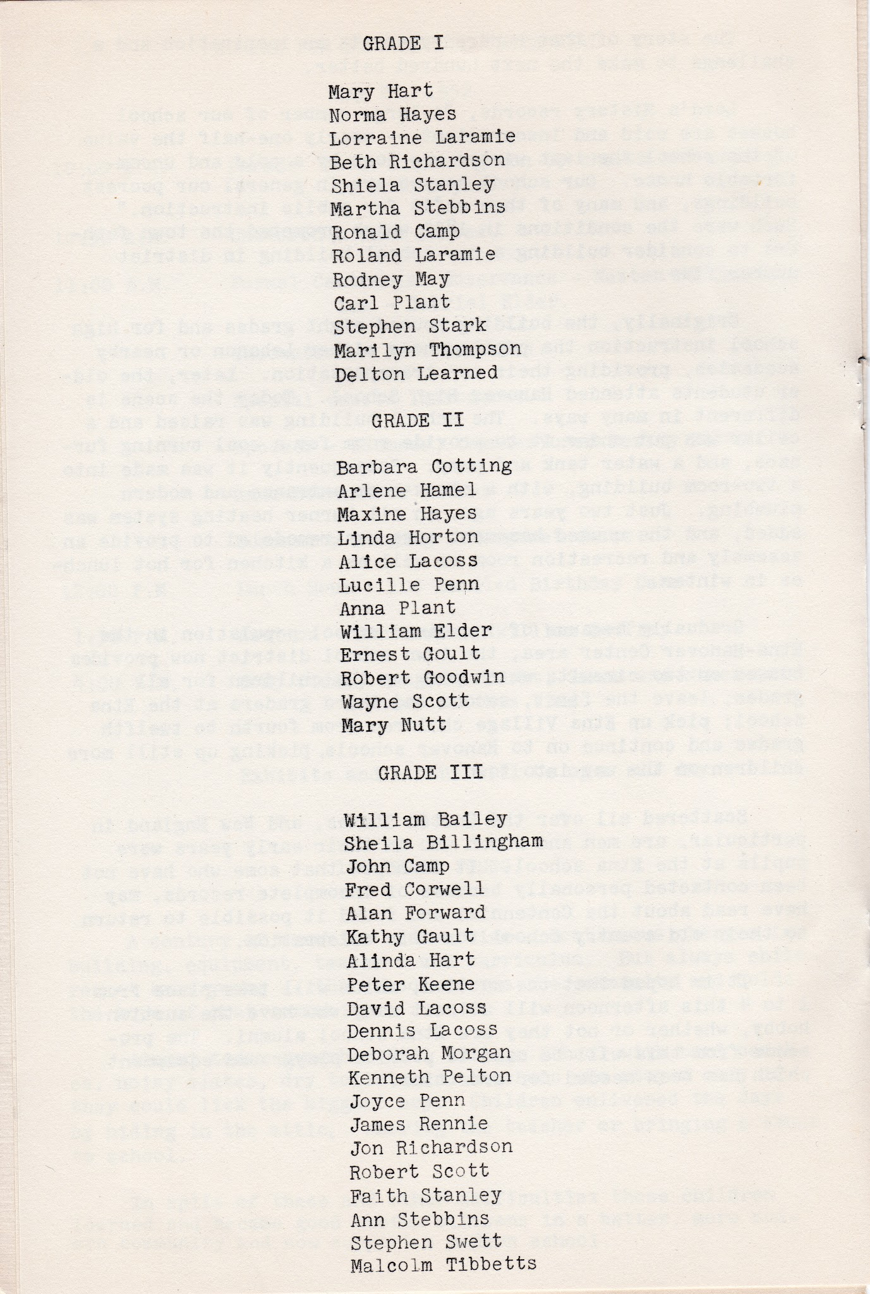

Slide 41
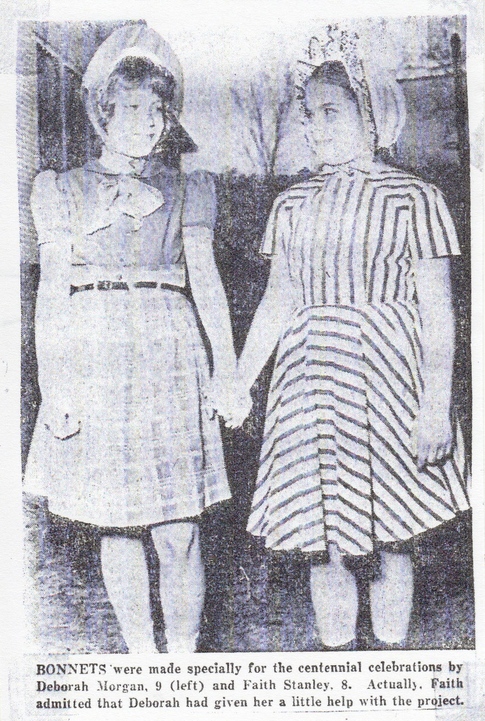
Bonnets were made by Deborah Morgan and Faith Stanley.
Notes:
Bonnets were made by Deborah Morgan and Faith Stanley.

Slide 42
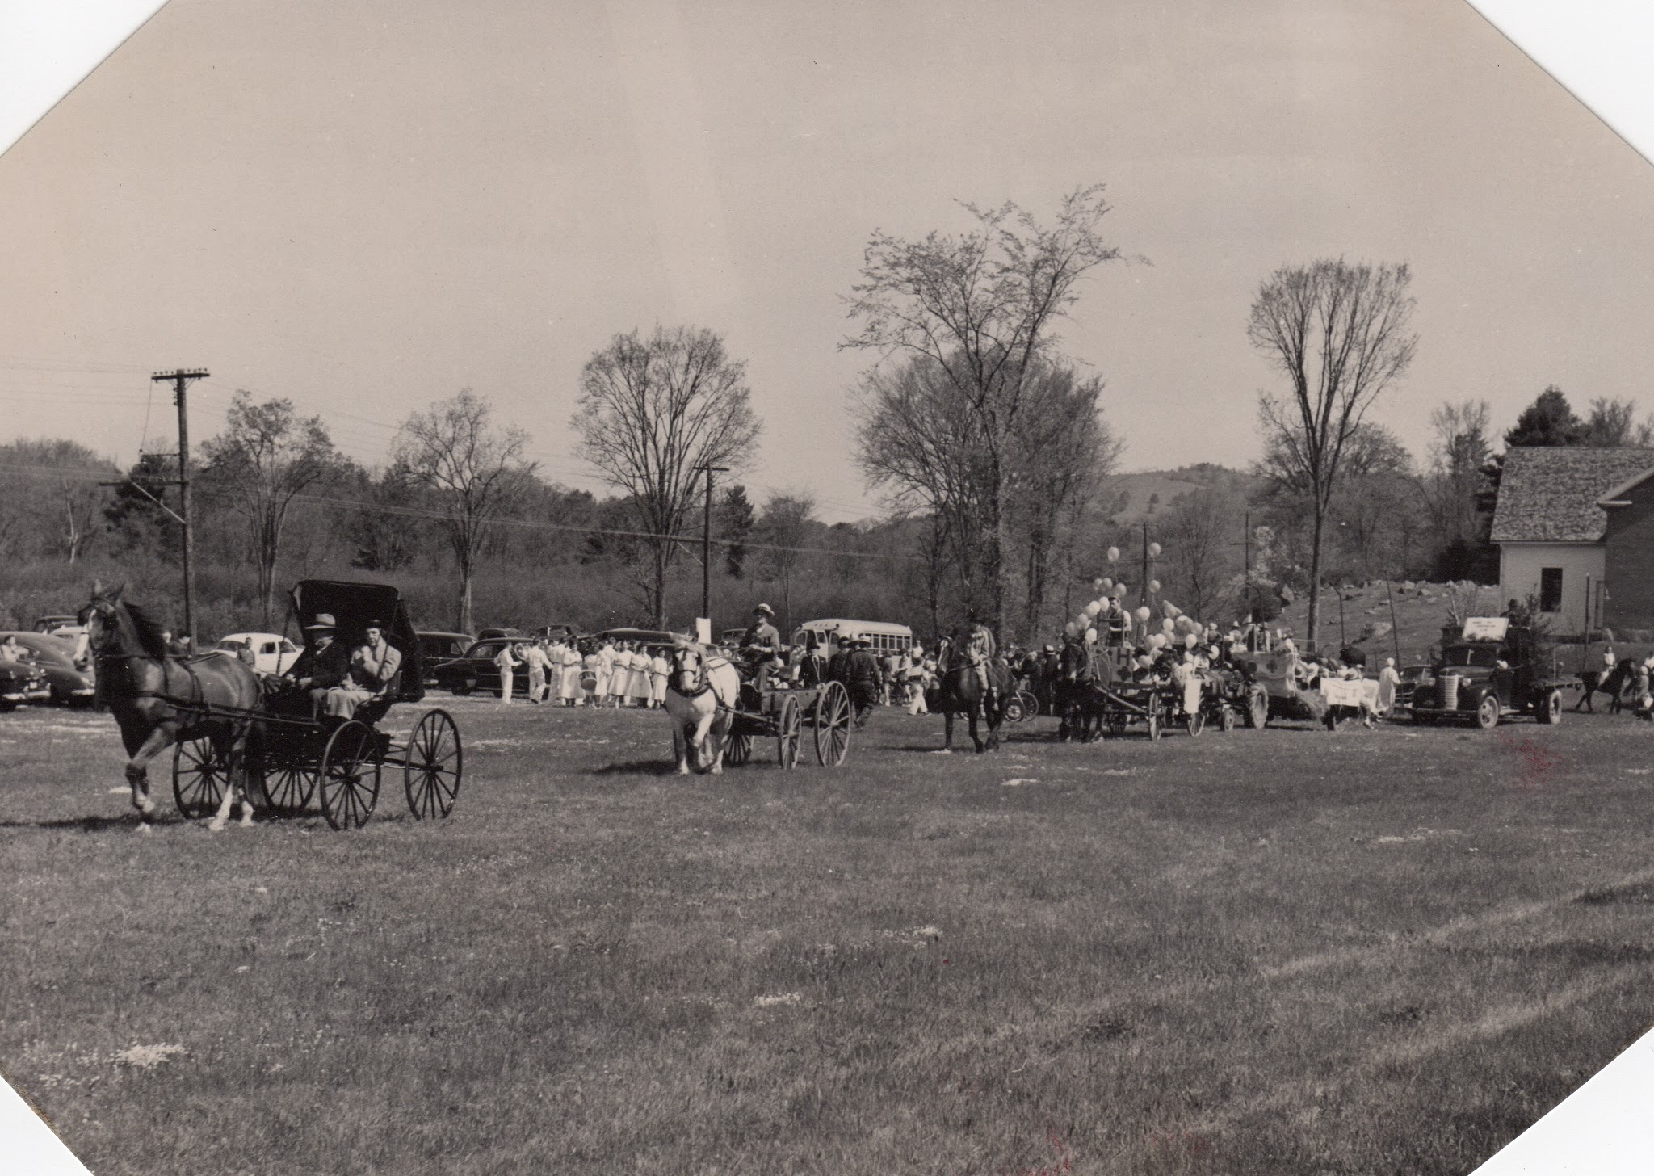
Led by a marshal from the Plainfield Riding School and 8 members of Ora Grant’s fife and drum corps in derbies and tails, the parade included floats, combined Lebanon and Enfield school bands, fire engines of past and present.
Notes:
Daily Eagle, May 26, 1952. Led by a marshal from the Plainfield Riding School and 8 members of Ora Grant’s fife and drumcorps in derbies and tails, the parade included floats, combined Lebanon and Enfield school bands, fire engines of past and present.

Slide 43
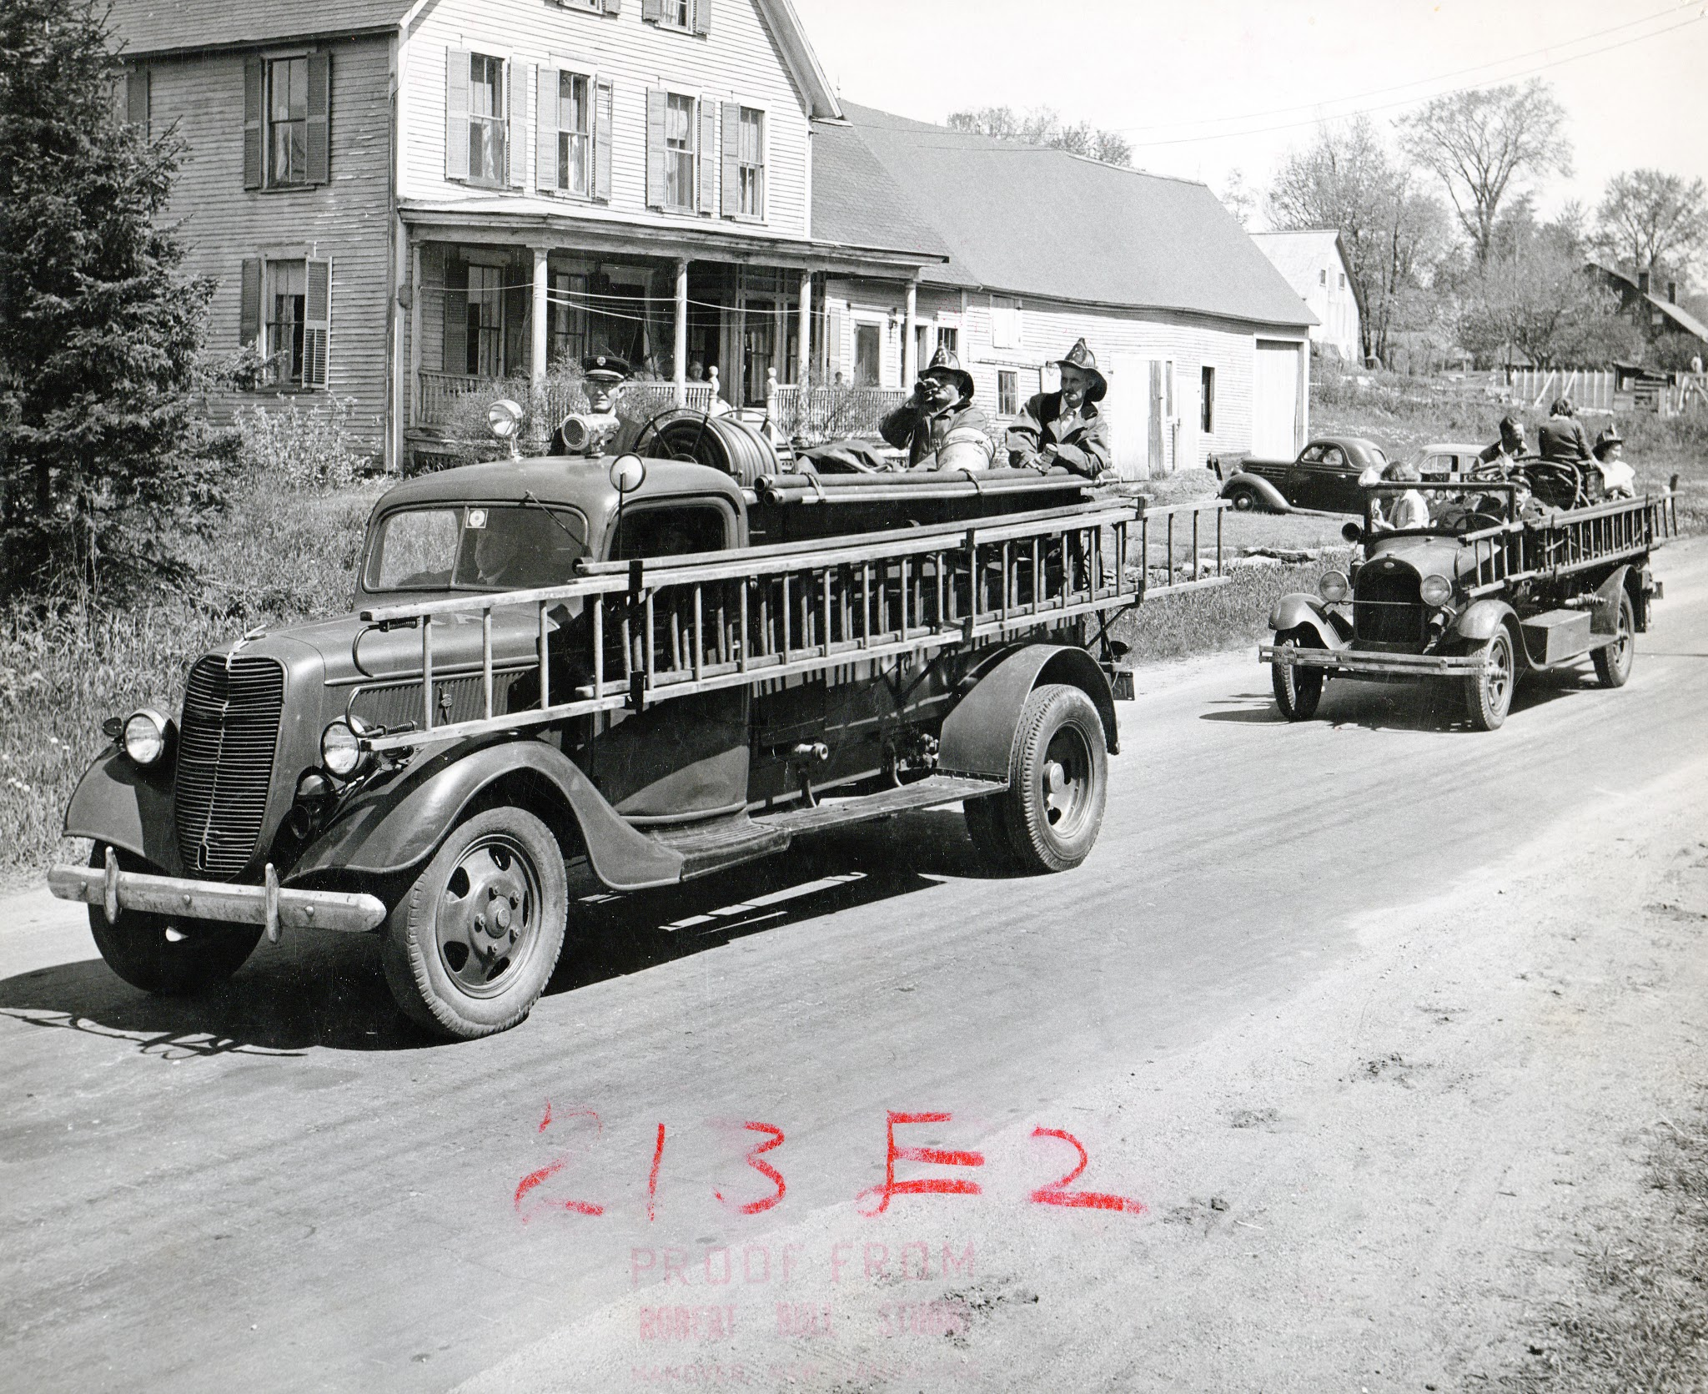
Fire engine going past house on the right of the library. Cliff Elder and Victor Gray, with Henry Thompson in the background.

Slide 44
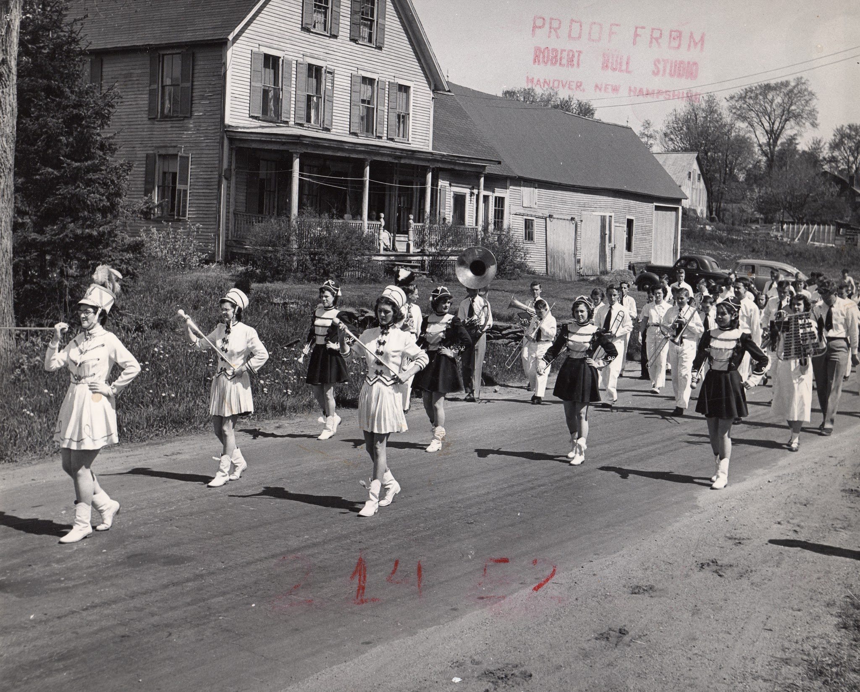
Combined Lebanon and Enfield band going past house to the right of Etna Library.
Notes:
Includes Bunny Thompson, Cora Hayes, Marjorie Gault, Marilyn Chesley, Vera Palmer, Stanley Barnes, Nellie and Archie Thompson, Stan Elder, Cliff Elder, and Mrs. Nichols.

Slide 45
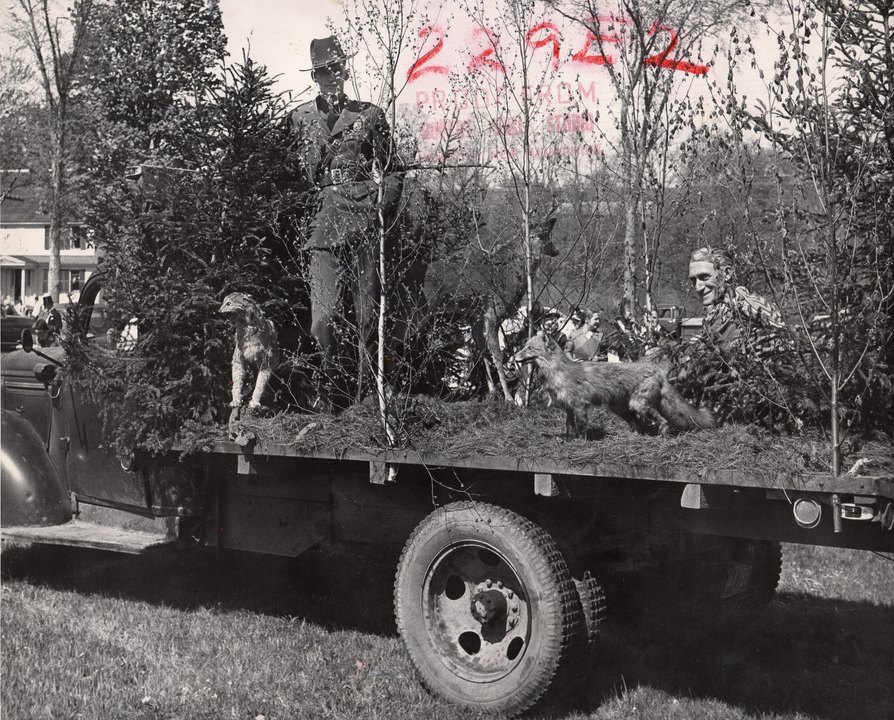
Moose Mountain Conservation Club float, Ted Hart behind.

Slide 46
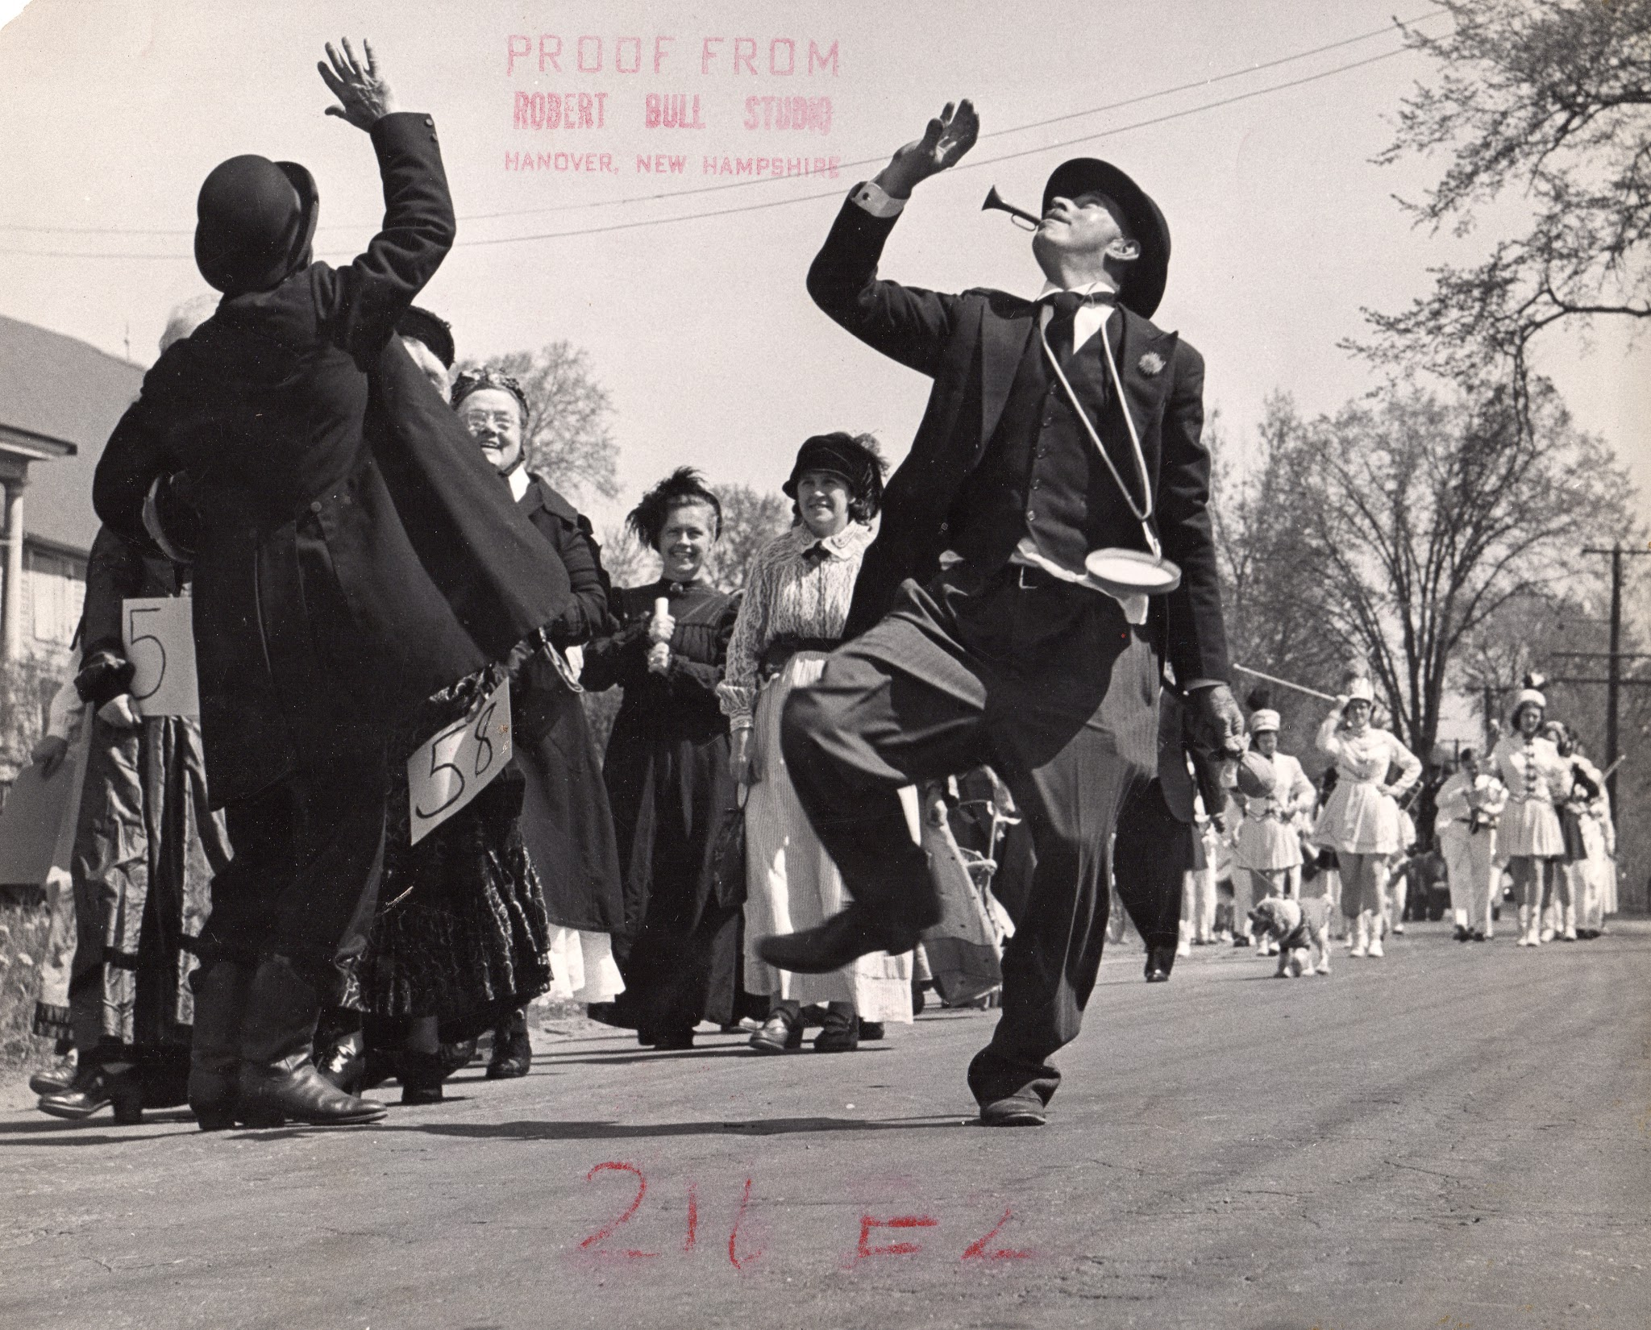
Country Dance performers with fiddler - Clara Stevens, Florence Cutting, and Blanche Lacoss.
Notes:
Sharing top honors in the float competition were Moose Mountain Conservation Club and a group which performed country dances as a fiddler played.

Slide 47
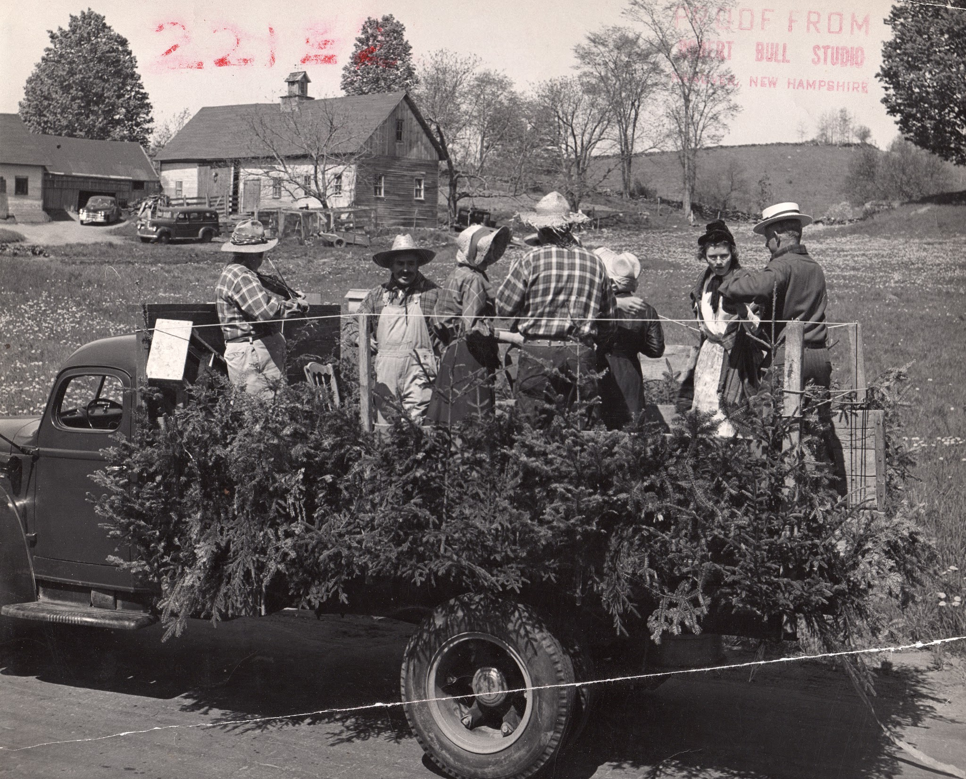
Parade passing Hayes Farm - Square Dancing Float

Slide 48
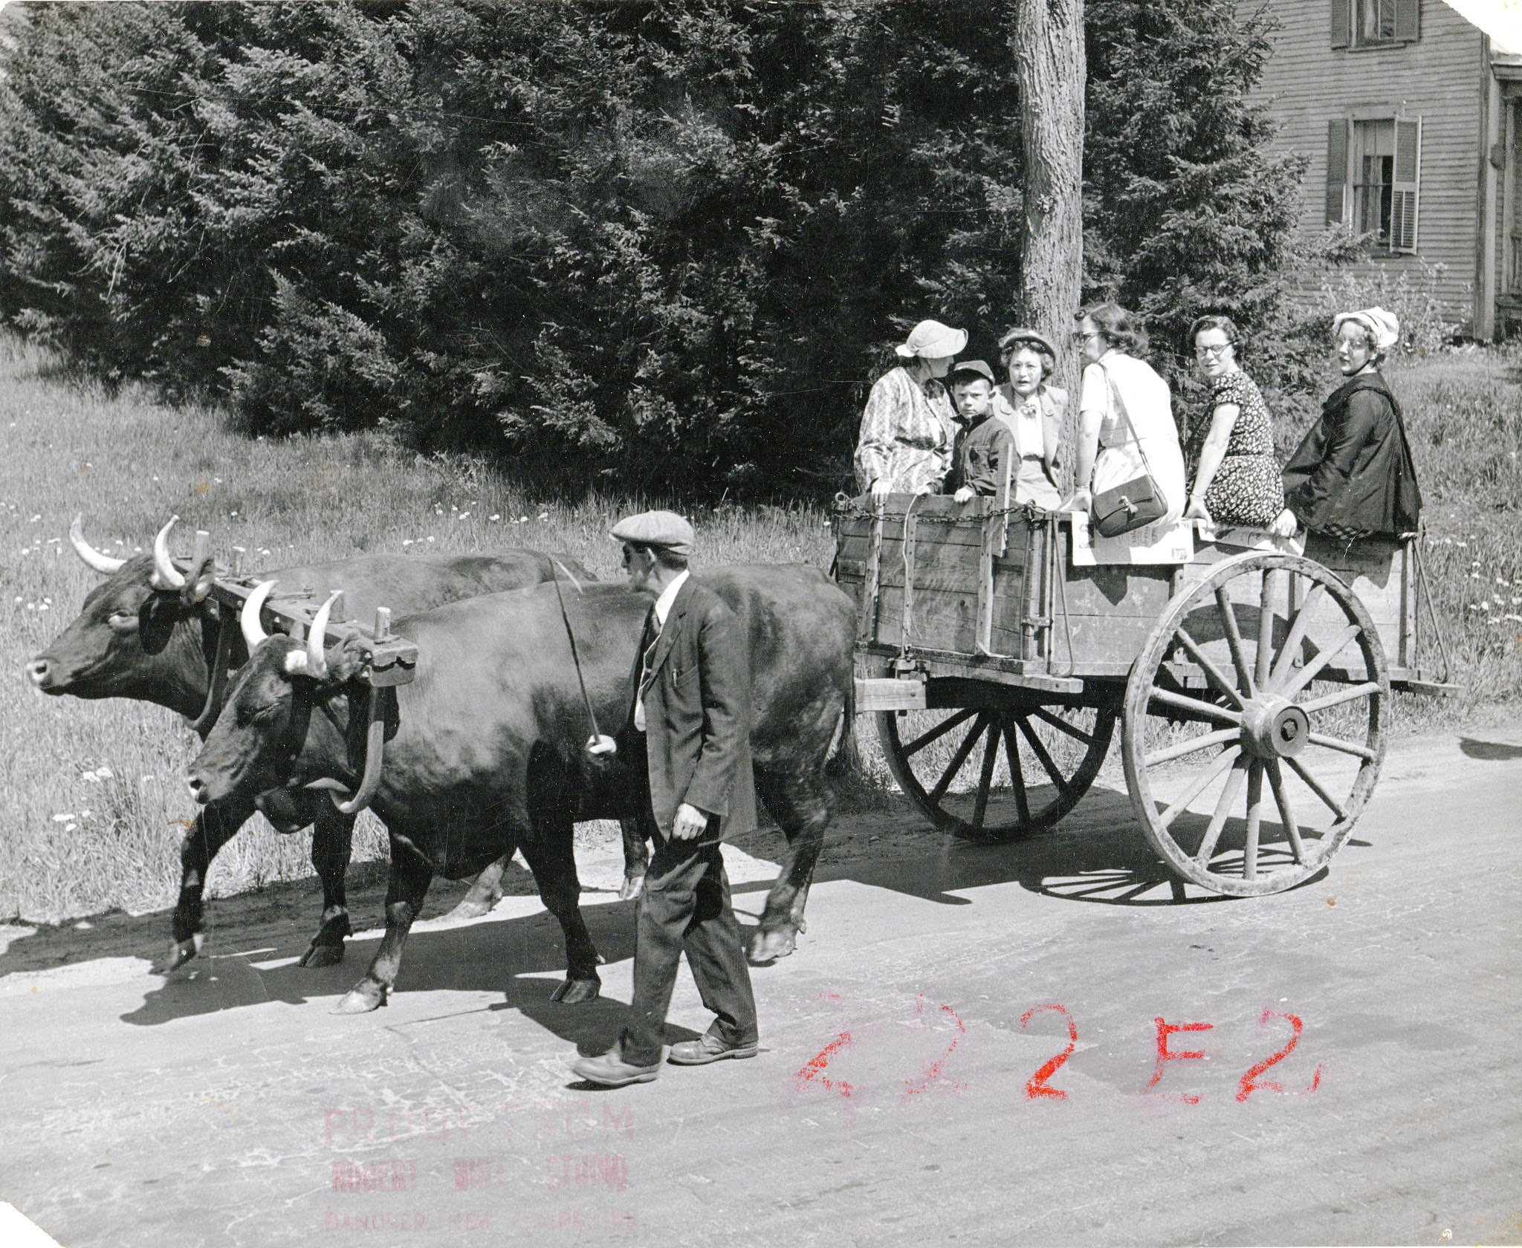
Driver Frank Coutemarshe, 6 year-old David Stebbins, Carrie Tibbetts, Ruth Whitney (?) Ruth Dennis, Alberta Stevens and Lillian Bailey in cart drawn by Glen Parker’s oxen.

Slide 49
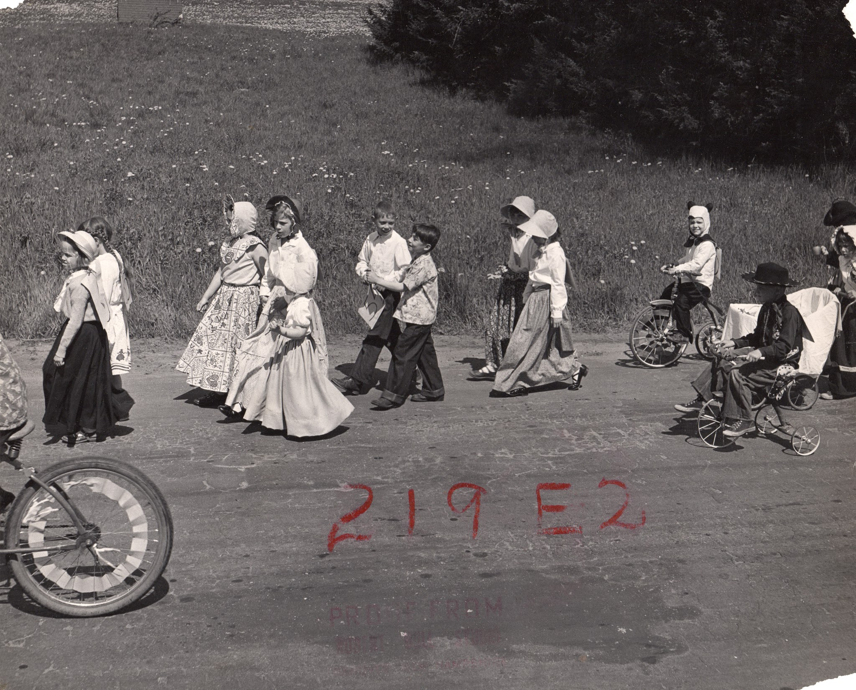
Maxine Hayes with Shiela Stanley, Faith Stanley, Debbie, Jane Morgan, Rodney May and Roland Laramie followed by maybe Alice Lacoss and Ann Stebbins. Linda Bent as a panda.
Notes:
Other awards went jointly to Mrs. Bailey’s and Mrs. Tibbett’s grades in the children’s division, to the Ladies Aid and a group of men including Harvey Camp, Leon Hayes, ALvin Poland, Robert Keene and Martin Remson.

Slide 50
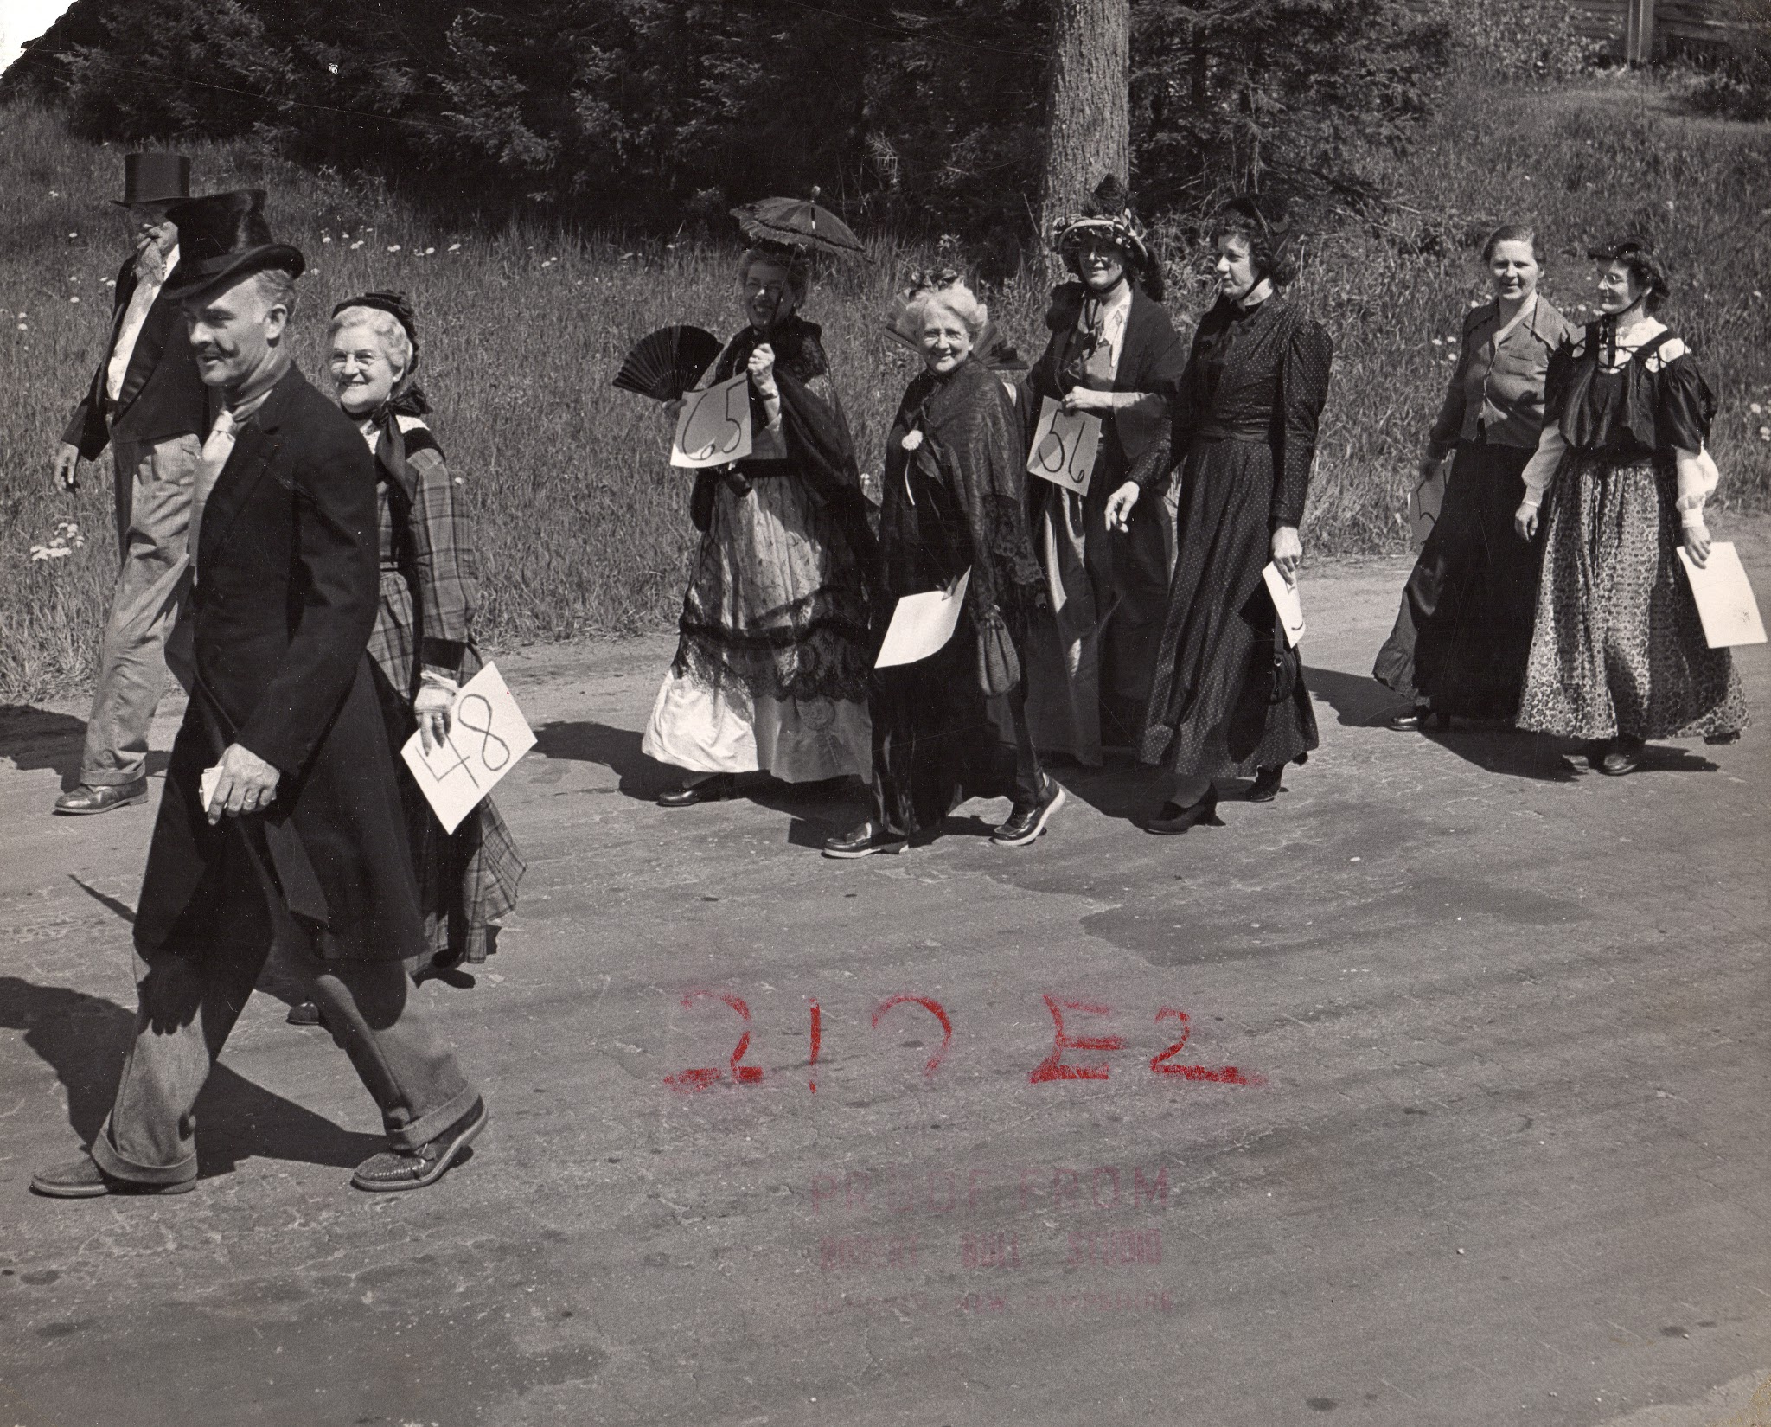
Robert Keene, Christy Reed, Margaret Chase, Helen Trumbull, (?)Hart

Slide 51
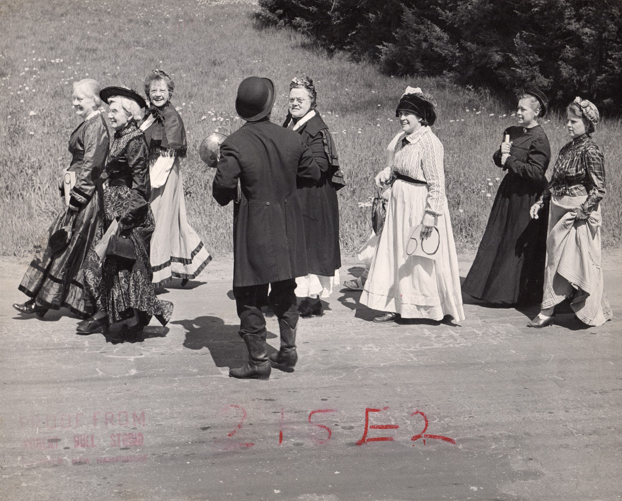
Julia Santucci, Melma Goodwin, Blanche Lacoss, Florence Cutting, Clara Stevens
Notes:
Florence Cutting’s sister?

Slide 52
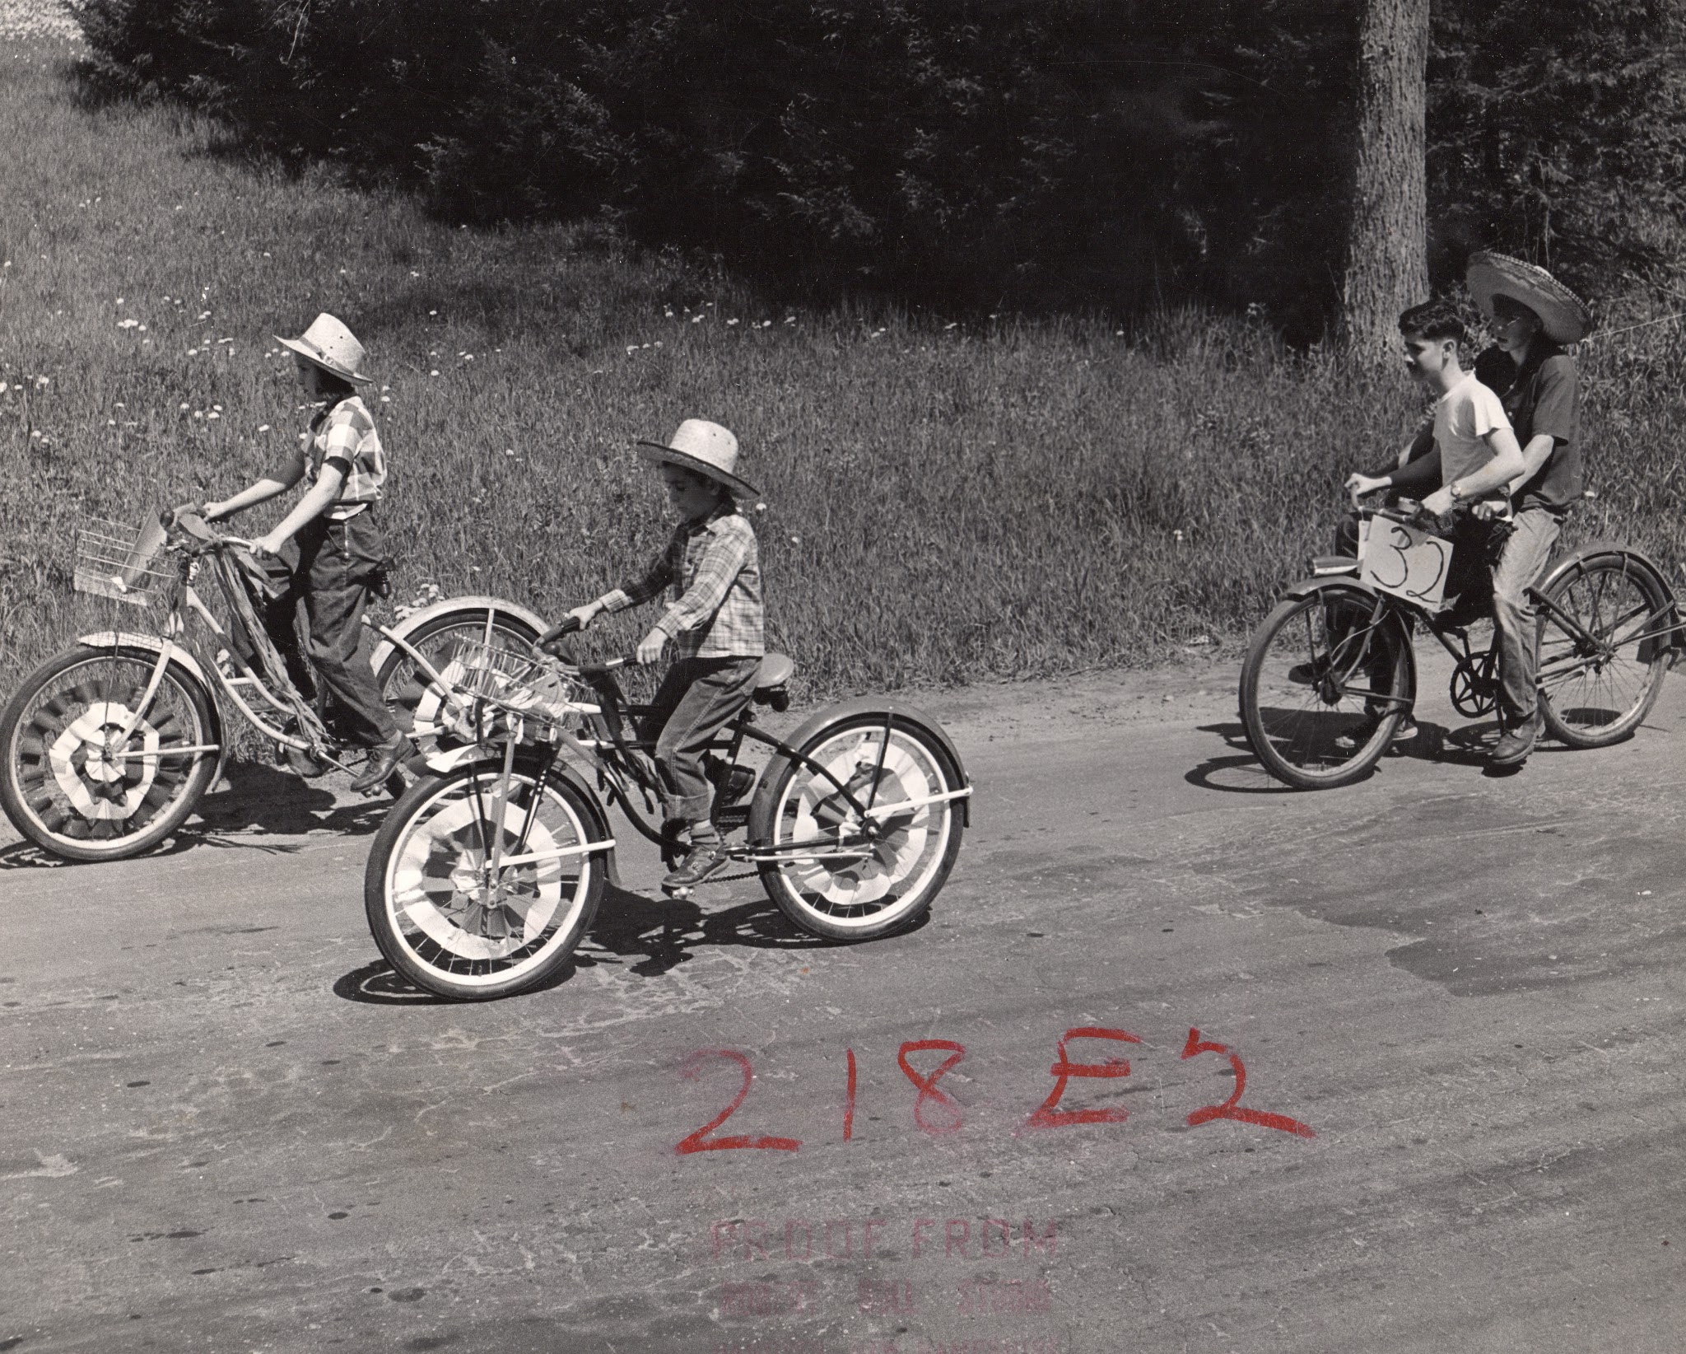
Bicycle riders in cowboy regalia

Slide 53
Etna/Hanover Center 4-H float - Sara Hart and Marjorie Gault in front, Bunny Thompson, Cora Hayes, Marilyn Cheslie, Vera, Stanley Barnes, Nellie and Archie Thompson, Stan Elder, Cliff Elder, Mrs. Nichols. Diane Pelton in back?

Slide 54
Nancy Bailey, Vera Palmer, Stanley Barnes, with the front row of Jimmy Renee, John Richardson, and Bill Bailey on 4-H Float.
Notes:
Nancy Bailey, Vera Palmer, Stanley Barnes,, with the front row of Jimmy Renee, John Richardson, and Bill Bailey

Slide 55
Davina Dana, wife of "Little Lester" LaBombard, Elmer Dana, Stan Elder, Dick Lacoss, Janet (?) Gray

Slide 56
Notes:
Marchers approach the bridge over Mink Brook.

Slide 57
6 year old David Stebbins,driver Frank Coutemarshe, Carrie Tibbetts and Lillian Bailey and Ruth Dennis, church organist, in cart drawn by Glen Parker’s oxen.

Slide 59
Victor Gray, Gordan Hayes, Cliff Elder, Harvey Camp, Morris Hayes, Bob Keene, and Leon Hayes

Slide 60
Ora Grant’s band
Notes:
Prize awarded to the fife and drum corps was used to start an aumni fund.

Slide 62
Combined Lebanon and Enfield School Band

Slide 63
Niles Lacoss, Mr. Remson?

Slide 64
Includes Florence Cutting, Ruth (?)Scott, Clara Stevens, and Melma Goodwin

Slide 65
Ballam grandchildren of Helene and Alvin Poland

Slide 66
Robert May?

Slide 67
Opening with sections by the school band directed by Harold Odell with Nelson Barden of Lebanon high school as student conductor, the formal program included a demonstration of square dancing and singing by the Etna students.
Notes:
Opening with sections by the school band directed by Harold Odell with Nelson Barden of Lebanon high school as student conductor, the formal program included a demonstration of square dancing and singing by the Etna students which at that point only included the first three grades.

Slide 68
Barbara Pelton on far right with Ken’s brother Keith and sister Jan. Esther Record Stanley, braids across head, 4th adult from right. David (?) dancing with Debbie in dark hat (?), Shiela Stanley in light skirt with John Camp, Arlene Hamel with Jon Richardson, Faith in light hat and plaid skirt with Bill Bailey (?).
Notes:
On the grounds, there was a food and beverage booth operated by the Etna 4-H club, one selling hand work made by the Ladies Aid and another offering doughnuts and coffee. There were also exhibits run by the Moose Mt. Conservation Club, Den 7 of the Cub Scouts and the Mascoma Valley Archers.

Slide 69
Ann Stebbins and Dennis Lacoss, Jon Richardson and Arlene Hamel, Shiela Stanley and John Camp.

Slide 70
Commissioner of Agriculture Pearley Fitts, Etna alumnus, giving address, right to left: Faith Stanley with pigtails, Maxine Hayes, Alice LaCoss with hat. Margaret Chase and her mother Christy Reed.
Notes:
Commissioner of Agriculture Pearley Fitts, an alumnus of the school, reminisced about events of its history. “It is communities such as this that led the way in educational fields.”

Slide 71
Gabriel Elder, master of ceremonies, led with Avin Poland a period of community singing prior to lunch when a centennial cake was served. Surrounded by 100 candles and frosted with sketches of the school as it appeared in 1852 and as it looks today, it was baked by Mrs. Effie Merrill, a former teacher at the school.
Notes:
Gabriel Elder, master of ceremonies, led with Avin Poland a period of community singing prior to lunch when a centennial cake was served. Surrounded by 100 candles and frosted with sketches of the school as it appeared in 1852 and as it looks today, it was baked by Mrs. Effie Merrill, a former teacher at the school.

Slide 72
William Godfrey auctioneer, Louise Keene assistant, Lillian (?) LaBombard
Notes:
An auction was held in the afternoon until 8:30 pm. Hundreds of donated articles were sold at a profit of $225 to be used for playground equipment.

Slide 73
Judge Jack Stebbins, Martin Remson?

Slide 74
Judge Jack Stebbins

Slide 75
Gabe Elder, Alvin Poland, William Chase

Slide 76
Leon Hayes, descended from David Hayes, an early settler from Connecticut who established a farm on the hill that carries his name. Barrett’s Hanover, NH Vol. II

Slide 77
Growing Up in Etna

Slide 79
Boys, dog and calves - a Renee boy or two?

Slide 80
Girl with her doll and cat

Slide 81
Pat Stebbins, David Stebbins, Ann Stebbins, John Stebbins

Slide 82
Debbie Morgan, Faith Stanley and Ann Stebbins waiting for bus, first day of kindergarten.

Slide 83
Sources
Bailey, Mrs. William (Lillian). Schoolhouse Centennial album.
Bailey, Mrs. William (Lillian). “Etna School Centennial Celebration Will Highlight Years of Educational Progress: Program Starts 10:00 A.M with Parade on Main Street.” Gazette, Thursday, May 22, 1952.
Barrett, Frank Jay. Hanover, New Hampshire Volume 2 (Images of America). 1998.
Crow, Andrew. Historical Reports of Etna, NH. Eagle Scout Project. 1978.

Slide 84
Daily Eagle newspaper.
Hanover Improvement Society. Town of Hanover 1761 - 2011; a collection of essays and photographs celebrating the 250th anniversary of the Town of Hanover. 2011.
Lord, John King. History of Hanover, N.H. Dartmouth Press, 1928.
Robbie, Libby. “Lillian Bailey completes 42 year of teaching and promoting reading.” The Record, June 3, 1985
Photos: Bill Bailey, Tim Bent, Alexandra Lihatch Corwin, Ann Stebbins Cioffi

